Slide 1
Immune Burdens Robbing Vitality
Modern times and Age Old Issues
Chronic Immune Support As The Solution

Slide 2
This approach is unique to the Standard Process school of thought “No other company promotes it”
The product line iterates a long-term approach to health and healing – the long view

Slide 3
DISCLAIMER
Standard Process sponsors this seminar to provide healthcare information to practitioners and to provide them the opportunity to hear about the views & recommendations of practitioners like Dr. Stuart White. Health-related information provided here is not a substitute of medical advice.
Neither Standard Process nor Stuart White have evaluated the legal status of any products, services or recommendations with respect to State or Federal laws, including scope of practice. Standard Process NW and Stuart White do not and cannot accept responsibility for errors or omissions or for any consequences from applications of the information provided and makes no warranty, expressed or implied, with respect to the information provided.
The following seminar is completely compiled and presented by Stuart White with no suggestions or advice from Standard Process, and contains only his individual opinions and estimation of relevant material as derived from his education and experience of 40 years in practice consulting with over 43,000 cases.

Slide 4
What we hope to teach -
Promote autophagy
Sequential Immune Up-Regulation
Mixed Infection Syndrome
The unburdened immune system is more able to monitor and address metabolic issues
Every person is in a process of homeostatic promotion to offset the decline of health
Dramatic increase in compliance due to immediate limbic upliftment
Sequential Immune Up-Regulation is really sequential liver, spleen, lymphatic, lung, GI, endocrine, cardiovascular, organ up-regulation
Nothing is more powerful than an idea whose time has come

Slide 5
Hypothesis -
The only reason why anything that ever was working, stops working is because of infection

Slide 6
“See that all the essential dietary principles are available to the body in abundance, and give nature an opportunity to perform according to her original plans.”
Royal Lee, November 13, 1933 – Vitamin News

Slide 7
Understanding
The Modern World

Slide 8
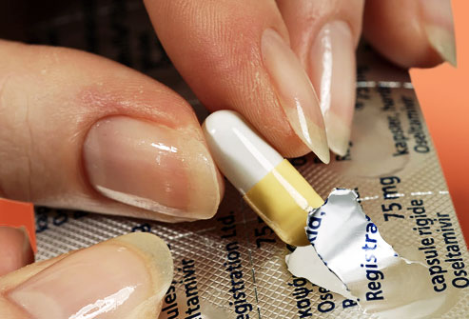
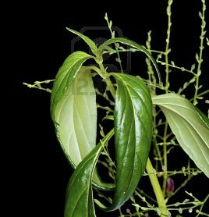
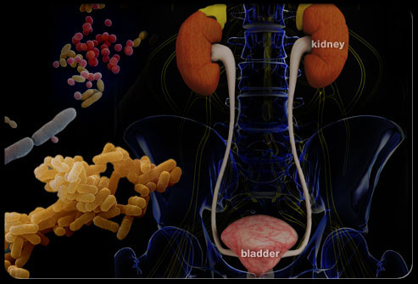
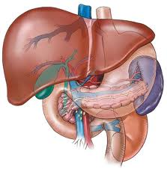
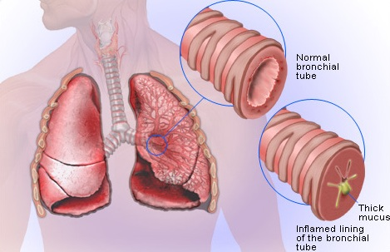
Infection as Plague – Life as we know it
The immune challenge
History of antibiotics
Antibiotic resistance
The post-antibiotic era

Slide 9
The Immune Challenge
Modern epidemics, viruses jumping species
Antibiotic-resistant bacteria
High costs, long lead times for new antibiotics
Antibiotic-induced changes in human flora and the modern epidemic of Clostridium perfringens
The rising incidence of atopic allergy, for example anaphylaxis to peanuts
The rising incidence of many autoimmune diseases, including type 1 diabetes
Immunosenescence

Slide 10
According to your DNA, from all recorded learning and adaptation, the number one cause of death is infection.
All effort shall be to survive that.

Slide 11
Antibiotics – A brief history
In 1928 Alexander Fleming realized that mold on a discarded culture had an antibacterial action
The mold was ‘penicillin’ and the bacteria were Staphylococci
First antibiotics prescribed in the late 1930s
Bacterial infection, as a cause of death ↓↓↓. From 1944 to 1972 life expectancy ↑ by 8 years
In 1969 the then US Surgeon General stated time to “…close the books on infectious diseases”
By 1999 resistance had emerged for all known antibiotics in use
http://www.abc.net.au/scientc/slab/antibiotics/history.htm

Slide 12
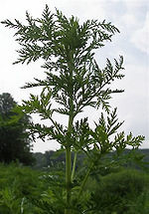
Antibiotic Resistance
According to the World Health Organization (March 2012), “Antimicrobial resistance threatens a return to the pre-antibiotic era”
440,000 new cases of multidrug-resistant tuberculosis (MDR-TB) emerge annually (150,000 deaths). MDR-TB reported in 64 countries to date
Resistance to earlier generation antimalarial medicines is widespread in most malaria-endemic countries
http://www.who.int/mediacentre/factsheets/fs194/en/index/html
Notes:
In the 1960s, a research program, under the name Project 523, was set up by the Chinese army to find an adequate treatment for malaria. In 1972, in the course of this research, Tu Youyou4 discovered artemisinin in the leaves of Artemisia annua (annual wormwood).

Slide 13
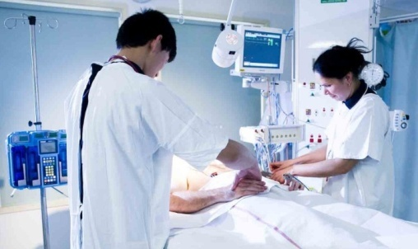
Antibiotic Resistance
Many hospital-acquired infections are caused by highly resistant bacteria such as methicillin- resistant S. aureus (MRSA) and vancomycin-resistant enterococci(VRE)¹
In the US, more than 18000 people die each year (50 every day!) from MRSA² and up to 30000 from antibiotic-resistant Clostridium³
1 http://www.who.int/mediacentre/factsheets/fs194/en/index/html
2 Klevens RM et al. JAMA 2007; 298(15): 1763-1771
3 Tenover FC. http://www.hhs.gov/asl/testify/2008/06/t20080624e.html accessed July 4, 2012

Slide 14
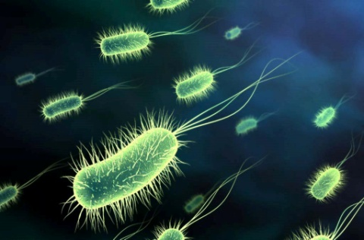
Antibiotic Resistance
The first step in the emergence of resistance
is a genetic change in the bacterium¹
Antibiotic resistant genes can then be transferred from one bacterium to another
Resistance can also spread through movement of bacteria from one host to another
Antibiotic resistance is an inevitable consequence of antibiotic use, the more you use the more resistance you get
The US is one of the highest users of antibiotics in the world, especially in agriculture
1 http://www.abc.net.au/science/slab/antibiotics/resistance.htm accessed July 4, 2012
2 http://news.vin.com/VINNews.aspx?articleId-18659 accessed July 4, 2012

Slide 15
Antibiotics in Agriculture
In December 2011 the FDA settled one of the central disputes in the debate about the use of antibiotics in food animals
US livestock consumed about 29 million pounds of antibiotics in 2009, about 4 times human medical use¹
In an effort to control this excessive use, in April 2012 the FDA announced that for the first time, farmers and ranchers will need a veterinarian’s prescription to give antibiotics to farm animals²
However, this move will require drug makers to voluntarily change their labels to require a prescription
1 http://news.vin.com/VINNews.aspx?articleId-18659 accessed July 4, 2012
2 http://newhope360.com/print/blog/fda-takes-biggest-step-yet-against- antibiotic-use-livestock?group_id=39291 accessed April 16, 2012
Notes:
How many deaths from resistant bacterial infection will it take for a complete ban?

Slide 16
The Post-Antibiotic Era
Dr Margaret Chan, director general of WHO,
“A post-antibiotic era means, in effect, an end to modern medicine as we know it. Things as common as Strep. throat or a child’s scratched knee could once again kill.
We are losing our first-line antimicrobials. Replacement treatments are more costly, more toxic, need much longer durations of treatment, and may require treatment in intensive care units.”
http://www.who.int/dg/speeches/2012/amr_20120314/en/index.html access July 4 2012

Slide 17
The Post-Antibiotic Era
“Hospitals have become hotbeds for highly-resistant pathogens, increasing the risk that hospitalization kills instead of cures.
In terms of new replacement antibiotics, the pipeline is virtually dry, especially for gram-negative bacteria. The cupboard is nearly bare.”
http://www.who.int/dg/speeches/2012/amr_20120314/en/index.html accessed July 4, 2012

Slide 18
New Antibiotics?
Few companies are willing to invest in drugs designed for short term use
According to Dr William Schaffner, chairman of preventive medicine at Vanderbilt University Medical Centre in Nashville, “If you create a new drug to reduce cholesterol, people will be taking that drug every day for the rest of their lives. But you only take antibiotics for a week or maybe 10 days.”
http://abcnews.go.com/blogs/health/2012/03/16/antibiotic-resistance-could-bring-end-of-modern-medicine/

Slide 19
The Nutritional & Herbal Approach
It is now clear that we are approaching crisis point with infection control
So, what can we offer?
What are the nutritional and herbal supports to support or preventing any type of infection?
IMMUNE ENHANCEMENT
Immune enhancement is our first-line treatment and is fundamental to infection control and treatment

Slide 20
Co-Infection – The Lesson of Lyme
Lyme Disease has revealed that often the co-infections are worse than the primary one – seeing this clinically expands our thinking to realize that everyone carries co-infectious burdens that chronically strain the immune system and create many of the chronic discomfort an malady people experience
Yeast/Candida overgrowth accompanies almost all immune burdens and autoimmune conditions
Biofilm conditions influence the success of the resistant infection
No longer can a one infection paradigm exist – that one infection is either causing others, or others are causing it

Slide 21
Mixed Infection Syndrome -
Virus
Fungus / Yeast
Parasite
Bacteria
Stealth
* Cavitated Infection – sequestered colonization typically near bone where less blood exchange occurs
* Latent Intracellular Conjugated Parasites
* DNA encoded hereditary infection

Slide 22
Infectious Personality Disorder -
Infection results in a direct invasion of the CNS across the single layer blood brain barrier (BBB)
Resultant CNS cell death (apoptosis) and neuro-inflammation
Infection directly creates immune activation and inflammatory response, GI microbiome alteration, HPA modulation and dysfunction altering hormonal expression and ability to maintain homeostasis
Each of the above contribute cumulatively to Mood Disorder

Slide 23
Mood Disorder from Infection -
Mood Disorders are the fastest increasing epidemic in the US
The NIH estimates that 20% of American adults deal with a mood disorder and one in six take psychiatric medication
Mood Disorders create personal and social burdens resulting in long and short term disability more than any other medical condition (JAMA. 1990; 264(19): 2524-2528)
Depression makes up 50% of total mood disorder
Compared to a decade ago (2005) the cost of mood disorder has risen by 21%

Slide 24
Infection and limbic depression -
Immune response to infection causes the symptoms that are described as “feeling sick” – malaise, fever, aching, catarrhal, etc
Most people feel depression/sadness during acute illness due to cytokine generated inflammatory response
Indeed often in the subclinical infection syndrome a depressed limbic (unhappy, morbid, non-playful, joyless) state is the first and most telling indication of an immune/infectious burden
We identify limbic depression and stress by interviewing and listening and respecting the stresses of life (financial, relationship, children, loneliness, etc) – and finding every person is either limbically depressed and burdened or they are limbically supported and modulated

Slide 25
Complexity and Potency
Complexity –
Covid 19 – is it manmade (functional augmentation of a bat virus)
5G network conversion
Mandatory vaccine and data chipping issues
Potency –
Innate immune and complement system
Acquired immune learning/activation with antibody and prepared immune response

Slide 26
Covid 19 Characteristics
What we know (we learn more daily)
Covid 19 – is it man altered bat virus (it would take approximately 800 years for natural selection to allow a bat virus to develop that could jump between species)
- Augmentation of function is a scientific term to describe the steps taken in a laboratory to increase the virulence of a virus in order to amplify its characteristics and better see ways to prepare therapies in advance
- the genome sequence of the virus is unique to the horseshoe bat (Living in caves 600 miles south of Wuhan in China)
- the virus is optimized for human transmission – an uncommon event in nature
- the S proteins on he surface of the viral particles are what make it dangerous and contagious and so able to infect humans
- In 2008 the covid 19 virus was augmented in function with HIV homology, bio-engineered for augmentation to predict and develop therapeutics
- Gain of function for the bat ACE II receptor to the human ACE II receptor
- Subsequently the gain of function continued (weaponized) at Fort Dietrich and UNC allowedaccess to receptors CD147, CD209, CD299 and GRP 78

Slide 27
Getting to know Covid 19 -
Unique characteristics of Covid 19:
Lives for 2 hours on stainless steel
Lives for 3 hours on plastic
Lives for 24 hours on cardboard
Stays suspended floating the air for three hours
In proper conditions (heat and hydration) virus can live ou tside the body for up to 7 weeks
The unique protein spike of this corona virus acts like the key to fit the receptor lock on numerous cells – namely lung cells, nerve tissue and RBC/T cells effecting the functionality of these cells and, when invaded, commandeering and killing these cells

Slide 28
Clinical Findings of Covid 19 -
Symptoms typically include: fever, neck stiffness, severe headache, loss of smell/taste, heavy sensation in the chest (fibrosis), fatigue, malaise and loss of limbic wellbeing
further observation reveals that the virus also can attack the heart and reduce output (ejection fraction reduced)
Can also penetrate the central nervous system and create aphasia and memory impairment and activate latent neuroviral activity which produces neuritis and extension neuralgias and paresthesias

Slide 29
Rumors of Covid 19 -
Manmade virus which has been augmented to study its characteristics
May have genetic strands from HIV, Ebola, SARS grafted into it
May have been accidentally or deliberately released on the public
May have been funded in China by the NIH ($3.7 million) after research of this sort was banned in the USA
Poor public health data management has inflated the morbidity of the virus
Some say there are 700,000 more people infected in American than has been estimated, which would then reduce the morbidity quotient against the number of deaths

Slide 30
Concept of Co-Infection
* The latest explanation of the Covid 19 dynamic is that infection of this carries a diverse complexity of many retroviruses and co-virus components.
* It also acts in the host to upset the latent viral balance which is being maintained in a state of suppression by immune tolerant mechanisms
* Which means the balanced seesaw can be upset
This Photo by Unknown Author is licensed under CC BY

Slide 31
Viral Replication
This Photo by Unknown Author is licensed under CC BY-SA

Slide 32
Synthetic Virus attacks immune compromised systems
Absence of Interferon 1 in the fermenter that grows virus means there is no suppression of viral activity
So there is a exponential increase of viral replication and adaptation including ‘accelerated evolution’ wherein the virus being grown picks up and combines with all the unnamed viral strains that are co-present
Virus is not allowed to replicate and mutate like that in the human body and nature because of the present of Interferon 1, which suppresses viral activity
This Photo by Unknown Author is licensed under CC BY-SA-NC

Slide 33
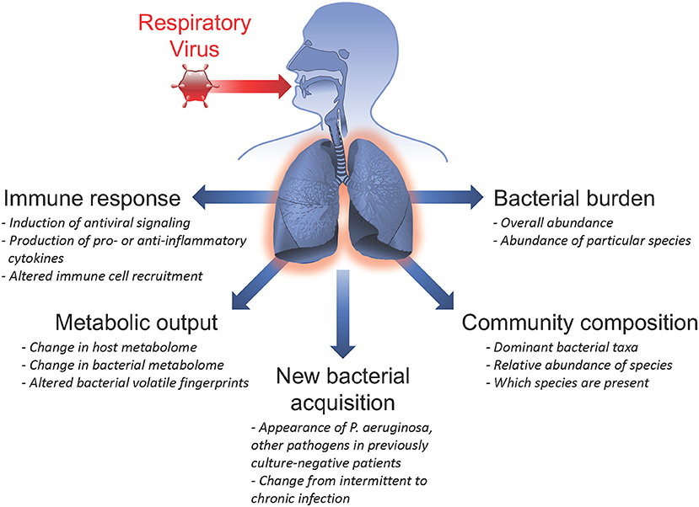
No Single Virus
Viruses don’t travel alone
HIV doesn’t cause AIDS because there is a multiplicity of interacting viruses all activating and spreading throughout the host
The answer always lies in host immune competence to interrupt viral spread and suppress viral activity
Be strong – Be prepared – this is the answer
The anti viral antidote is the potentiated human
This Photo by Unknown Author is licensed under CC BY-SA-NC
This Photo by Unknown Author is licensed under CC BY

Slide 34
Preparation to meet Covid 19 -
There is no prevention! There is only preparation for exposure to the virus for the entire population eventually
A vaccine is highly unlikely for a number of reasons (corona virus/ common cold cannot be vaccinated against according to world leading virologist who invented the vaccine for HPV and is thus nominated for the Nobel Prize, the quickest development of a vaccine in history took 4 years for the Measles vaccine, it will not create immunity against mutations of the virus, etc)
The immune system can meet Covid 19 and easily control exposure and spread and shorten symptomatology and contagiosity – Immune up-regulation is the answer to the pandemic

Slide 35
Opinions on Covid 19 -
This pandemic exposes the at risk population that is nutritionally deficient (Zn, etc) and biochemically imbalanced (immune compromised) according to Kerry Bone
The only people who complicate with viral exposure are those who receive only palliative care to suppress the symptoms and allow the virus to further penetrate and infect the body (suppressing fever/inflammatory complement system is contra-indicated) according to Stuart White

Slide 36
Understanding
Immune Modulation

Slide 37
The camel’s back
We may either unburden the camel’s back thus preventing it from being fractured
Or we may strengthen the camel to carry more burden
This seminar is about doing both
All trophic and immune/inflammatory modulation is strengthening the camel
All antimicrobial devices unburden the camel’s back

Slide 38
The camel’s back
Tropho-restorative nutrients and herbs strengthen the camel to carry and manage its burden of toxicity, infection, infestation and lifestyle
Antimicrobial efforts reduce the burden on the camel and reduce breaking the system
Real recovery and recovery of health supports both of these efforts sequentially, immediately upon initiation of therapy and chronically for the duration of therapy

Slide 39
Bio-Burden
“Let s/he who is amongst you without infectious/toxic burdens, or without mixed infection syndrome, or without chronic immune strain, or with no stealth infectious activity lead the way by telling how they have accomplished this purity of being while living in this world …
Otherwise let those who address and reduce the burden, and sequentially reduce the mixed infection population and so reduce the immune strain, and cleanse the stealth infection lead the way – and show that way to the rest …

Slide 40
Protective Preventive
Hyper
(Aggressive)
Reactive
(intolerant)
Hypo
(Permissive)
Unaware
(Blind)
Amplification
Attenuation
Familiarizing
Escalation

Slide 41
Immune Vigilance and Discretion
Amplification / Attenuation –
Thymosin produced by thymus cells mature the immune system to be moderate (not aggressive or permissive) in pattern recognition
It turns up or down the volume
Escalation / Familiarizing –
Interferon and cytokine expression shifts discretion/discernment
Th1 increases intolerance, while Th2 (and Th17) shifts toward self consciousness and absorption
Protective Preventive
Hyper
(Aggressive)
Reactive
(intolerant)
Hypo
(Permissive)
Unaware
(Blind)

Slide 42
Mixed Infection Syndrome -
Virus
Fungus / Yeast
Parasite
Bacteria
Stealth
* Cavitated Infection – sequestered colonization typically near bone where less blood exchange occurs
* Latent Intracellular Conjugated Parasites
* DNA encoded hereditary infection

Slide 43
Infectious Personality Disorder -
Infection results in a direct invasion of the CNS across the single layer blood brain barrier (BBB)
Resultant CNS cell death (apoptosis) and neuro-inflammation
Infection directly creates immune activation and inflammatory response, GI microbiome alteration, HPA modulation and dysfunction altering hormonal expression and ability to maintain homeostasis
Each of the above contribute cumulatively to Mood Disorder

Slide 44
Mood Disorder from Infection -
Mood Disorders are the fastest increasing epidemic in the US
The NIH estimates that 20% of American adults deal with a mood disorder and one in six take psychiatric medication
Mood Disorders create personal and social burdens resulting in long and short term disability more than any other medical condition (JAMA. 1990; 264(19): 2524-2528)
Depression makes up 50% of total mood disorder
Compared to a decade ago (2005) the cost of mood disorder has risen by 21%

Slide 45
Infection and limbic depression -
Immune response to infection causes the symptoms that are described as “feeling sick” – malaise, fever, aching, catarrhal, etc
Most people feel depression/sadness during acute illness due to cytokine generated inflammatory response
Indeed often in the subclinical infection syndrome a depressed limbic (unhappy, morbid, non-playful, joyless) state is the first and most telling indication of an immune/infectious burden
We identify limbic depression and stress by interviewing and listening and respecting the stresses of life (financial, relationship, children, loneliness, etc) – and finding every person is either limbically depressed and burdened or they are limbically supported and modulated

Slide 46
Anti Viral Tools -
Anti Viral Food: Ginger, Citrus and vitamin packed foods, yogurt/kefir, blue berries, appples, ginseng, tomatoes, wild salmon, chocolate, broccoli, olive oil, green tea, spinach, eggs, garlic, apple cider vinegar, lemon juice
Anti Viral Herbs: Elderberry, echinacea, calendula, garlic, astragulus, cat’s claw, ginger, licorice root, golden seal, green tea, olive leaf, pau d’arco, oregano oil, prickly ash bark, Oregon grape, St. John’s wort

Slide 47
Anti Fungal / Candida Tools -
Anti Fungal / Candida Food: Coconut oil, garlic, onion, seaweed, rutabaga, ginger, olive oil, lemon/lime juice, pumpkin seeds, cayenne, algae, cinnamon, papaya seeds, turmeric, fermented foods, bone broth, pau d’arco
Anti Fungal / Candida Herbs: turmeric, pau d’arco, olive leaf, garlic, black walnut, tea tree, cloves, goldenseal, oregano oil, calendula, spearmint, neem

Slide 48
Anti Parasitic Tools -
Anti Parasitic Food: sunflower seeds, coconut, onions, papaya seeds, garlic, pineapple, turmeric, fermented foods, cucumber seeds, raw pumpkin seeds, figs (ficin)
Anti Parasitic Herbs: papaya, clove, turmeric, ginger, cayenne, green hulls of black walnut, Chinese wormwood, wormwood, butcher’s broom, berberine, European barberry, thyme, oregano oil, diatomaceous earth

Slide 49
Anti Bacterial Tools -
Anti Bacterial Food: garlic, lemon, turmeric, onion, pineapple, ginger, horseradish, cabbage, papayas, rutabaga, grapefruit, chili pepper, broccoli, coconut, cranberries, cinnamon, fermented foods, carrots, oranges, pomegranate, honey
Anti Bacterial Herbs: Garlic, ginger, echinacea, goldenseal, clove, oregano, cloves, thyme, sage, basil, rosemary, peppermint, spearmint, eucalyptus, elderberry, berberine, Oregon grape, tea tree, neem,

Slide 50
Anti Stealth Infection Tools -
Anti Stealth Infection Food: coconut, garlic, fish (sardines, salmon, herring, mackerel), walnuts, flaxseed, canola oil, zinc, olive oil, citrus, onion, sunflower seeds, vitamin E,
Anti Stealth Infection Herbs: Elderberrry, echinacea, calendula, garlic, astragalus, cat’s claw, ginger, licorice, olive leaf, oregano, Chinese wormwood, myrrh, black cumin seed, St. John’s wort, goldenseal, berberine, medicinal mushrooms

Slide 51
Immune System – Mammalian
Immune development increased survivability
of organisms which promoted more sophisticated species evolution.
It permitted clarified DNA purity which increasingly ‘got the message out.’
Before immune development lifespans were brief and primarily unicellular.

Slide 52
Immune – ‘Immun’ means free
“If you’re not with us, then you’re against us”
It was always a competition for control of the creative DNA and the cellular machinery to support life
Immunity creates autonomy and selfhood
IDRS – Immune Defense Repair System
Functional term which includes the idea that the enabled immune system in addition to defending also repairs cellular structure and promotes DNA to proteomics to metabolomics translation accuracy

Slide 53
Immune Organization -
Innate Immunity (Nonspecific):
A lowly foot soldier responding within minutes to all foreign invaders.
Barricades (2 lines of defense):
1 Membranes – Skin & Mucosae creating barrier entrance prevention.
2 Inflammation mitigated through antimicrobial proteins, phagocytes and cells to inhibit movement through the body
Adaptive Immunity (Specific):
Infiltrating Barricade (3rd line of defense):
Requiring more time to mount this system was first revealed in the late 1800’s showing animals developed antibodies.
Antigen Specific – recognizing antigens
Systemic – not restricted to initial infection site
Memory – after initial exposure more severe defenses are mounted

Slide 54
Innate & Acquired Immunity
Primary roles of the healthy immune system are:
Identify potentially injurious and infectious substances
Distinguish self antigens (non-threatening) from non-self (threatening)
Assess the potential level of threat posed by infectious, toxic, or non-self antigens
Mount a response that is appropriate to the level of threat
Repair any damage that ensues from adversarial encounters
Too much response = inflammatory cascades
Too little response = tolerance of danger
WBC is optimal 6-8, outside optimal range may suggest acute or chronic immune burden, under 4 indicates bone marrow fatigue

Slide 55
Immune System – 2 Parts
Generally recognized that there are 2 parts of the immune system
Innate Immune System – Inborn initial response to eliminate microbes and infections, immediately or within hours – it is not in any locale or organ, it is in the WBC
Each cell is equipped with different mechanisms that allow it to attack and eliminate pathogens from the body demonstrating immune versatility
Non-specific defense against pathogens, activates the complement system of inflammatory response
Identifies self vs. non-self, complement system triggers inflammation and identifies foreign substances, and activates the adaptive immune system
Innate Immune Cells include:
Mast Cells
Natural Killer Cells
Phagocytes – Monocytes, Macrophages, Dendritic cells
Ranulocytes – Neutrophils, Eosinophils, Basophils
Adaptive Acquired Immune System – Learned response precisely addressing threat requiring 5-7 days for adaptive immune modulation to reach full activity and specific lymphocyte presence
Results in TH1 cellular phagocytosis or TH2 humoral antibodies
TH1 responds to living things bacteria, fungus, virus
TH2 responds to non-living things (and parasites) including food, pollens, bad fats, heavy metals

Slide 56
Immune Structure

Slide 57
Innate Immunity
Barriers are effective but when breached internal innate immune defenses come into play.
Body has many nonspecific cellular and chemical dev ices for protection.
Phagocytes
Natural killer cells
Antimicrobial proteins
Inflammation targets immune system for defense and repair
Fever
Surface Barriers – skin (keratinized) and mucosae line all exterior surfaces (Skin, Digestive, Respiratory, Urinary, Reproductive)
Acidity of skin/vagina is pH 3 to 5
Stomach Acid
Lysozymes in saliva and lacrimal fluid
Sticky mucus traps/ antiseptic paint
Ciliated surfaces

Slide 58
Innate Immunity
Innate immunity is responsible for the immediate response to a pathogen - within hours
During the initial stages of a viral infection the cytokines generated by the innate immune response account for most of the symptoms experienced
Antimicrobial peptides such as defensins are also released, interferons, iron-binding proteins
Tortora GJ and Derrickson B, Principles of Anatomy and Physiology, 2009, John Wiley & Sons, 12th Edition
Notes:
Innate immunity has no memory, rather it relies on inbuilt responses (see later)
Just say this b/w 1st and 2nd point……. This is primordial - all plants and animals
Barriers are part of innate immunity as well.

Slide 59
Innate Immunity
Key cells of innate immunity
Phagocytes:
- Monocytes (In the tissue become macrophages)
- Macrophages (The big eaters – wandering/free and fixed Kupffer Cells in the liver and microglial brain) – in search of cellular debris or invaders
- Neutrophils (most abundant WBC)
- Eosinophils (position against Helminth and discharge destructive cytoplasmic granules over the invader)
- Basophil (Anti-parasitic)
- Mast cells (weakly phagocytic to wide range of invaders)
Tortora GJ and Derrickson B, Principles of Anatomy and Physiology, 2009, John Wiley & Sons, 12th Edition
Notes:
Innate immunity has no memory, rather it relies on inbuilt responses (see later)
Monocytes
Histocytes (connective tissue) Kupffer cells (Liver), alveolar macrophages (Lungs), glial cells (brain)

Slide 61
Phagocytosis

Slide 62
Innate Natural Killer Cells - Police
Larger granular lymphocytes capable of lysing and killing cancer cells and virus infected cells before the adaptive immune system is enlisted – ‘pit bulls’
Unlike lymphocytes, which can only react against specific antigens, the NK cells are less picky – by recognizing surface sugars they release cytolytic chemicals called ‘perforins’
Shortly after the target invaders reveal channels in their membrane and the nucleus disintegrates rapidly
Also secrete potent chemicals that promote the inflammatory response
Tortora GJ and Derrickson B, Principles of Anatomy and Physiology, 2009, John Wiley & Sons, 12th Edition
Notes:
Innate immunity has no memory, rather it relies on inbuilt responses (see later)
Just say this b/w 1st and 2nd point……. This is primordial - all plants and animals
Barriers are part of innate immunity as well.

Slide 63
Determining Food Allergies
Blood type sensitivities Eat For Your Blood Type, D’Amatto
Most food allergies are delayed sensitivity reactions – difficult to objectively determine
Elisa Act lymphocyte response assay Dr. Russell Jaffe Serammune Labs, Virginia, 800/525-7372
Elimination is the most accurate and labor intensive - 2 week elimination then reintroduce and watch for 4 days for reactions
Histaminic Reactions (rash, red eyes, serous secretions) vs. Immune Activity (fever, catarrhal, lymphatic congestion, aching)
Basic 4 allergies that most complicate healing process – wheat (gluten), corn, soy, milk (casein)
Additionally suspect chocolate, peanuts, tomatoes, beef

Slide 64
Food Allergies – Now & Later
Immediate response within hours or next day | Delayed response onset 2-7 days later
Histaminic | Immunological – viral, bacterial, parasitic
Red, burning eyes, serous secretions (clear) | Colds & Flu – WBC mediated response
Tiredness, sleepiness | Achiness
Headaches | Catarrhal, phlegm (colored)
Mood changes, irritability | Fever
Rashes, hives | Eczema
Nausea, cramps, diarrhea | Emesis
Loss mental accuity | Elevated C-reactive protein, SED rate, AA:EA ratio

Slide 65
Allergic Events schematic
Tissue/cell structures
Blood/lymph fluids
Infectious process
Irritation leading to infestation
Viron
Gut lumen
Gut lining
Allergens
Foreignness
Immune response

Slide 66
Generalization of allergen
Milk allergy is primarily casein protein intolerance commonly seen in respiratory and atopic symptoms
Wheat allergy is primarily a gluten protein intolerance commonly effecting GI symptoms and hyper tension & siderosis
Corn allergy is primarily a zein protein intolerance commonly effecting neurological symptoms
Soy allergy is more acquired and therefore can be unlearned commonly effecting acne rosacea and paranasal rashes

Slide 67
Neuro chemistry - Endorphins
Food allergens can create morphine-like endorphins that may modulate vascular supply to regional brain areas – this has been observed on pet scans
Caseinomorphins derived from milk protein allergy
Glutenomorphins derive from gluten allergy
This is the emerging biochemistry of how allergens can influence autism, ADHD, and neurological function

Slide 68
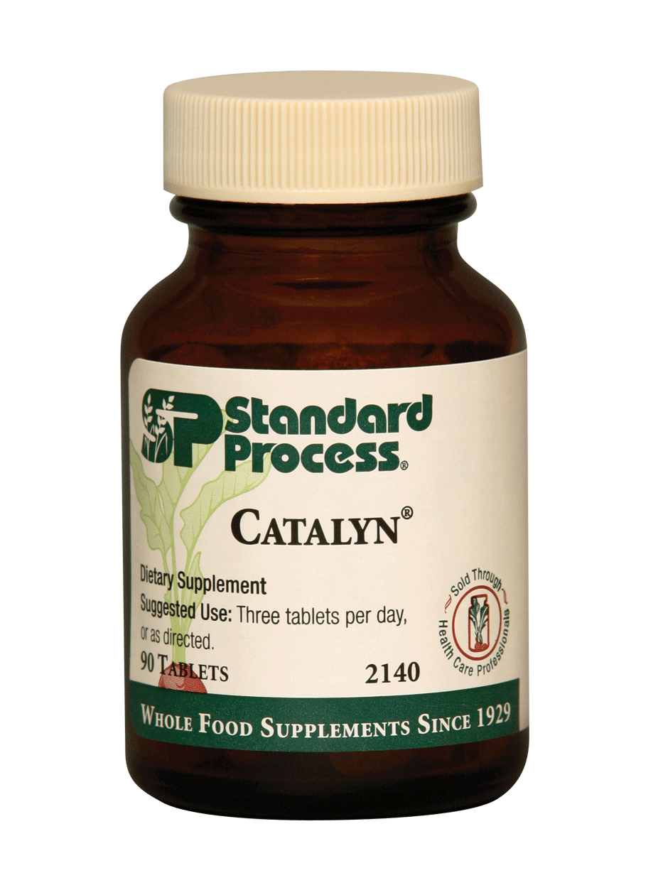
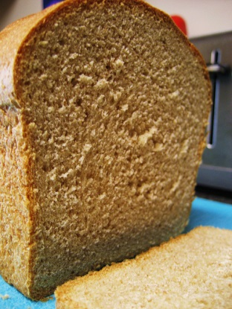
Just how much gluten is in Catalyn anyway?
Your average slice of whole wheat bread contains around 4.8 grams of gluten. Each tablet of Catalyn contains around .0125 mg of gluten - which means (drum roll) you would have to take around 384,000 Catalyn to equal the amount gluten in one slice of bread!
So, let’s think about this . . . if you took 6 Catalyn tablets a day for a year – that’s 365 days, that means it would take just over 175 years to get to the same amount of gluten as ONE slice of bread.
The smallest amount of gluten which has been shown by biopsy to cause damage to a celiac is 0.1 gram per day. This is approximately the amount of gluten contained in 1/48th of a slice of bread or 8000 Catalyn.
Catassi et al.http://www.celiac.com/articles/38/1/How-much-gluten-is-in-a-normal-diet-and-how-much-does-it-take-to-cause-damage-in-a-celiac)

Slide 69
Primary Inflammatory Foods
There are 14 primary inflammatory foods:
To reduce these for five days is to dramatically reduce the inflammatory amplitude systemically – remarkable changes seen in 1-2 days – then re-introduction protocol can determine the actual offending food(s)
Milk
Corn
Gluten
Soy
Peanuts
Beef
Tomato
Chocolate
Rice
Nuts
Sesame
Peas
Eggs
Sugar

Slide 70
Cytokines – Immune Messages
Immune response results in the release of cytokines meant to direct local and distant immune function
These cytokine messenger molecules also drive HPA status and thus determine global brain status
Cytokines subsequently cause the release of WBC inflammatory mediators to direct the inflammatory process of repair
Therefore immune status and activity determine HPA/brain settings
Hypervigilant or depressed immune states reflect in brain states

Slide 71
Cytokines – Immune Messages
The HPA Axis is the conductor of homeostatic symphony
This system additionally intertwines with virtually every aspect of physiology through the production of CRH and ACTH – indeed resistive and ‘hard-to-treat” conditions all share the described cytokine cascade disturbance
The take away is that any chronic perturbation to one element of the system will ripple through other components of the web
Persistent stressors without relief continuously stimulate the CRH-ACTH-cortisol axis resulting in high levels of cortisol and some neuronal disruption and death in the negative feedback loop (hippocampus and hypothalamus)
This may lead to depression and behavioral disturbance

Slide 72
Cytokines – Immune Messages
So the immune modulation and unburdening is required to achieve HPA and endocrine balance
The concept of immune sparing and unburdening is essential to any long term concept of HPA integrity
The sequential immune up-regulation is the avenue to HPA strength and health
The HPA axis will not completely balance and limbic health will not be achieved without immune and cytokine support

Slide 73
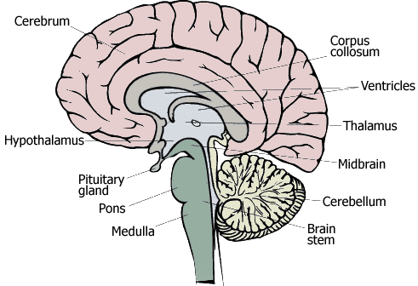
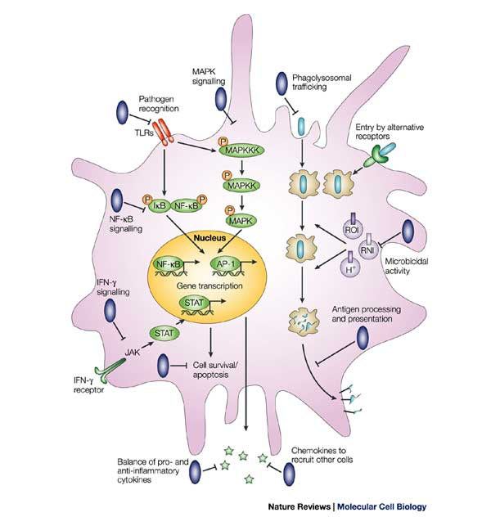
Someone you met
IL-1β, TNF-α, IL-6
Cytokines signal in the brain:
Saturable transporters
BBB leakiness
Localized production
Binding to receptors on afferent nerve fibers
Recruitment of activated cells
HPA AXIS
PNS
SNS
Cytokines and DOCs
NE
IL-1β, TNF-α, IL-6
NF-κB
Ach
GCs
Something you et
Immuno-competent Cell (Macrophage)
Raison CL, Lowry CA, Rook GA.. Arch Gen Psychiatry. 2010 Dec;67(12):1211-24.

Slide 74
Immune Modulation
An Immune Paradigm

Slide 75
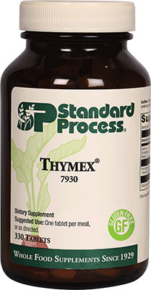
Thymex
Thymex supports the thymus gland with bovine thymus Cytosol™ extract, calcium, and magnesium. Supports a healthy thymus gland, the master gland of the immune system
Can be used in combination with other immune support products

Slide 76
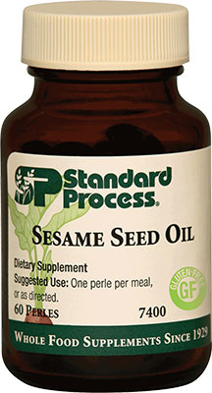
Sesame Seed Oil
Sesame Seed Oil contains essential fatty acids, as well as naturally occurring vitamin E. Provides antioxidants
Supports healthy liver function
Supports immune system function

Slide 77
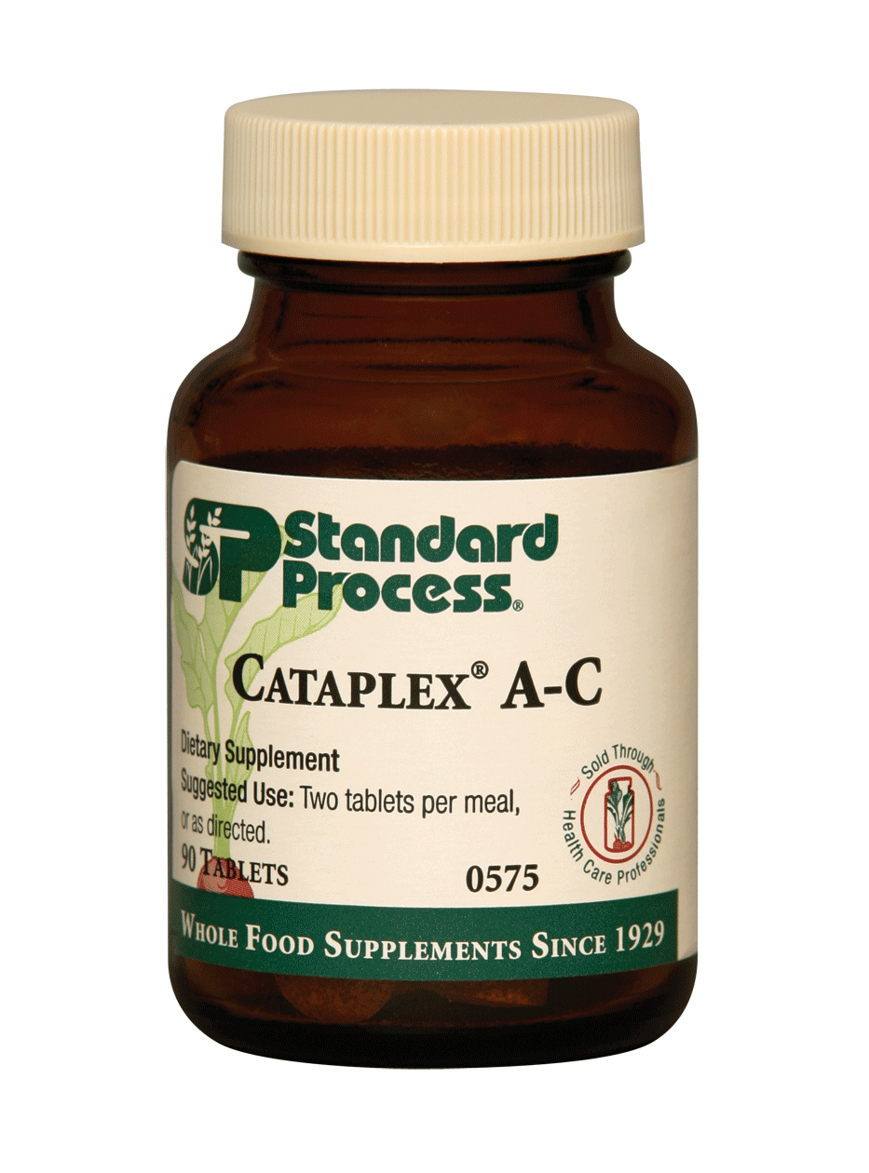
Cataplex® AC
Vitamin A | 1,500 IU
Vitamin C | 11 mg
Proprietary Blend: 490 mg Echinacea (root)†, calcium lactate, sweet potato†, carrot (root)†, bovine adrenal†, bovine kidney†, nutritional yeast†, magnesium citrate, alfalfa flour†, dried alfalfa (whole plant) juice†, mushroom†, dried buckwheat (leaf) juice†, buckwheat (seed)†, bovine bone†, defatted wheat (germ)†, oat flour†, sunflower lecithin†, veal bone†, vitamin E (sunflower), rice (bran)†, and carrot oil†.

Slide 78
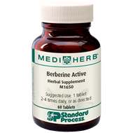
Berberine
Caution: Not to be used during pregnancy and lactation unless otherwise directed by a qualified health care professional.
Other Ingredients: Microcrystalline cellulose, sodium starch glycolate, croscarmellose sodium, hypromellose, magnesium stearate, dibasic calcium phosphate dihydrate and silicon dioxide.
For other contraindications and cautions, please refer to the Potential Herb-Drug Interactions Chart.
Supplement Facts
Serving Size: 1 tablet Servings per Container: 60
Amount per Serving %DV
Phellodendron 20:1 extract from Phellodendron amurense stem bark 8.8 g Containing berberine 200 mg | 440 mg | †
†Daily Value (DV) not established.

Slide 79
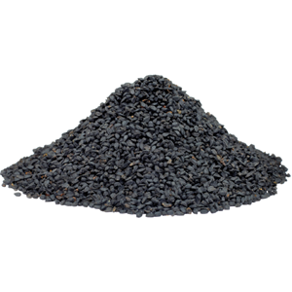
Black Cumin Seed Forte
Supplement Facts
Serving Size: 1 tablet Servings per Container: 40
Amount per Serving %DV
Calcium | 63 mg | 4%
Black Cumin seed 5:1 extract from Nigella sativa seed 2.0 g | 400 mg | †
†Daily Value (DV) not established.

Slide 80
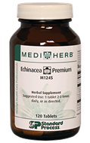
Echinacea Premium
Calcium | 90 mg
Echinacea root 4:1 extract from Echinacea angustifolia root 600 mg Containing alkylamides 2.0 mg | 150 mg
Echinacea root 6:1 extract from Echinacea purpurea root 675 mg Containing alkylamides 2.1 mg | 112.5 mg

Slide 81
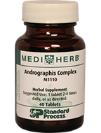
Andrographis
Calcium | 40 mg
Echinacea root 4:1 extract from Echinacea angustifolia root 500 mg | 125 mg
Holy Basil herb 5:1 extract from Ocimum tenuiflorum herb 500 mg | 100 mg
Andrographis herb 10:1 extract from Andrographis paniculata herb 1.0 g Containing andrographolide 10 mg | 100 mg
Holy Basil (Ocimum tenuiflorum) herb essential oil | 10 mg

Slide 82
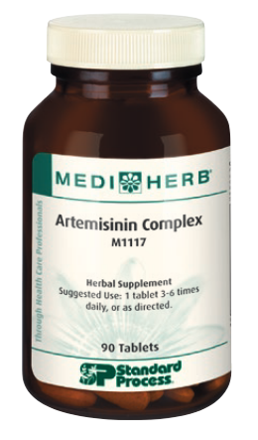
Artemisinin
support normal flushing of natural toxins from the body
encourage healthy function of organs of elimination
cleanse the blood
encourage healthy bowel function
support healthy digestion
support a healthy intestinal environment*

Slide 83
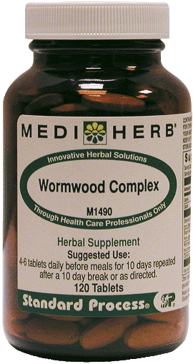
Wormwood Complex
Calcium | 20 mg
Stemona root 5:1 extract from Stemona sessilifolia root 1.0 g | 200 mg
Black Walnut hull 4:1 extract from Juglans nigra hull 100 mg | 25 mg
Wormwood herb 4:1 extract from Artemisia absinthium herb 100 mg | 25 mg
Clove bud (Syzygium aromaticum) essential oil | 20 mg

Slide 84
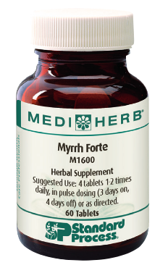
Myrrh
support healthy bowel function
support healthy digestion
support a healthy intestinal environment
support gastrointestinal health
support sinus and respiratory health*

Slide 85
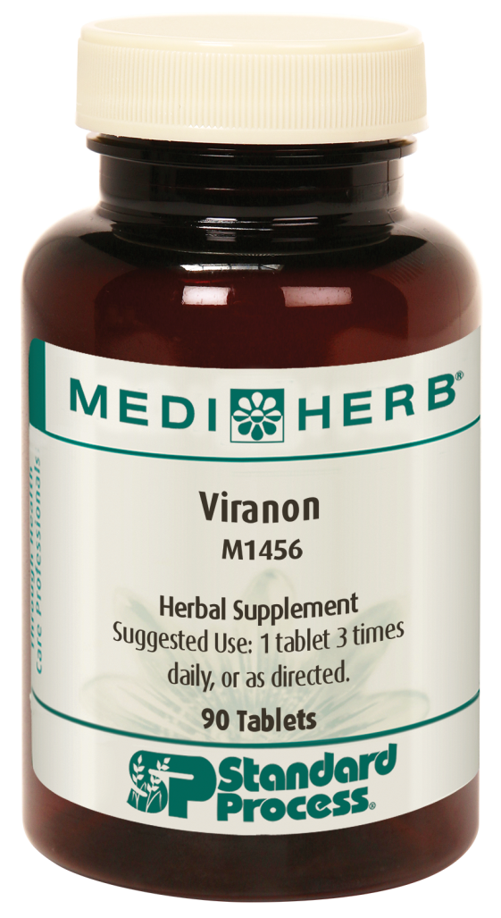
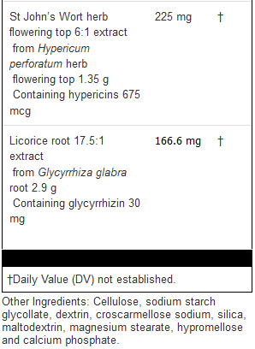
Viranon

Slide 86
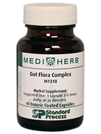
Gut Flora Complex
Anise (Pimpinella anisum) fruit essential oil | 125 mg
Andrographis ariel parts 10:1 extract from Andrographis paniculata ariel parts 1.0 g Containing andrographolide 10 mg | 100 mg
Phellodendron stem bark 20:1 extract from Phellodendron amurense stem bark 1.6 g Containing berberine 36 mg | 80 mg
Oregano (Origanum vulgare) leaf essential oil | 75 mg

Slide 87
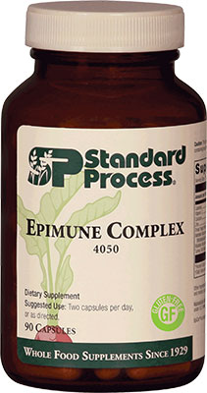
Epimune
Epimune Complex supports specific aspects of immune activity and contains research-supported ingredients such as EpiCor® and maitake and turkey tail mushrooms. Supports healthy white blood cells
Supports normal mucus secretion and nasal passages
Helps support respiratory health year-round, especially during seasonal challenges
Helps activate and balance a healthy immune system response function

Slide 88
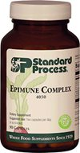
Epicor
EpiCor whole food fermentate is a specialty ingredient made using natural yeast (“Saccharomyces cerevisiae”) that goes through a closely held trade secret fermentation and drying processes.
It is neither yeast or Beta Glucan

Slide 89
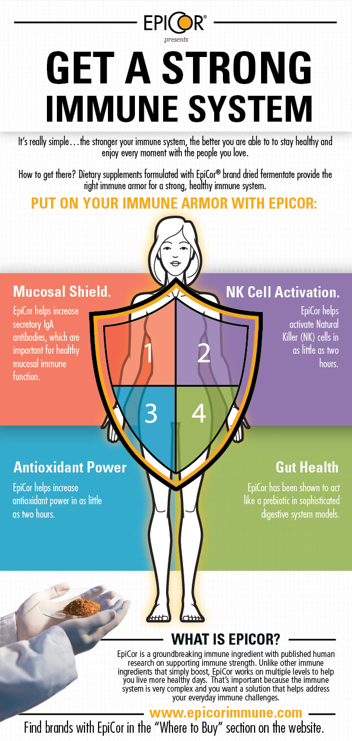
First Line of Defense. EpiCor helps strengthen your mucosal armor by significantly increasing secretory immunoglobulin A (sIgA) levels in your saliva.
Second Line of Defense. EpiCor helps support another level of immune armor by increasing NK cell activity
Antioxidant Power Published research shows that EpiCor helps strengthen your immune armor by increasing antioxidant power in as little as two hours.
Gut Health. EpiCor has been shown to act like a prebiotic in sophisticated digestive system models by increasing bifidobacteria and lactobacilli and the important short chain fatty acid called butyrate for gut health.
Notes:
First Line of Defense. EpiCor helps strengthen your mucosal armor by significantly increasing secretory immunoglobulin A (sIgA) levels in your saliva. sIgA is a key antibody in your saliva and other mucus membranes.¹ sIgA antibodies are in our eyes, mouth, nose and other mucus membranes throughout our bodies to help trap pathogens before they may cause harm.²
Second Line of Defense. EpiCor helps support another level of immune armor by increasing NK cell activity. NK cells are a type of white blood cell circulating in our blood and organs that are fast and effective in seeking out and destroying bad cells at the initial occurrence.³ NK cells are called “natural killer” because they don’t need help from other cells to differentiate “good” cells from “bad” cells.⁴ This makes them much quicker to respond to keep your body healthy.
Antioxidant Power
Antioxidants circulate in your blood and tissues and help protect from cellular oxidative damage, which may affect how your immune system works over time.⁵ Published research shows that EpiCor helps strengthen your immune armor by increasing antioxidant power in as little as two hours.
Gut Health
More and more people are taking gut support supplements to not only support their digestive systems, but also their immune systems. The digestive system plays a major role in the healthy function of your immune system. In fact, the tens of trillions of beneficial bacteria in your gut are an important part of keeping you healthy. To help your intestinal bacteria stay alive and thrive, they need fibers known as prebiotics, which are foods that nourish the beneficial bacteria. Prebiotics help the good bacteria, like bifidobacteria and lactobacilli, grow and multiply to help your gut stay healthy. EpiCor has been shown to act like a prebiotic in sophisticated digestive system models by increasing bifidobacteria and lactobacilli and the important short chain fatty acid called butyrate for gut health.

Slide 90
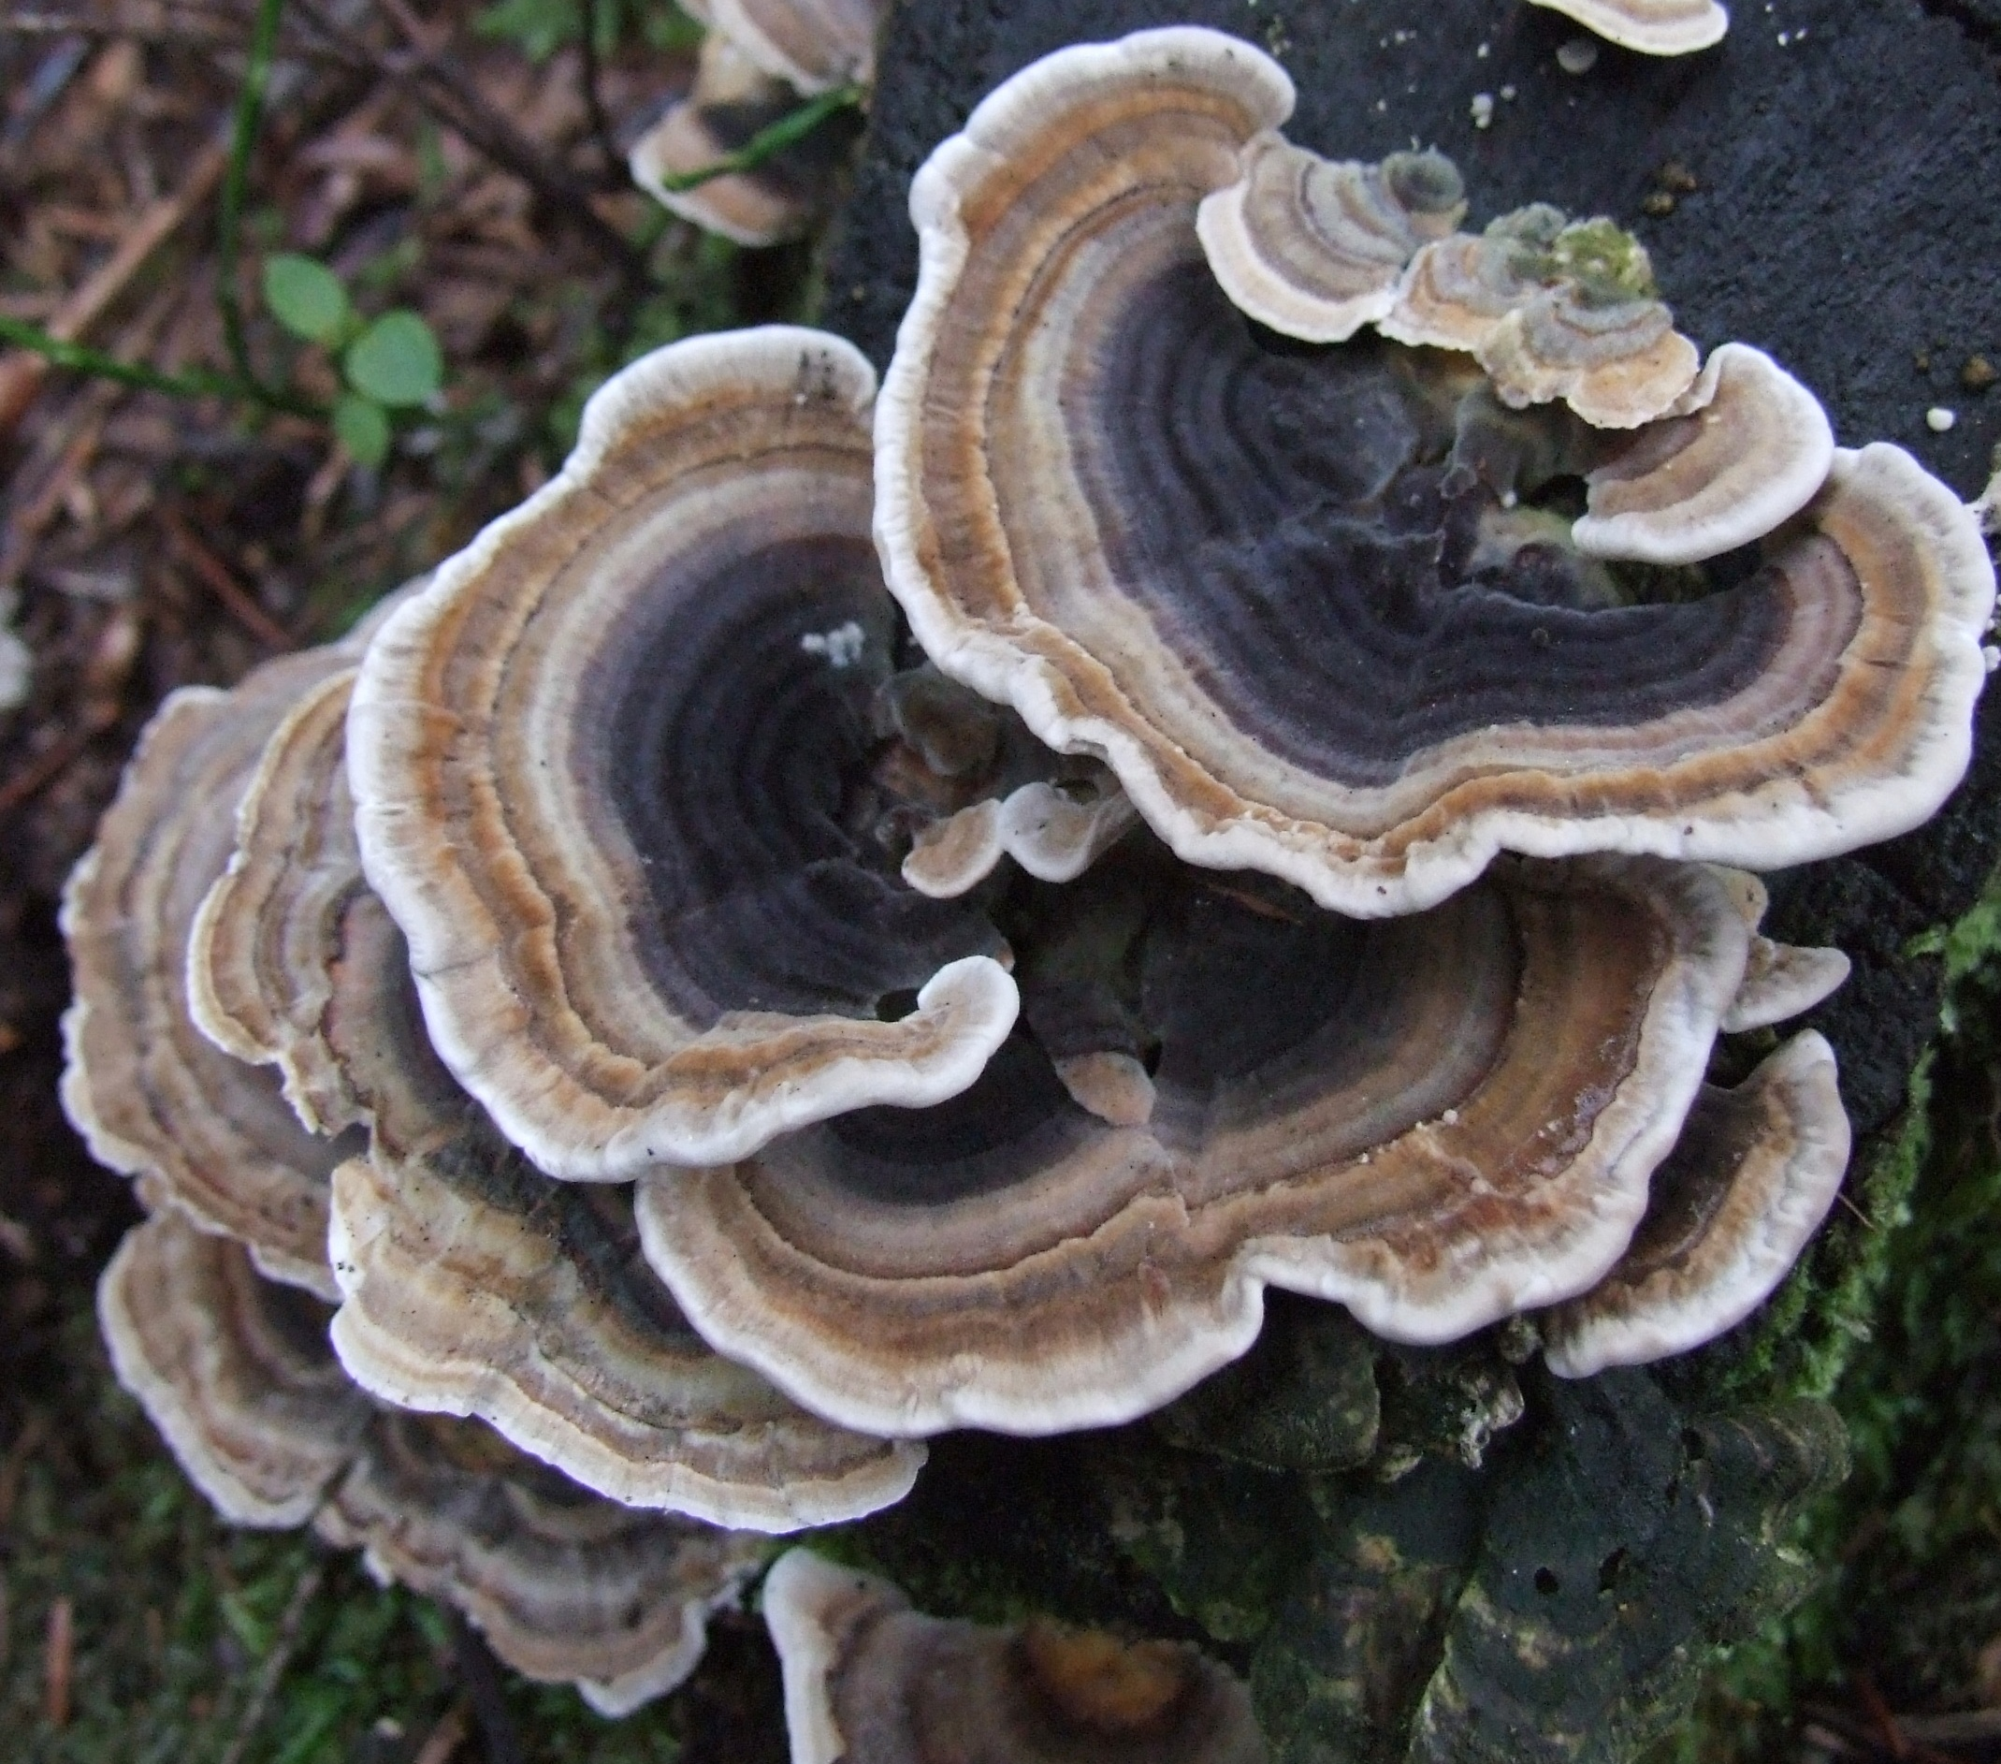
Coriolus Versicolor
Turkey tail mushroom
PSP induces production of many pleiotropic cytokines with predominantly a pro-inflammatory profile, which act locally and systemically.
PSP has stimulatory effects on many immune cell types, enhancing their proliferation and cytoki
PSP promotes immune responses via induction of immunoglobulin production and engagement of various pattern-recognition molecules.ne release.
Front Immunol. 2017; 8: 1087.

Slide 91
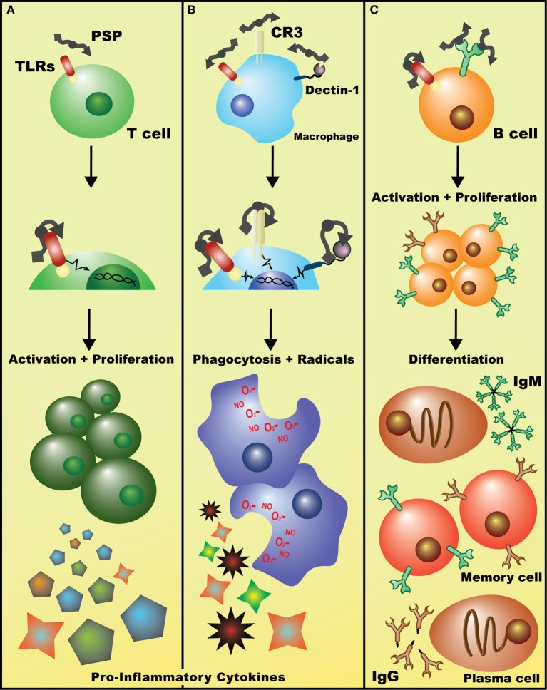
Potential mechanisms of immuostimulatory effects of Coriolus versicolor. (A) Detection of polysaccharopeptide (PSP) by TLR(s) (and perhaps other receptors) on T lymphocytes initiates signaling cascades, such as the p38 MAPK pathway, leading to enhanced T cell proliferation and the release of largely pro-inflammatory cytokines such as IL-2 and IFN-γ. (B) Binding of PSP to any/all of Dectin-1, CR3, or TLRs on macrophages leads to the activation of genetic events that increase phagocytic activity and induces the production of oxidative radicals and cytokines such as tumor necrosis factor-α. (C) Recognition of PSP by the BCR leads to B cell activation, clonal proliferation, and eventual differentiation into IgM⁺ or IgG⁺ plasma and memory B cells. Alternatively, PSP may be acting on B cells in a similar fashion to T cells, non-specifically activating them through TLR(s) and leading to a general increase in polyclonal IgM and IgG levels (data not shown).
Front Immunol. 2017; 8: 1087.

Slide 92
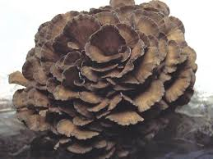
Maitake Gold 454
MaitakeGold is a patented 300:1 concentrate achieved through hot water extraction and fractionation; MushroomScience’s Full Spectrum Maitake extract is a 15:1 concentrate also produced through hot water extraction.
According to the studies this Maitake fraction hasthe ability to directly enhance the activity of Natural Killer (NK) cells and to change NK precursor cells into activated NK cells.*

Slide 93
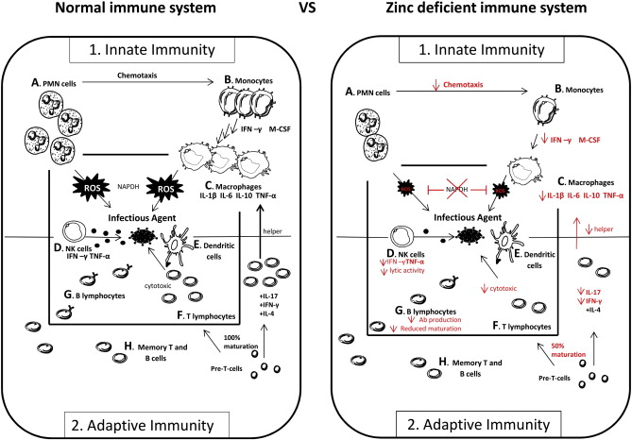
Zinc
2 capsules of Epimune provides 10 mg of zinc chelate. Adequate zinc levels are critical for proper immune function. But more is not better and taking excessive zinc supplemtation can cause other mineral imbalances.
Autoimmunity Reviews Volume 14, Issue 4, April 2015, Pages 277-285

Slide 94
Zinc-deficiency induced changes in the distribution of rat white blood cells.
Zinc-deficiency induced changes in the distribution of rat white blood cells.
Someya Y¹, Tanihata J, Sato S, Kawano F, Shirato K, Sugiyama M, Kawashima Y, Nomura S, Tachiyashiki K, Imaizumi K.
AZinc is known to play an important role for immune-functions. However, the effects of zinc-deficiency on the immune response system from the point of view of the distribution changes of the number of total white blood cells (WBCs) are still primarily unknown. Therefore, the effects of zinc-deficiency on the number of total WBCs, neutrophil, eosinophil, basophil, monocyte and lymphocytes (T lymphocyte, B lymphocyte and NK cell) were studied in rats. The weaned male rats were randomly divided into the zinc deficient diet (ZDD: 0.7 mg zinc/kg diet) group and the control diet (CON: 34.8 mg zinc/kg diet) group, and were pair-fed for 4 wk. The number of lymphocyte subsets, visceral organ weights, serum zinc, corticosterone and IL-6 concentrations were also determined. Zinc-deficiency increased duration-dependently the number of total white blood cells, granulocytes (neutrophil, eosinophil and basophil) and monocytes in 2-4 wk without changing the number of lymphocytes, T lymphocytes, B lymphocytes or NK cells. The relative weights of thymus and adrenals were 0.63 times (p<0.01) lower and 1.60 times (p<0.001) higher in ZDD group than in CON group, respectively. Zinc-deficiency increased serum corticosterone concentration to 1.48 times (p<0.05) without changing serum IL-6 concentration, as compared with those of CON group. From these results, zinc-deficiency increases markedly the number of granulocytes and monocytes without changing the number of lymphocytes, T lymphocytes, B lymphocytes or NK cells. These results also suggest that zinc-deficiency induces stress responses and the responses may have in part participated in increased actions of the number of granulocytes and monocytes during zinc-deficiency, and induce thymus atrophy and adrenal hypertrophy.
J Nutr Sci Vitaminol (Tokyo). 2009 Apr;55(2):162-9.

Slide 95
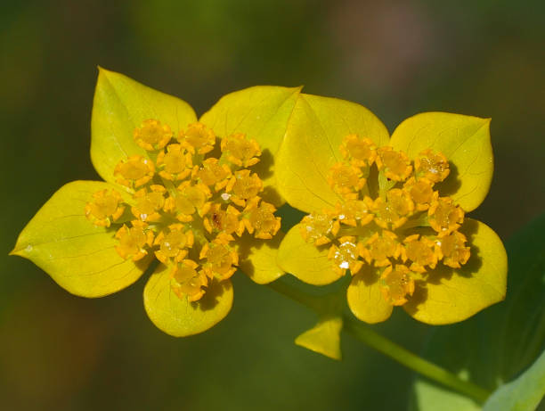
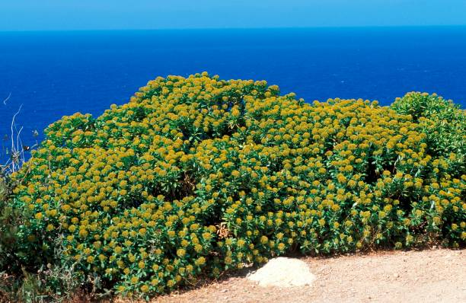
Bupleurum – unfathomed?
Women sometimes use it for premenstrual syndrome (PMS) and painful periods (dysmenorrhea). Bupleurum is also used for fatigue, headache, ringing in the ears (tinnitus), trouble sleeping (insomnia), depression, liver disorders, loss of appetite (anorexia)
Popular in China, this flowering plant is known as either Chai Hu or Thorough wax (a name adopted around the world as well)
They use the bupleurum mainly for medicinal uses, treating ailments like cough, flu, fatigue, fevers, colds and headaches
Bupleurum is considered an easy plant to grow from seed form.

Slide 96
Bupleurum – unfathomed?
Side Effects. Mild lassitude, sedation, and drowsiness
Large doses may increase flatulence and bowel movements
Allergy to injected bupleurum has been reported
Widely considered anti-infective and anti-cancer
Bupleurum is a large genus of annual or perennial herbs or woody shrubs, with about 190 species, belonging to the family Apiaceae
The full size of its species may vary between a few cm to up to 3 m high. Their compound umbels of small flowers are adorned with bracteoles that are sometimes large and may play a role in attracting pollinators
Bupleurum is a plant. People use the root for medicine. Bupleurum is included in many Chinese and Japanese traditional herbal formulas.
People use bupleurum for liver infections, respiratory infections, digestion problems, menstrual problems, and many other conditions, but there is no good scientific evidence to support these uses.
Bupleurum may stimulate the cells of the immune system to work harder. It might also have other effects, but none of these are proven in humans.

Slide 97
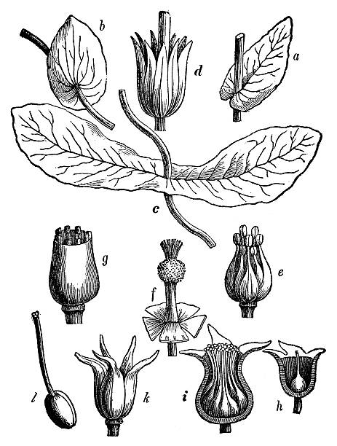
Bupleurum – Known to be effective for:
Swelling (inflammation) of the liver caused by the hepatitis B virus (hepatitis B). Early research shows that an herbal combination containing bupleurum (Sho-saiko-to) might help the body to fight off chronic hepatitis B infection.
Flu (influenza). Early research shows that an herbal combination containing bupleurum (chima qingwen) might help the body to fight off a type of flu known as H1N1.
Liver cancer. People with hepatitis B can develop liver scarring (cirrhosis), which can increase their risk of developing liver cancer. Also, some people with hepatitis B infection have antibodies against that infection, while others do not. Early research shows that an herbal combination containing bupleurum (Sho-saiko-to) can reduce the risk of liver cancer in people with hepatitis B and cirrhosis who do NOT have antibodies against the hepatitis B infection. It does not seem to reduce the risk in people who DO have antibodies against the hepatitis B infection.

Slide 98
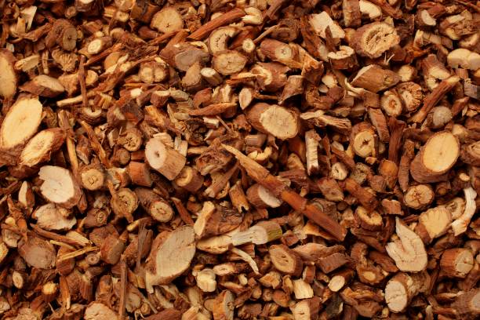
Bupleurum – Known to be effective for: Con’t
Asthma.
Chest pain (angina).
Constipation.
Cough.
Depression.
Diarrhea.
Epilepsy.
Fatigue.
Fevers.
Headache.
Hemorrhoids.
High cholesterol.
Indigestion.
Joint pain (rheumatism).
Liver disorders.
Loss of appetite.

Slide 99
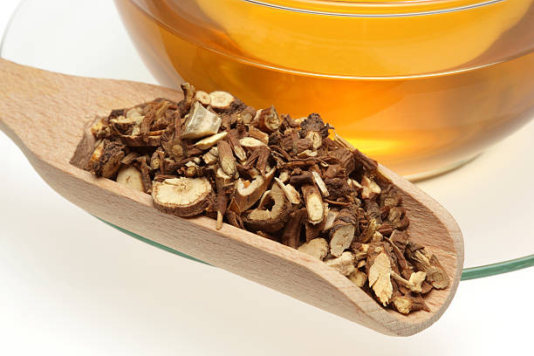
Bupleurum – Known to be effective for: Con’t
Malaria.
Muscle cramps.
Pain.
Painful periods (dysmenorrhea).
Premenstrual syndrome (PMS).
Ringing in the ears.
Stimulating the adrenal gland.
The common cold.
Stimulating the adrenal gland.
Trouble sleeping (insomnia)

Slide 100
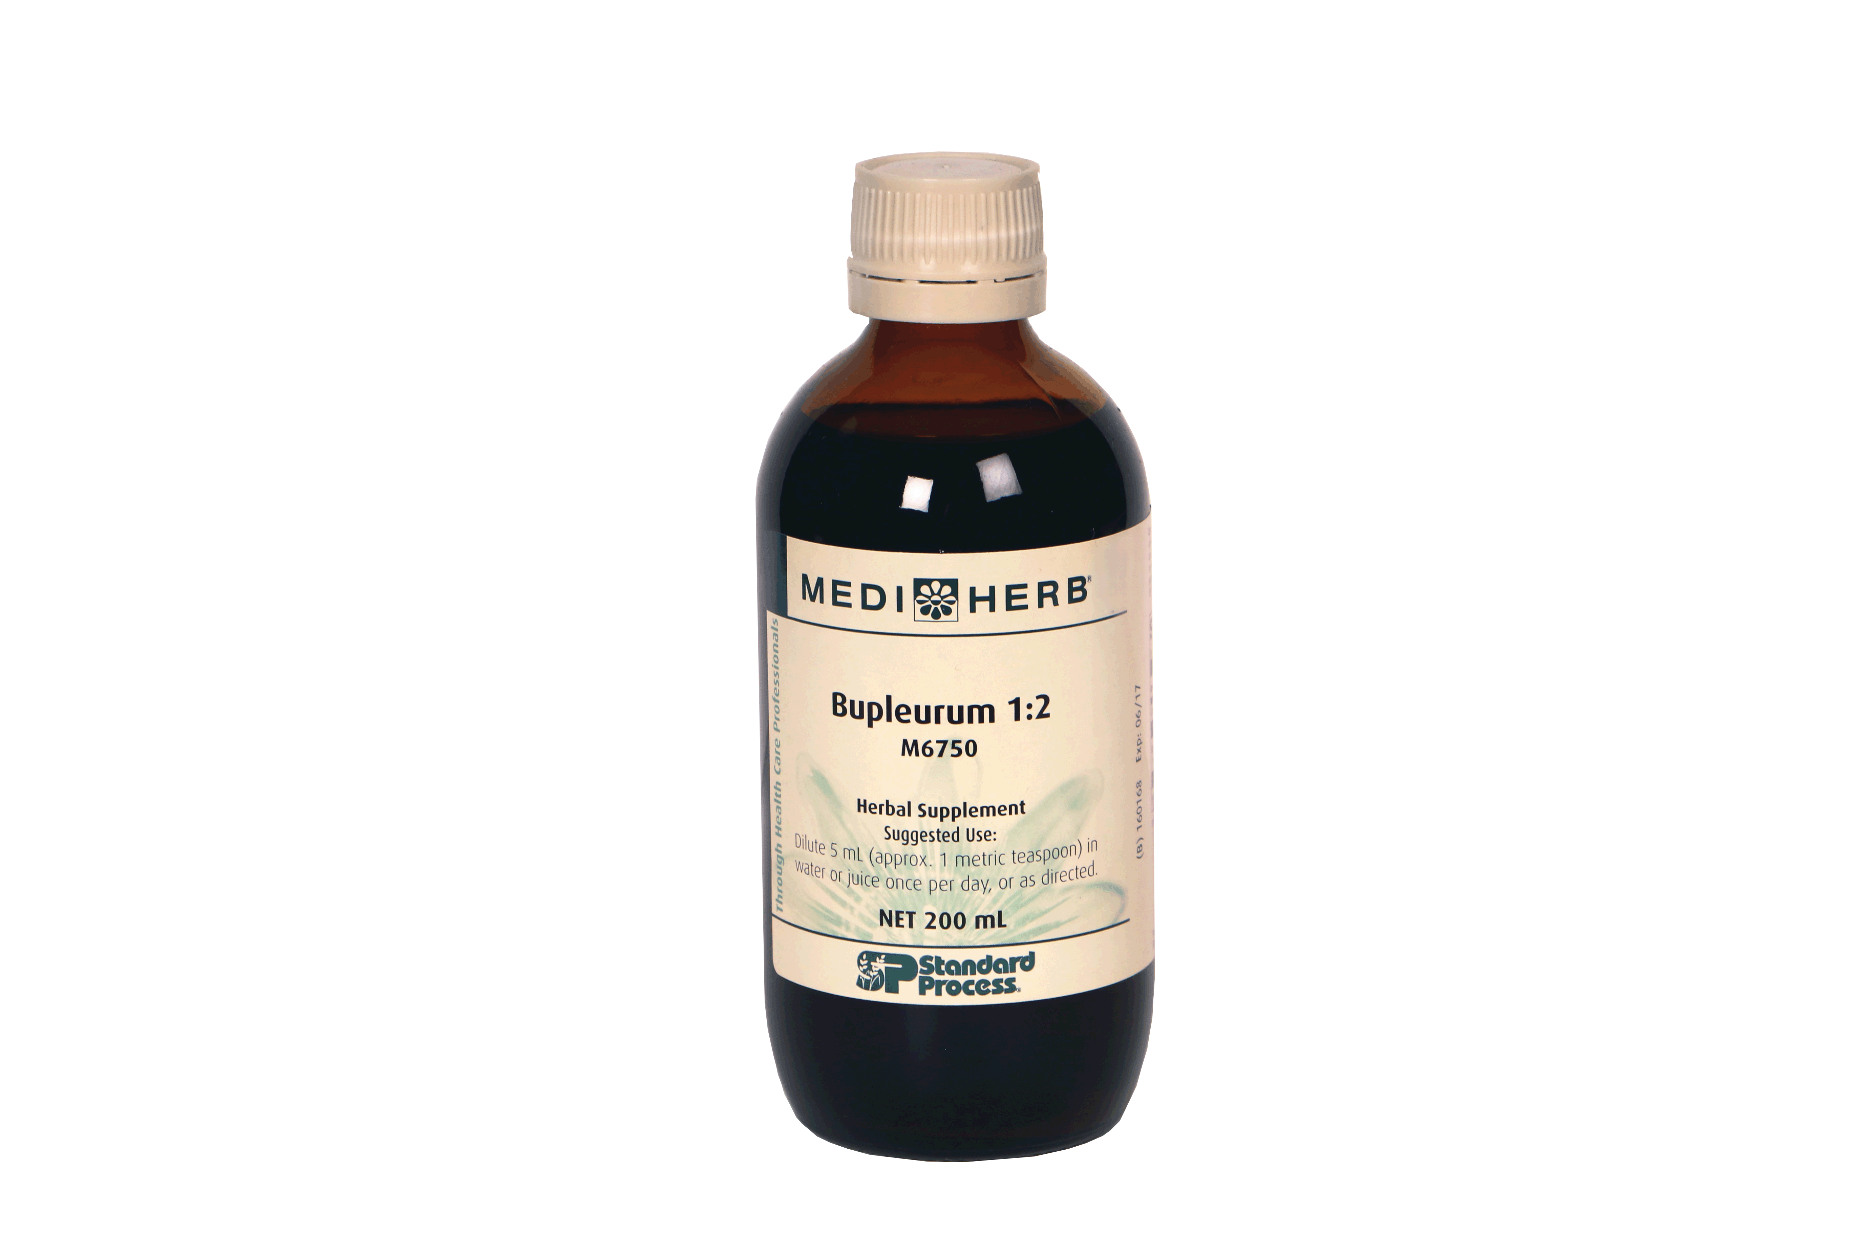
Bupleurum – Unsung Hero by Mediherb
Muscle Bupleurum contains triterpenoid saponins (called saikosaponins), sterols and other phytochemicals that actively:
promote healthy liver function
support adrenal gland health
stimulate protein synthesis
promote the body's normal resistance function*
Suggested Use: Dilute 5 mL (approx. 1 teaspoon) in water or juice once per day, or as directed. cramps.
Caution: Not to be used during pregnancy and lactation unless otherwise directed by a qualified health care professional.
Supplement Facts
Serving Size: 5 mL (1 tsp)
Servings per Container: 40
Amount per Serving %DV
Calories 10
Bupleurum root 1:2 extract from Bupleurum falcatum root 2.5 5 mL †
†Daily Value (DV) not established.
Other Ingredients: Purified water and 45% alcohol

Slide 101
What we know to begin with - Review
We have a wonderful starting place by reviewing the established details about Bupleurum liquid extract
Thanks to Kerry Bone and many others who have supported and promoted the legacy information – our clinical experience is the starting place
Our mission as clinicians is to expand and define the therapeutic dimensions of this product for the known and as yet unknown applications it may promise

Slide 102
Autophagy – what is that?
Autophagy (or autophagocytosis) (from the Ancient Greek αὐτόφαγος autóphagos, meaning "self-devouring" and κύτος kýtos, meaning "hollow") is the natural, regulated mechanism of the cell that removes unnecessary or disfunctional components
Autophagy is a normal physiological process in the body that deals with destruction of cells in the body. It maintains homeostasis or normal functioning by protein degradation and turnover of the destroyed cell organelles for new cell formation. During cellular stress the process of Autophagy is upscaled and increased

Slide 103
Autophagy in Health & Disease
Autophagy has been highlighted for its protective roles in various physiological and pathological conditions including (1) cellular homeostasis and genome stability maintenance, (2) immunomodulation, (3) hepatoprotection and aggregate removal, (4) cancers, and (5) emotional instability conditions
Autophagic regulation is mainly responsible for maintenance of normal cellular and hormonal homeostasis, defense against pathogen invasion, and protection against toxic protein aggregate accumulation, and beneficial improvements in all of these at the cellular level are related to improved vitality.

Slide 104
Inducing Autophagy to remediate cancers
Chin Med. 2014; 9: 21.
Published online 2014 Sep 11. doi: 10.1186/1749-8546-9-21
PMCID: PMC4165614
PMID: 25228909

Slide 105
Findings of Research
Table 1
Comparisons of CM applications, pharmacological actions, and autophagy effects of Chaihu
CM applications | Pharmacological effects | Autophagic effects
Improvement of alternating chills and fever | Antipyresis Antibacteria, antivirus, and anti-endotoxin Immunomodulation | Immunomodulation Anti-pathogens Modulation of cytokine secretion Removal of toxic mutant proteins and aggregates
Modulation of inflammatory symptoms and diseases | Immunomodulation Antibacteria and antivirus Modulation of cytokine secretion | Immunomodulation by pathogen and cytokine control Removal of abnormal protein aggregates Detoxification and degradation of toxins and inflammatory proteins
Reduction of distention and pain in the chest and flank Improvement of digestive functions: loss of appetite, dyspepsia, and flatulence | Hepatoprotection Anti-inflammation Anti-fibrosis Promotion of pancreatic digestive enzyme secretion | Cellular catabolism for removal of waste materials Immunomodulation Anti-pathogens Removal of toxic mutant proteins and aggregates Regulation of lipid metabolism
Improvement of circulation or stasis of blood and body fluid, and accumulation of phlegm | Promotion of cancer cell death Reduction in cancer cell proliferation Immunomodulation, apoptosis, and anti-angiogenesis | Maintenance of genomic stability Promotion of autophagic cell death

Slide 106
Different Types of Saikosaponins - Active
Bupleurum alleviates a wide spectrum of disorders in a multi-target manner through its immunomodulatory, antipyretic, hepatoprotective, choleretic, autophagy-inducing, sedative and analgesic, antihyperlipidemic, antiviral, and anticancer effects.
The pharmacological effects of Bupleurum are attributed to its active components, Ssa, saikosaponin-c (Ssc), and Ssd. Ssa exhibits antiproliferative, anti-inflammatory, anticancer, antioxidative, and hepatoprotective effects. Ssc induces umbilical vein endothelial cell proliferation, migration, and capillary vascularization, and possesses anti-hepatitis effects. Ssd also exhibits immunomodulatory, antiproliferative, and anticancer effects. In particular, Ssd induces autophagy and autophagic cell death in apoptosis-defective cells via direct inhibition of sarcoplasmic/endoplasmic reticulum Ca²⁺ ATPase pump (SERCA) and mammalian target of rapamycin (mTOR), with disruption of calcium homeostasis and induction of endoplasmic reticulum (ER) stress

Slide 107
Saikosaponins are the key
The contemporary clinical indications for Chaihu (Bupleurum) include common cold, malaria, cholecystitis, globus pharyngitis, gynecological diseases, depression, hepatitis, liver cirrhosis, pancreatitis, and hyperlipidemia
Bupleurum and its active components (saikosaponins) exhibited immunomodulatory, antiviral, antipyretic, hepatoprotective, anticancer, sedative, and analgesic effects. Our recent study further revealed that saikosaponin-a (Ssa) and saikosaponin-d (Ssd), which are related to gan qi regulation can induce autophagy

Slide 108
From the Known to the Unknown – Explore
We always move into the unknown from what we know –
We know pathogen exposure of all types is increasing potentially due to increasing population or environmental distortion
It is our mission to explore possibility and create convention for the sake of those who follow – new ideas will become accepted and adopted as the norm
We have been given a great gift in the diversity of immune modulatory products – all thanks to Standard Process, Royal Lee, Kerry Bone and many others who make possible what will follow because we dare to understand and imagine what we know and have yet to know

Slide 109
Learning a new way – Sequential Augmentation
Mixed Infection Syndrome is widespread and either clinical or sub-clinical in everyone
Sequential Immune Up-Regulation is the idea to employ
Immune modulation is achieved by reducing immune burdens and augmenting autophagy

Slide 110
Protocols for Sequential Immune Up-Regulation (one month each)
Lymph/Immune – Thymex 3-4 bid, Congaplex 4-5 bid, Allerplex 4-5 bid
Bone Marrow / Hemopoiesis – Sesame Oil 2-3 bid, Biost 3 bid
Thymus / Cytokine – Epimune 1 bid, Thymus PMG 3 bid
Spleen – Immuplex 2-3 bid, Spleen PMG 3 bid, Dessicated Spleen 3 bid
HepatoBiliary – Livco 2 bid, Livton 2 bid, AF Betafood 5 bid, Livaplex 2-3 bid
Parasites – Zymex II 2-3 bid, Wormwood 2 bid, Artemisinin 2 bid
Yeast / Fungal Overgrowth – Garlic Forte 1 bid, Gut Flora Complex 2 bid
Viral Burden – Viranon 2 bid, Andrographis 2 bid, Cyruta Plus 3 bid
Stealth Infection – Myrrh Forte 2 bid, Cats Claw 2 bid, Berberine Active 2 bid, Black Cumin 2 bid, Bupleurum 1 teaspoon bid
Metal Toxicity – Chelaco 1-2 bid, Spanish Black Raddish 3 bid
Autoimmunity – Rehmannia Complex 2 bid

Slide 111
Take Away Principles -
Promote autophagy
Sequential Immune Up-Regulation
Mixed Infection Syndrome
The unburdened immune system is more able to monitor and address metabolic issues
Every person is in a process of homeostatic promotion to offset the decline of health
Dramatic increase in compliance due to immediate limbic upliftment
Sequential Immune Up-Regulation is really sequential liver, spleen, lymphatic, lung, GI, endocrine, cardiovascular, organ up-regulation
Nothing is more powerful than an idea whose time has come

