Slide 1
Mentoring the Mentors Top Ten Products
Stuart White, DC, DACBN, DABN
Synergy Holistic & Whole Health Assoc.
980/355-0842, 713/522-6336
stuartwhitewha@gmail.com
www.synergycharlotte.com & www.wholehealthassoc.com
www.doctorofthefuture.org

Slide 2
Mentor goals:
To declare what is possible and establish a commitment to that possibility
Address personal and professional barriers limiting the ability to serve
Evolution of vision/mission/ethics that drive success
Create immediate action steps to apply learning and growth
Construct the round table of applied trophologists

Slide 3
Mentoring the mentor:
Who are the mentors? – Practitioners
Who are we mentoring? – Patients and GAP
What’s the purpose? – Optimized life
How does it work? – Whatever you learn you teach someone else (anyone else)
Who’s is included? – Self selection, you pick yourself

Slide 4
Mentoring the mentor:
Each participant attends monthly teleconferences (1 hour in duration, 3rd Wednesday of every 2nd month) creating a round table discussion/exploration of the dynamics and details of a nutrition-based holistic practice
Each participant chooses how to convey the notes and information to their world and community – no information squandering

Slide 5
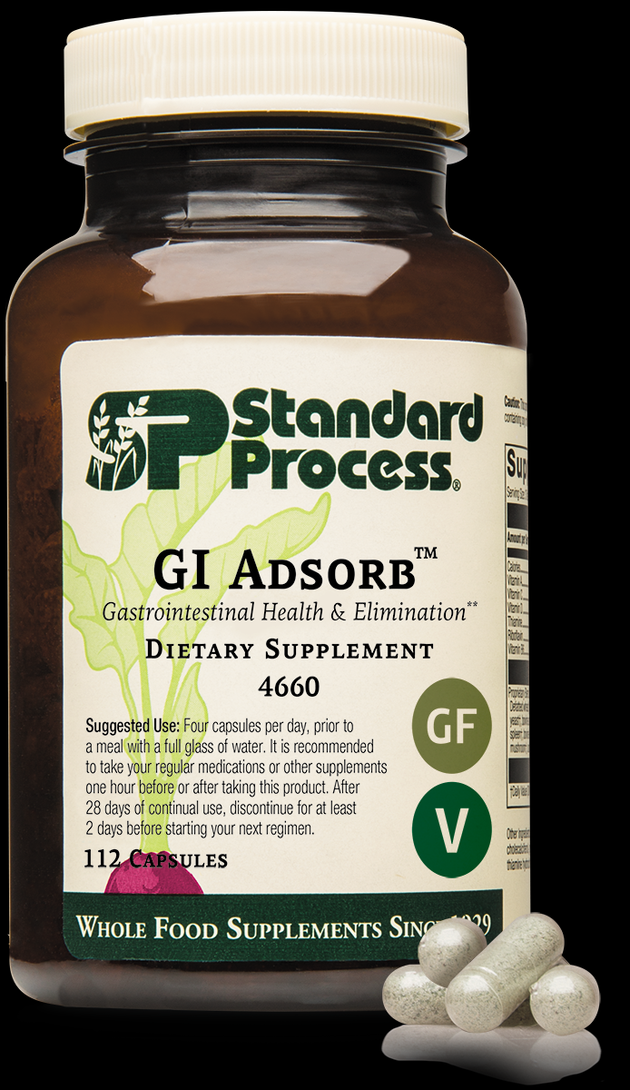
GI Adsorb –binding and eliminating:
New kid in the block
Brand new capabilities clinically
Clarity of mind
Relaxation
Gut repair and renewal
Reduction of chronic toxicity and burdens we have become accustomed to

Slide 6
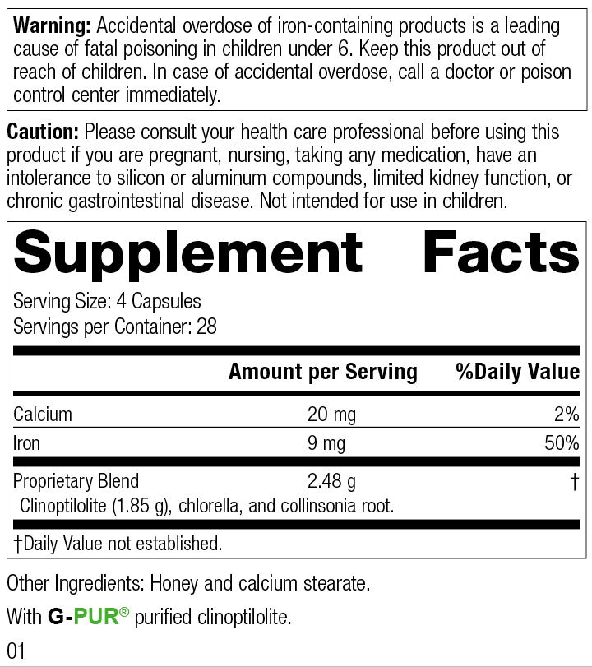
GI Adsorb
GI Adsorb is a GI health supplement that contains clinoptilolite, an adsorbent zeolite mineral, and is formulated to support GI health and elimination.* It also:
Contains purified Clinoptilolite (G-PUR®) — a mineral that has adsorbent properties towards naturally occurring toxins*
Contains Collinsonia Root, which has been historically used to support normal elimination and digestive health*
Helps support a healthy gut barrier*
Helps with the body's removal of naturally occurring toxins by supporting a healthy GI barrier and normal elimination*

Slide 7
GI Adsorb – SP Tells it straight
GI Adsorb provides important elimination support
The elements that go into the body — nutrients, vitamins, and minerals — are most commonly thought of as the substances that help the various systems operate at their best. However, elements that can help eliminate substances from the body are also greatly important. GI health and toxin removal play important roles, and are essential for helping people achieve optimal wellness. That’s why GI Adsorb from Standard Process is formulated to support GI health and normal elimination.*
What is G-PUR®?
GI Adsorb contains G-PUR®, a purified, high-quality zeolite/clinoptilolite mineral that ensures a strong adsorbent property. Zeolites, which come from volcanic ash that has been weathered in marine environments for millions of years, have been used in a variety of applications — most commonly for water purification.
What is adsorption, and why is it important for toxin removal?
Adsorbents (not to be confused with absorbent) are materials capable of trapping certain substances to their surface or within pores, shielding them from interactions in a biological or chemical system.1
Adsorption differs from absorption on one key way: the way molecules are removed. In adsorption, molecules from a toxin are held loosely on the surface of the adsorbent and can be easily removed without entering the adsorbent.
What are the benefits of clinoptilolite?
Adsorbent compounds, including the G-PUR® clinoptilolite found in GI Adsorb, have been investigated in cell studies, animal models, and clinical trials for their ability to support the GI system as it faces stressed conditions.2-7 Clinoptilolite is a zeolite mineral. Its molecules trap naturally occurring toxins on their surfaces to remove them through normal elimination.

Slide 8
Same Times Every Two Months
Mentoring the Mentors will continue in 2021 on the following dates at 1 PM EST
September 15
November 17

Slide 9
Ideas are the foundation…
Nothing is more powerful
Than an idea whose time has come
BJ Palmer, DC

Slide 10
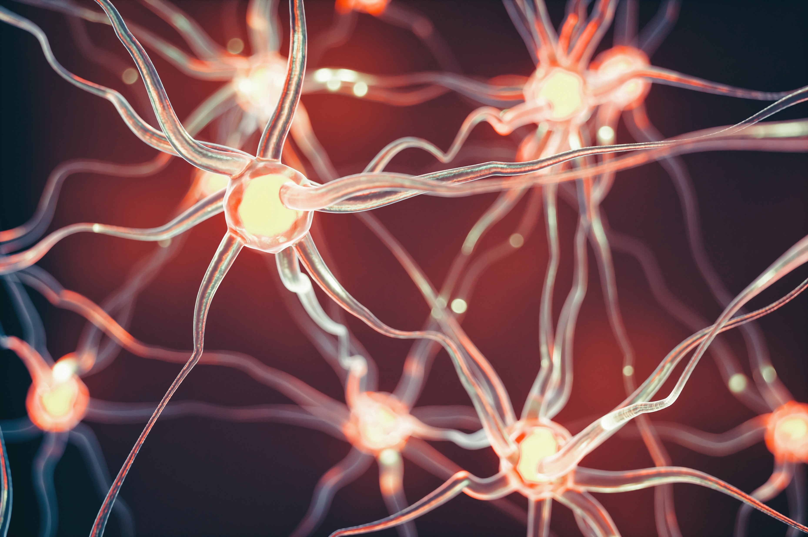
Humbly and Genuinely -
These are my ideas

Slide 11
Truth & Understanding
Suffering is the origin of consciousness
Fyodor Dostoevsky

Slide 12
Understanding the Suffering
We suffer
Our patients suffer
We suffer as practitioners
All humanity suffers
All life suffers
Feel it for a purpose – To learn the truth

Slide 13
Suffering according to Buddhism
While there are many subcategories, the three basic patterns of suffering are:
The suffering of suffering - This one we’re all familiar with: the pain of birth, old age, sickness, and death, as the Buddha described it.
The suffering of change. When you do get what you want, you can’t hold onto it. Even if things are going great now, it’s just a matter of time. The richest, most successful person in the world will eventually lose it all.
All-pervasive suffering. This is the type of suffering we are most likely not to recognize, yet the most instructive when we do. It’s the general background of anxiety and insecurity that colors even our happiest moments. Deep down, we fear that life doesn’t offer us solid ground and that our very existence is questionable. From a Buddhist point of view, these doubts are well-founded, and exploring them offers us glimpses of wisdom.

Slide 14
Making the Suffering Noble
Creating purpose in suffering can help patients understand and move through the process
Learning and growing and evolving become the trade words of our work, and additionally must be part of documented change
This is how I learned the body/mind connection of specific supplements and was awarded the privilege of sharing the intimacy of suffering that healers may know with their patients

Slide 15
Documentation of Suffering
When we take the case history we may include emotional and social dimensions
This in turn leads to showing evolution in these dimensions and is the basis for teaching and advice

Slide 16
Covid 19 Characteristics Understanding dictates action

Slide 17
Herd Immunity is happening
COVID-19 mortality — which had declined for the last 10 weeks straight — is currently at the epidemic threshold, meaning if it slides down just a little more, COVID-19 will no longer meet the CDC's criteria for "epidemic" status.
In other words, the fact that young and middle-aged adults are testing positive in droves is not a warning sign of an impending onslaught of deaths, as the risk of death in these age groups is minuscule. If anything, it seems to show herd immunity is building which, ultimately, will help protect the most vulnerable among us.

Slide 18
Viral Replication
Even though the COVID-19 curve has been flattened, mainstream media outlets continue to push doomsday predictions of an impending explosion of deaths
· According to Stanford University's disease prevention chairman Dr. John Ioannidis, the COVID-19 fatality rate for those under the age of 45 is “almost zero,” and between the ages of 45 and 70, it’s somewhere between 0.05% and 0.3%
· So, the fact that young and middle-aged adults are testing positive in droves is not a warning sign of an impending onslaught of deaths, as the risk of death in these age groups is minuscule
· According to the Centers for Disease Control and Prevention, the COVID-19 mortality — which had declined for the last 10 weeks straight — “is currently at the epidemic threshold,” meaning if it declines just a little more, COVID-19 will no longer be considered an epidemic
This Photo by Unknown Author is licensed under CC BY-SA

Slide 19
Testing to flatten the curve -
Why Did They Want to Flatten the Curve?
The primary justification for the tyrannical governmental interventions of COVID-19 was to slow the spread of the infection so that hospital resources would not be overwhelmed, causing people to die due to lack of medical care. These interventions were not about stopping the spread or reducing the number of people that would eventually get infected.
It was only intended to slow it down so, eventually, naturally-acquired herd immunity — the best kind — would prevent its spread. Well guess what? They have changed the narrative. That is why you now do not hear anything about flattening the curve. Instead they transitioned the fear-mongering to alarm the public that the number of “cases” are increasing.
Bear in mind that you do NOT need any test to be classified as a COVID case. All you need is a simple upper respiratory infection and you can legally be classified as a COVID-19 case to artificially inflate the totals.
This Photo by Unknown Author is licensed under CC BY-SA

Slide 20
Immunity – 81% Resistant
Majority of People Appear Resistant to COVID-19
Another study28,29 published in the journal Cell found 70% of samples from patients who had recovered from mild cases of COVID-19 had resistance to SARS-CoV-2 on the T-cell level. Curiously, 40% to 60% of people who had not been exposed to SARS-CoV-2 also had resistance to the virus on the T-cell level.
According to the authors, this suggests there's "cross-reactive T cell recognition between circulating 'common cold' coronaviruses and SARS-CoV-2." In other words, if you've recovered from a common cold caused by a particular coronavirus, your humoral immune system may activate when you encounter SARS-CoV-2, thus rendering you resistant to COVID-19.
May 14, 2020, Science magazine reported30 these Cell findings, drawing parallels to another earlier paper31 by German investigators that had come to a similar conclusion. That German paper,32 the preprint of which was posted April 22, 2020, on Medrxiv, found helper T cells that targeted the SARS-CoV-2 spike protein in 15 of 18 patients hospitalized with COVID-19.
Yet another study,33,34,35 this one by researchers in Singapore, found common colds caused by the betacoronaviruses OC43 and HKU1 might make you more resistant to SARS-CoV-2 infection, and that the resulting immunity might last as long as 17 years.
The authors suggest that if you've beat a common cold caused by a OC43 or HKU1 betacoronavirus in the past, you may have a 50/50 chance of having defensive T-cells that can recognize and help defend against SARS-CoV-2.
81% of Unexposed Individuals May Be Resistant to SARS-CoV-2
Two additional studies suggesting herd immunity is near were reported36 by Reason, July 1, 2020. These include a Swedish study,37,38 which found "SARS-CoV-2 elicits robust memory T cell responses akin to those observed in the context of successful vaccines, suggesting that natural exposure or infection may prevent recurrent episodes of severe COVID-19 also in seronegative individual." Similarly, a German study39 concluded:
"SARS-CoV-2-specific T-cell epitopes enabled detection of post-infectious T-cell immunity, even in seronegative convalescents. Cross-reactive SARS-CoV-2 T-cell epitopes revealed preexisting T-cell responses in 81% of unexposed individuals, and validation of similarity to common cold human coronaviruses provided a functional basis for postulated heterologous immunity in SARS-CoV-2 infection."
This Photo by Unknown Author is licensed under CC BY-SA

Slide 21
Complexity and Potency
Complexity –
Covid 19 – is it manmade (functional augmentation of a bat virus)
5G network conversion
Mandatory vaccine and data chipping issues
Potency –
Innate immune and complement system
Acquired immune learning/activation with antibody and prepared immune response

Slide 22
Covid 19 Characteristics
What we know (we learn more daily)
Covid 19 – is it man altered bat virus (it would take approximately 800 years for natural selection to allow a bat virus to develop that could jump between species)
- Augmentation of function is a scientific term to describe the steps taken in a laboratory to increase the virulence of a virus in order to amplify its characteristics and better see ways to prepare therapies in advance
- the genome sequence of the virus is unique to the horseshoe bat (Living in caves 600 miles south of Wuhan in China)
- the virus is optimized for human transmission – an uncommon event in nature
- the S proteins on he surface of the viral particles are what make it dangerous and contagious and so able to infect humans
- In 2008 the covid 19 virus was augmented in function with HIV homology, bio-engineered for augmentation to predict and develop therapeutics
- Gain of function for the bat ACE II receptor to the human ACE II receptor
- Subsequently the gain of function continued (weaponized) at Fort Dietrich and UNC allowedaccess to receptors CD147, CD209, CD299 and GRP 78

Slide 23
Getting to know Covid 19 -
Unique characteristics of Covid 19:
Lives for 2 hours on stainless steel
Lives for 3 hours on plastic
Lives for 24 hours on cardboard
Stays suspended floating the air for three hours
In proper conditions (heat and hydration) virus can live ou tside the body for up to 7 weeks
The unique protein spike of this corona virus acts like the key to fit the receptor lock on numerous cells – namely lung cells, nerve tissue and RBC/T cells effecting the functionality of these cells and, when invaded, commandeering and killing these cells

Slide 24
Clinical Findings of Covid 19 -
Symptoms typically include: fever, neck stiffness, severe headache, loss of smell/taste, heavy sensation in the chest (fibrosis), fatigue, malaise and loss of limbic wellbeing
further observation reveals that the virus also can attack the heart and reduce output (ejection fraction reduced)
Can also penetrate the central nervous system and create aphasia and memory impairment and activate latent neuroviral activity which produces neuritis and extension neuralgias and paresthesias

Slide 25
Rumors of Covid 19 -
Manmade virus which has been augmented to study its characteristics
May have genetic strands from HIV, Ebola, SARS grafted into it
May have been accidentally or deliberately released on the public
May have been funded in China by the NIH ($3.7 million) after research of this sort was banned in the USA
Poor public health data management has inflated the morbidity of the virus
Some say there are 700,000 more people infected in American than has been estimated, which would then reduce the morbidity quotient against the number of deaths

Slide 26
Concept of Co-Infection
* The latest explanation of the Covid 19 dynamic is that infection of this carries a diverse complexity of many retroviruses and co-virus components.
* It also acts in the host to upset the latent viral balance which is being maintained in a state of suppression by immune tolerant mechanisms
* Which means the balanced seesaw can be upset
This Photo by Unknown Author is licensed under CC BY

Slide 27
Flattening the curve …
The total all-cause mortality is not significantly different than in previous years as discussed by my interview with Denis Rancourt. Many other deaths have been shifted to COVID-19, bringing a high spike in deaths, but when you look at the area under the curve for total deaths, it really doesn't differ from previous years.
This was also echoed by the American Institute for Economic Research.44 Back in April 2020 they referred to the COVID-19 pandemic as "An egregious statistical horror story" that resulted in "a vandalistic lockdown on the economy," which:
"… would have been an outrage even if the assumptions were not wildly astronomically wrong. Flattening the curve was always a fool's errand that widened the damage …
The latest figures on overall death rates from all causes show no increase at all. Deaths are lower than in 2019, 2018, 2017 and 2015, slightly higher than in 2016. Any upward bias is imparted by population growth.
Now writing a book on the crisis with bestselling author Jay Richards, [statistician William] Briggs concludes: 'Since pneumonia deaths are up, yet all deaths are down, it must mean people are being recorded as dying from other things at smaller rates than usual.' Deaths from other causes are simply being ascribed to the coronavirus.
As usual every year, deaths began trending downward in January. It's an annual pattern. Look it up. Since the lockdown began in mid-March, the politicians cannot claim that their policies had anything to do with the declining death rate.
A global study45 published in Israel by Professor Isaac Ben-Israel, chairman of the Israeli Space Agency and Council on Research and Development, shows that 'the spread of the coronavirus declines to almost zero after 70 days — no matter where it strikes, and no matter what measures governments impose to try to thwart it.'
In fact, by impeding herd immunity, particularly among students and other non-susceptible young people, the lockdown in the U.S. has prolonged and exacerbated the medical problem. As Briggs concludes, 'People need to get out into virus-killing sunshine and germicidal air.'"

Slide 28
Synthetic Virus attacks immune compromised systems
Absence of Interferon 1 in the fermenter that grows virus means there is no suppression of viral activity
So there is an exponential increase of viral replication and adaptation including ‘accelerated evolution’ wherein the virus being grown picks up and combines with all the unnamed viral strains that are co-present
Virus is not allowed to replicate and mutate like that in the human body and nature because of the present of Interferon 1, which suppresses viral activity
This Photo by Unknown Author is licensed under CC BY-SA-NC

Slide 29
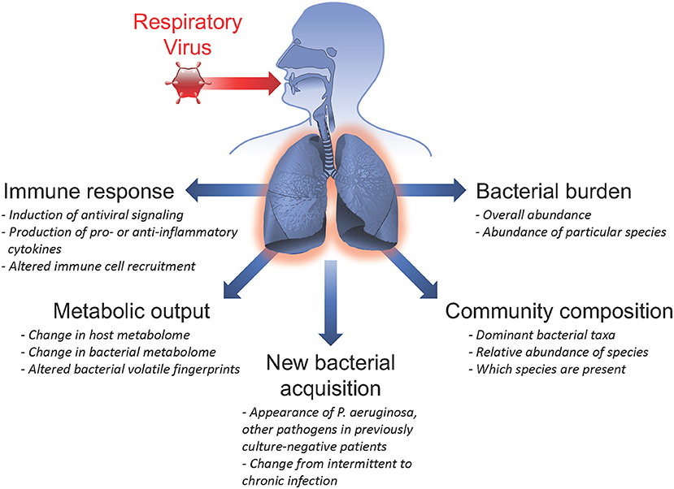
No Single Virus
Viruses don’t travel alone
HIV doesn’t cause AIDS because there is a multiplicity of interacting viruses all activating and spreading throughout the host
The answer always lies in host immune competence to interrupt viral spread and suppress viral activity
Be strong – Be prepared – this is the answer
The anti viral antidote is the potentiated human
This Photo by Unknown Author is licensed under CC BY-SA-NC
This Photo by Unknown Author is licensed under CC BY

Slide 30
Preparation to meet Covid 19, 20, 21 …
There is no prevention! There is only preparation for exposure to the virus for the entire population eventually
A vaccine is highly unlikely for a number of reasons (corona virus/ common cold cannot be vaccinated against according to world leading virologist who invented the vaccine for HPV and is thus nominated for the Nobel Prize, the quickest development of a vaccine in history took 4 years for the Measles vaccine, it will not create immunity against mutations of the virus, etc)
The immune system can meet Covid 19 and easily control exposure and spread and shorten symptomatology and contagiosity – Immune up-regulation is the answer to the pandemic

Slide 31
Opinions on Covid 19 -
This pandemic exposes the at risk population that is nutritionally deficient (Zn, D3, Quercitin etc) and biochemically imbalanced (immune compromised) according to Kerry Bone
The only people who complicate with viral exposure are those who receive only palliative care to suppress the symptoms and allow the virus to further penetrate and infect the body (suppressing fever/inflammatory complement system is contra-indicated) according to Stuart White

Slide 32
Ivermectin outcomes are obvious -
The massive drop in cases and deaths in India to almost nothing after the addition of Ivermectin proved the drug's effectiveness. This is a truth that the NIH, CDC, and FDA cannot allow because it would endanger the vaccine policy. Never mind that Ivermectin would save more lives with much less risk, much less cost, and it would end the pandemic quickly.
Uttar Pradesh is a state in India that contains 241 million people. The United States’ population is 331 million people. Therefore, Uttar Pradesh can be compared to the United States, with 2/3 of our population size.
This data shows how Ivermectin knocked their COVID-19 cases and deaths - which we know were Delta Variant - down to almost zero within weeks. A population comparable to the US went from about 35,000 cases and 350 deaths per day to nearly ZERO within weeks of adding Ivermectin to their protocol.
By comparison, on August 5, here in the good ol’ USA, blessed with the glorious vaccines, we have 127,108 new cases per day and 574 new deaths.
Let us look at the August 5 numbers from Uttar Pradesh with 2/3 of our population. Uttar Pradesh, using Ivermectin, had a total of 26 new cases and exactly THREE deaths. The US without Ivermectin has precisely 4889 times as many daily cases and 191 times as many deaths as Uttar Pradesh with Ivermectin.
It is not even close. Countries do orders of magnitude better WITH Ivermectin. It might be comparable to the difference in travel between using an automobile versus a horse and buggy.

Slide 33
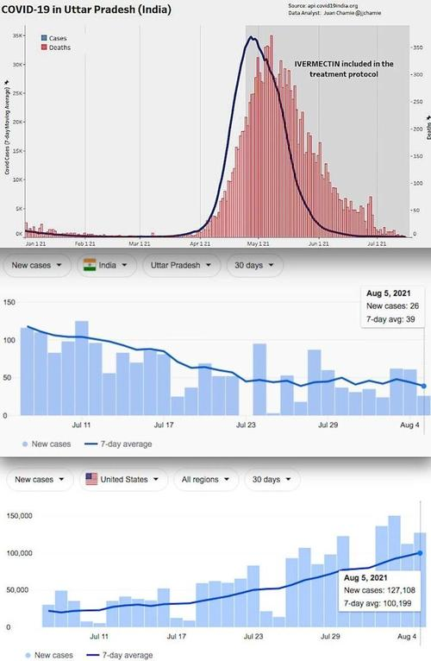
Ivermectin outcomes are obvious -
Uttar Pradesh on Ivermectin: Population 240 Million [4.9% fully vaccinated]
COVID Daily Cases: 26
COVID Daily Deaths: 3
The United States off Ivermectin: Population 331 Million [50.5% fully vaccinated]
COVID Daily Cases: 127,108
COVID Daily Deaths: 574
Let us look at other Ivermectin using areas of India with numbers from August 5, 2021, compiled by the JHU CSSE:
Delhi on Ivermectin: Population 31 Million [15% fully vaccinated]
COVID Daily Cases: 61
COVID Daily Deaths: 2
Uttarakhand on Ivermectin: Population 11.4 Million [15% fully vaccinated]
COVID Daily Cases: 24
COVID Daily Deaths: 0

Slide 34
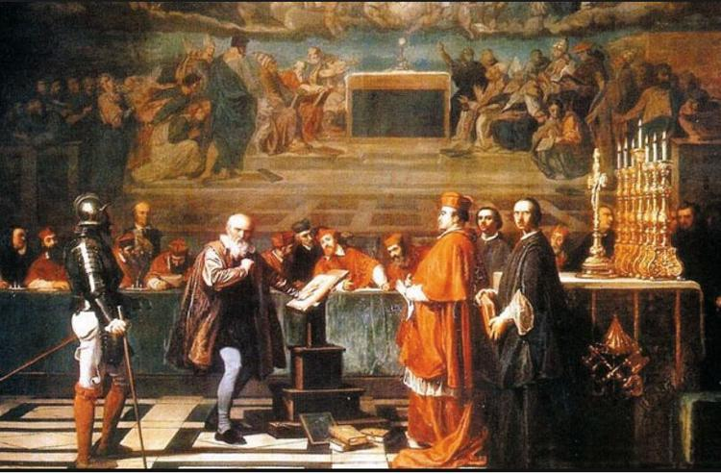
Ivermectin outcomes are obvious -
Now let us look at an area of India that rejected Ivermectin.
Tamil Nadu announced they would reject Ivermectin and instead follow the dubious USA-style guidance of using Remdesivir. Knowing this, you might expect their numbers to be closer to the US, with more cases and more deaths. You would be correct. Tamil Nadu went on to lead India in COVID-19 cases.
Tamil Nadu continues to suffer for its choice to reject Ivermectin. As a result, the Delta variant continues to ravage their citizens while it was virtually wiped out in the Ivermectin-using states. Likewise, in the United States, without Ivermectin, both the vaccinated and unvaccinated continue to spread the Delta variant like wildfire.
Tamil Nadu off Ivermectin: Population 78.8 Million [6.9% fully vaccinated]
COVID Daily Cases: 1,997
COVID Daily Deaths: 33
Heresy is disagreeing with the government, or their health authority, even if they are all wrong and even if their policies harm people. Today we no longer call it heresy; it is labeled as misinformation.
Galileo was found guilty of heresy and sentenced on June 22, 1633, to formal imprisonment, although this was commuted to house arrest, under which he remained for the rest of his life.

Slide 35
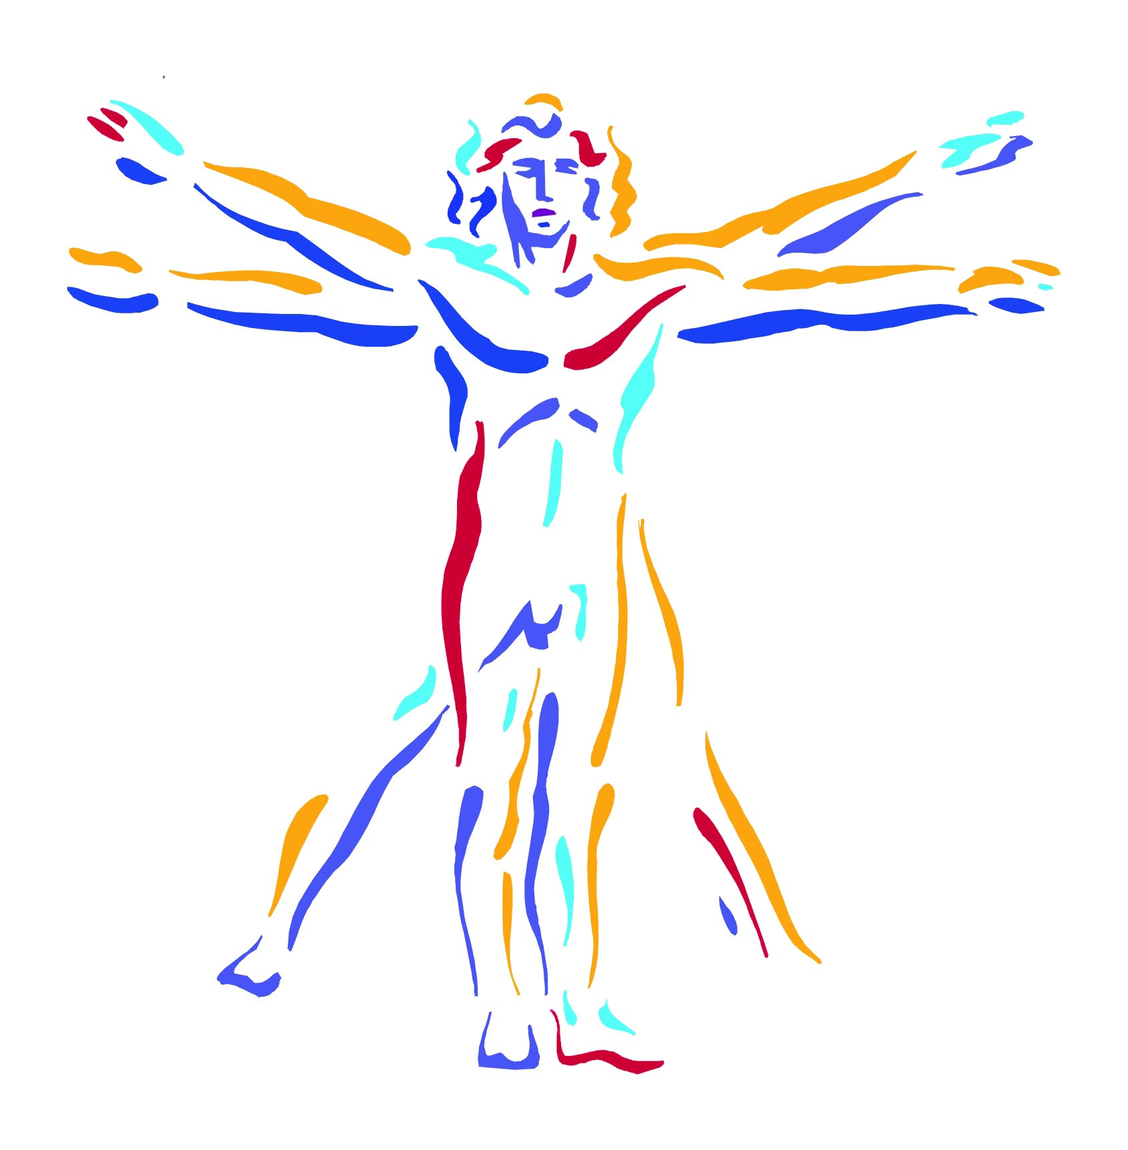
Change the world
It always wants to

