Slide 1
Mentoring the Mentors
Stuart White, DC, DACBN, DABN
Synergy Holistic & Whole Health Assoc.
980/355-0842, 713/522-6336
stuartwhitewha@gmail.com
www.synergycharlotte.com & www.wholehealthassoc.com
www.doctorofthefuture.org

Slide 2
Mentor goals:
To declare what is possible and establish a commitment to that possibility
Address personal and professional barriers limiting the ability to serve
Evolution of vision/mission/ethics that drive success
Create immediate action steps to apply learning and growth
Construct the round table of applied trophologists

Slide 3
Mentoring the mentor:
Who are the mentors? – Practitioners
Who are we mentoring? – Patients and GAP
What’s the purpose? – Optimized life
How does it work? – Whatever you learn you teach someone else (anyone else)
Who’s is included? – Self selection, you pick yourself

Slide 4
Mentoring the mentor:
Each participant attends monthly teleconferences (1 hour in duration, 3rd Wednesday of every 2nd month) creating a round table discussion/exploration of the dynamics and details of a nutrition-based holistic practice
Each participant chooses how to convey the notes and information to their world and community – no information squandering

Slide 5
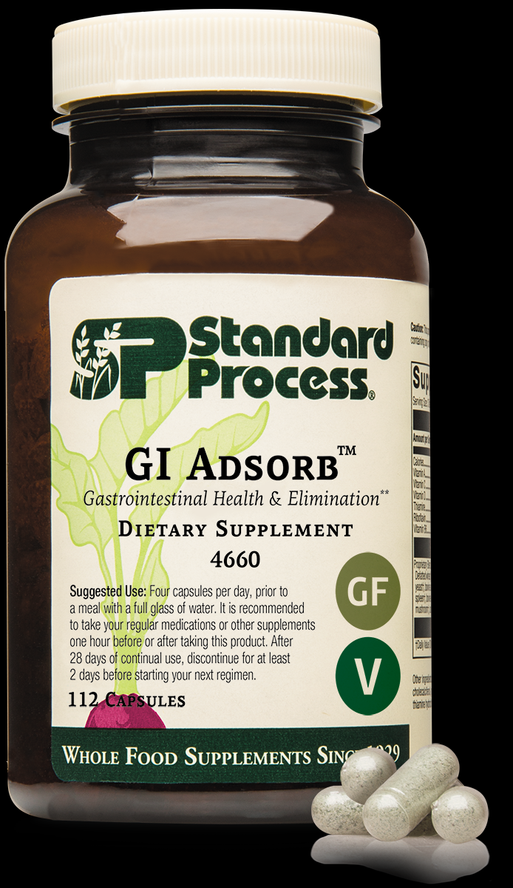
GI Adsorb –binding and eliminating:
New kid in the block
Brand new capabilities clinically
Clarity of mind
Relaxation
Gut repair and renewal
Reduction of chronic toxicity and burdens we have become accustomed to

Slide 6
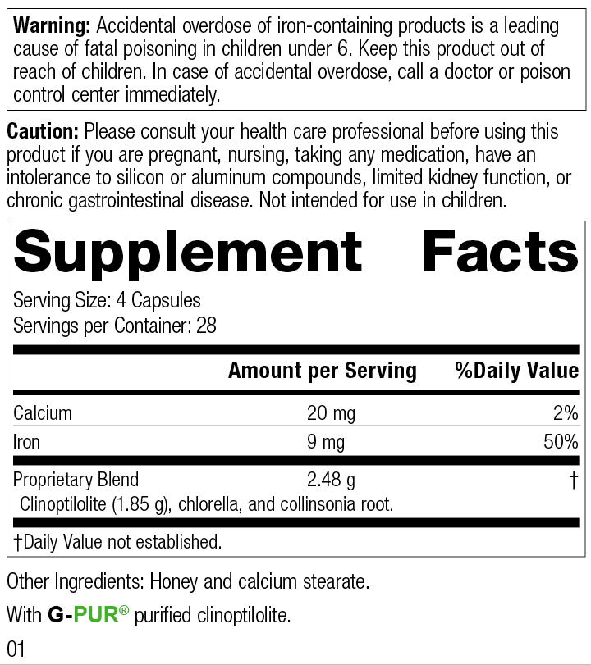
GI Adsorb
GI Adsorb is a GI health supplement that contains clinoptilolite, an adsorbent zeolite mineral, and is formulated to support GI health and elimination.* It also:
Contains purified Clinoptilolite (G-PUR®) — a mineral that has adsorbent properties towards naturally occurring toxins*
Contains Collinsonia Root, which has been historically used to support normal elimination and digestive health*
Helps support a healthy gut barrier*
Helps with the body's removal of naturally occurring toxins by supporting a healthy GI barrier and normal elimination*

Slide 7
GI Adsorb – SP Tells it straight
GI Adsorb provides important elimination support
The elements that go into the body — nutrients, vitamins, and minerals — are most commonly thought of as the substances that help the various systems operate at their best. However, elements that can help eliminate substances from the body are also greatly important. GI health and toxin removal play important roles, and are essential for helping people achieve optimal wellness. That’s why GI Adsorb from Standard Process is formulated to support GI health and normal elimination.*
What is G-PUR®?
GI Adsorb contains G-PUR®, a purified, high-quality zeolite/clinoptilolite mineral that ensures a strong adsorbent property. Zeolites, which come from volcanic ash that has been weathered in marine environments for millions of years, have been used in a variety of applications — most commonly for water purification.
What is adsorption, and why is it important for toxin removal?
Adsorbents (not to be confused with absorbent) are materials capable of trapping certain substances to their surface or within pores, shielding them from interactions in a biological or chemical system.1
Adsorption differs from absorption on one key way: the way molecules are removed. In adsorption, molecules from a toxin are held loosely on the surface of the adsorbent and can be easily removed without entering the adsorbent.
What are the benefits of clinoptilolite?
Adsorbent compounds, including the G-PUR® clinoptilolite found in GI Adsorb, have been investigated in cell studies, animal models, and clinical trials for their ability to support the GI system as it faces stressed conditions.2-7 Clinoptilolite is a zeolite mineral. Its molecules trap naturally occurring toxins on their surfaces to remove them through normal elimination.

Slide 8
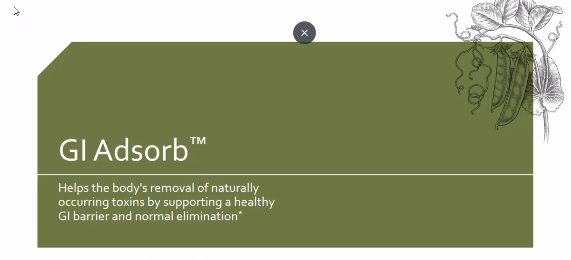
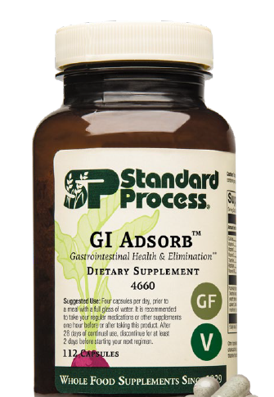
Notes:
Gi Adsorb was released last month and I know many practitioners have started to integrate GI Adsorb into their practices
GI Adsorb is the replacement for Cholacol II, as many of you know because of issues with Bentonite clay we haven’t had Cholacol II for several years.
As good as Choloacol II was, I believe GI Adsorb will be better and more diverse in its uses.
Cholacol II was a short-term product used typically for a week or two, it had limited range of what it was used for and in some cases could cause bloating or stomach cramps
2. The dosage of Cholacol II was very high at 12 per day on an empty stomach, which many patients found it hard to comply with.
Lets’ talk about what makes GI Adsorb such a special product…

Slide 9
Notes:
Standard Process has been on the search and testing many types of products for several years and finally secured an sourced a specific ingredient that met the standards and quality we demand and with research to back it.
You can see at the bottom of this slide some of the other ingredients we considered and tested. These included Activated Charcoal, Diatomaceous Earth, Humic/Fulvic acid, and other sources of Bentonite Clay, all of which had limited scope of efficacy and other issues associated with them.
Clinoptilolite is also stable at different pH’s and is exceptionally pure, making it superior to other similar products in the market containing bentonite clay or charcoal.
Clinoptilolite a specific form of Zeolite rose to the top with all the areas it supports
Zeolites/ Clinoptilolite were first used for water purification and has stood the test of time for its adsorbent qualities and beyond.
Let’s break it down a bit further on the next slide

Slide 10
Notes:
Zeolites are microscopic, porous minerals that cluster to form larger aggregates with small individual cavities, they are naturally occurring adsorbent substances. The type of natural zeolite, SP uses is in GI Adsorb is clinoptilolite, which is specific to human health, It includes an ion exchange as well as surface adsorption capacity.
Clinoptilolite is an “adsorbent” a substance that is capable of trapping certain substances to its surface or exchange within its pores.
Here’s a simple example between and absorbent and a adsorbent:
The difference between an “absorbent,” which traps substances by allowing them to permeate its structure uniformly a paper towel absorbs liquid it brings the substance into it.
An adsorbent like piece of notebook paper doesn’t actually draw water in like a paper towel

Slide 11
Notes:
Gi Adsorb has a patented G-Pur Clinoptilolite which we source from a company called G-Science. This specific Clinoptilolite in studies has shown its ability to support the gut barrier and shield the GI tract from many different types of toxins entering the GI tract.
In one 12-week double blind placebo trial using 1.85 grams of clinoptilolite showed significant improvement in GI integrity compared to placebo in keeping out and eliminating toxins including C-Diff.
They used the Zonulin test, which measures a family of zonulin proteins in the stool) when elevated, indicates the breakdown of tight junctions between intestinal epithelial cells. Again, Clinoptilolite showed a significant decrease in Zonulin levels.
Figure 1: shows the structure of tight junction proteins between cells was retained
Figure 2: shows the barrier strength of the cell monolayer

Slide 12
Notes:
Another component of GI Adsorb is Cracked wall Chlorella it provides a good source of chlorophyll but probably best known for its detoxifying effects. The World Health Organization did a study showing chlorella pulls dioxin levels down and improves cholesterol levels and blood sugar levels as well as stimulating the immune system
Chlorella in general is powerful sources of nutrition, including macronutrients, micronutrients, and phytonutrients – a triple threat. Chlorella has a variety of health benefits for humans, including its adsorbent activity.
Chlorella has been studied for its ability to support detoxification. A 2015 study showed its ability to detoxify the body of carcinogenic chemicals – like heterocyclic amines (HCAs) which are carcinogenic and formed when beef, pork or fish are cooked at high temperatures especially pan-fried foods
Also polycyclic aromatic hydrocarbons (PAHs) these chemicals are from gasoline engines, tobacco smoke, burning wood-coal, garbage etc. They form small particles in the air that can affect the nervous system, immune system and beyond

Slide 13
Notes:
COLLINSONIA ROOT - it maintains proper tone in the vascular system. Magnesium phosphate is an active factor which gives it this function. Collinsonia primarily has been used to prevent the formation of hemorrhoids and varicose veins, or to assist in their removal if they have already formed.
This product is made from the rock-hard root of the plant, ground up fine and put into capsules. Remember that in conditions of varicose veins and hemorrhoids, the patient often has a congested liver.

Slide 15
Notes:
Clinoptilolite is a specific patented form of zeolite. It is an ancient volcanic ash mineral with honeycomb shaped pores. The unique purified form of zeolite used in GI AdsorbTM has positively charged calcium ions in each honeycomb shaped pore. This allows the product to detoxify metals and microbes and restore overall gut health,
Three main mechanisms of action:
1. Adsorbing – Molecules that have an affinity for the charged calcium become bound and trapped in the honeycomb structures - this includes heavy metals such as lead, mercury, cadmium, and nickel.
2. Binding – Microbes that are small enough to fit in the pores are trapped and held inside to safely pass through the body (these include mycotoxins and bacterial exotoxins).
3. Agglomoration – The clinoptilolite minerals will surround substance and bind together to form an agglomerate shell, safely removing it from the body.
PB-Lead
Cd-Cadmium
Cu-Copper
Co-Cobalt
Hg- Mercury
Ni-Nickel

Slide 16
Notes:
Clinoptilolite’s adsorbent properties make it critical for the elimination of mycotoxins, includes aflatoxins which are caused by molds found on many foods – nuts can be high in aflatoxins
Exotoxins are secreted by bacteria can be eliminated with clinoptilolite as well as
ammonia, cholesterol, and harmful heavy metals, such as lead, cadmium, silver, and mercury. Mycotoxins are secondary metabolites produced by microscopic fungi, and they are associated with negative health outcomes in humans
Clinoptilolite promotes regular bowel movements by support the GI lining under stress conditions, it counteracts GI barrier damage, and enhances mucosal barrier protection and repair.
GI Adsorb is effective for toxin removal, helping the body’s natural detoxification process remove toxins and keep the body in homeostasis

Slide 17
Dosage: 4 Capsules per day all at once with a full glass of water
Four capsules per day, prior to a meal with a full glass of water. It is recommended to take your regular medications or other supplements one hour before or after taking this product. After 28 days of continual use, discontinue for at least 2 days before starting your next regimen.
Considerations for Standard Process GI AdsorbTM
Heavy metal removal • Mycotoxin removal
Bacterial exotoxin removal • Leaky gut
Alleviates intestinal breakdown • Microbial dysbiosis
Travel • Metabolic detoxification
Contaminated food or water • Normal elimination
IBS symptoms / diarrhea

Slide 18
Notes:
Zonulin is a test to look at a specific proteins when increased represents increased GI toxicity because of its ability to open tight junctions of the intestinal lining
Lac-tu-lose mannitol test – A urine test to check leaky gut syndrome by seeing how much sugar leaks through the gut lining
A1-antitrypsin – Is a protein produced by the liver it circulates in the blood, high levels in the stool can signify gut barrier disruption

Slide 19
Dosing Instructions for GI Adsorb

Slide 20
Powerful Combinations
GI Tract Health combine with GI StabilityTM or Okra Pepsin E3
Travel combine with Zypan® and/or Zymex®
Detoxification combine with the 21-Day Purification Program/10-Day
Programs/SP Detox Balance™ or ChelaCo
Liver Support combine with Spanish Black Radish or LivCo®
Fat Digestion combine with Cholacol® and/or Betafood®

Slide 21
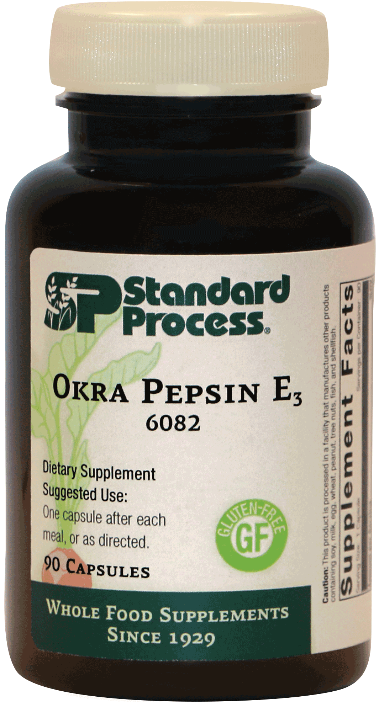
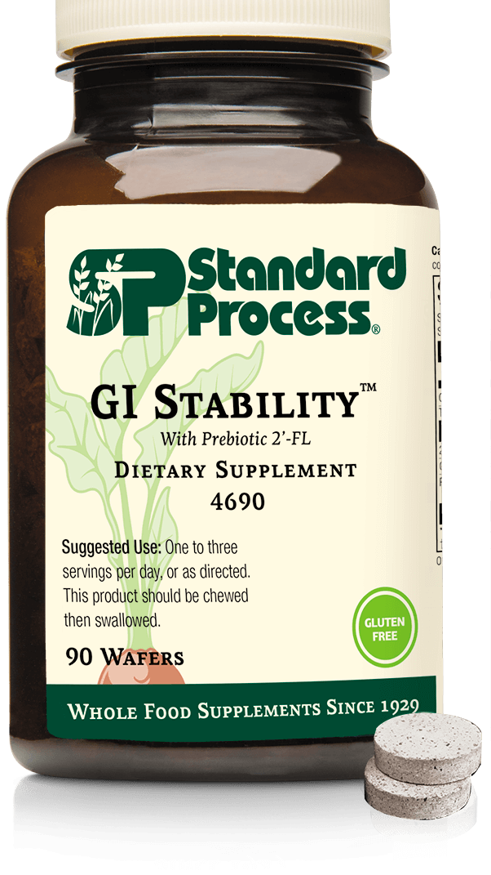
Combine GI Adsorb with GI Stability and Okra Pepsin
GI Tract Health
Notes:
One of the main issues of course with leaky gut is hyperpermeability of the GI tract due to compounds or toxins that cross the GI barrier because of a weakened and damaged mucosal lining
GI Stability with the 2-FL’ the prebiotic carbohydrate that is chemically identical to human milk oligosaccharides has shown to benefit the lower GI, where only a few Bifidobacterium strains can metabolize it to enhance microbiome function. 2’-FL has shown to positively support the proper functioning of the GI barriers, also, by decreasing immune activation and inflammation.
2’-FL as a Decoy
2’-FL also acting as a decoy in the gut. Microbial invaders make their way to the lower GI where they adhere to surface sugars that line our GI tract, here they colonize and create biological toxins, which in turn leads to dysbiosis, inflammation, and gut symptoms. 2’-FL has a similar structure to the surface sugars that line the GI tract, causing the microbial invaders to attach to the 2’-FL as opposed to our own GI tract, diverting the microbes away from healthy tissue and avoiding an inflammatory response.
Okra Pepsin E3 with its fiber and mucilage properties is soothing to the digestive tract, it has anti-adhesive properties that block H. Pylori colonization in the stomach and binds to bile acids allowing for excretion of cholesterol and toxic metabolites through the stool.
Okra is also high in key nutrients that help with inflammation, methylation, oxidative stress and blood sugar balance. Don’t forget the Pepsin in this product helps digest invaders that adhere GI tract and the E3 that helps to heal the GI tract.

Slide 22
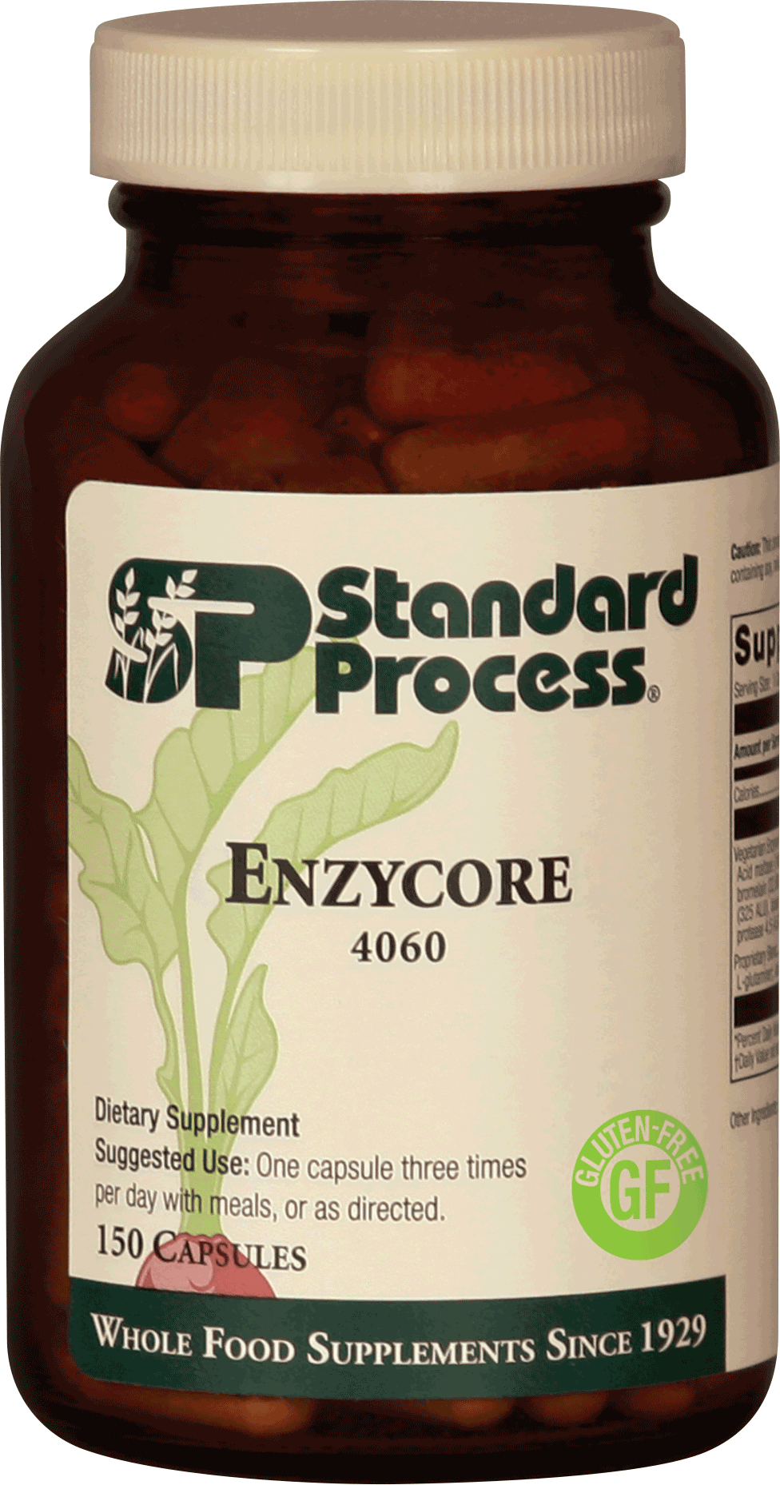
Combine GI Adsorb with Zypan and Enzycore
Travel

Slide 23
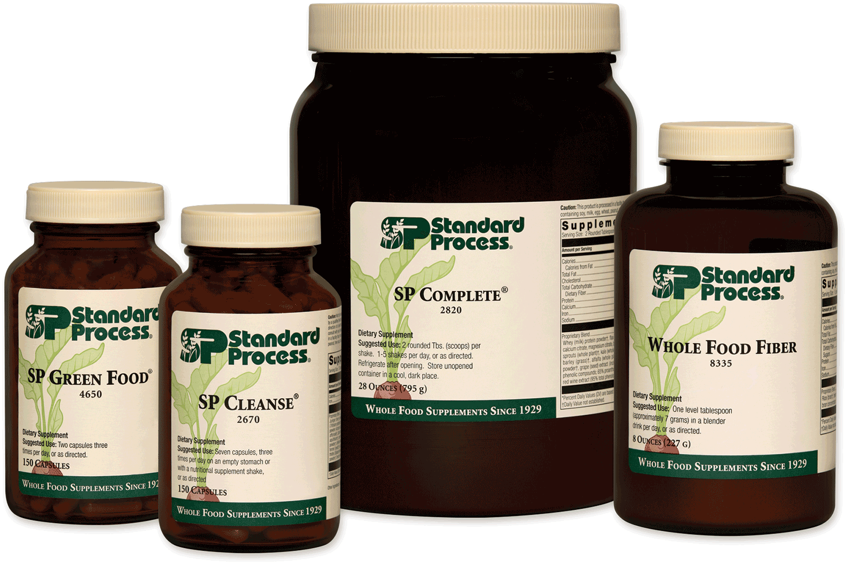
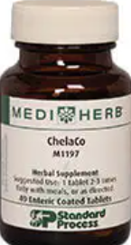
Combine GI Adsorb with the 21-Day Purification Program or the10-Day Programs Consider ChelaCo
Detoxification
&
Purification
Notes:
In 1989 the EPA estimated in 1 year almost
6 billion lbs of chemicals were either dumped into public sewage or released into
the ground, surface waters or air.

Slide 24
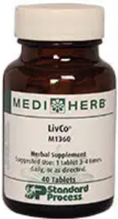
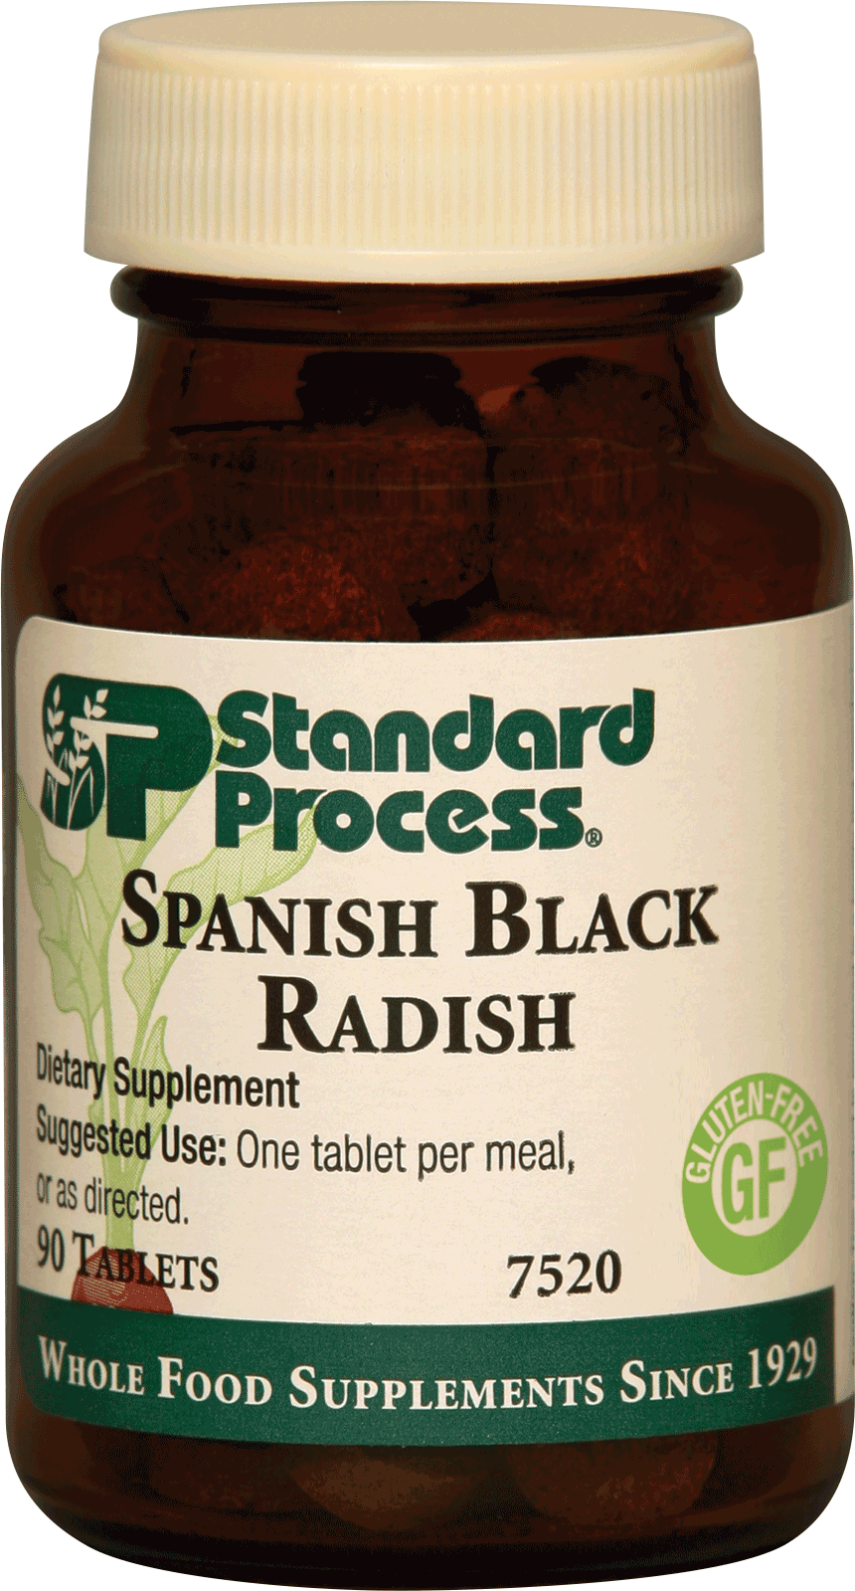
Combine GI Adsorb with Spanish Black Radish / LivCo®
Liver Support

Slide 25
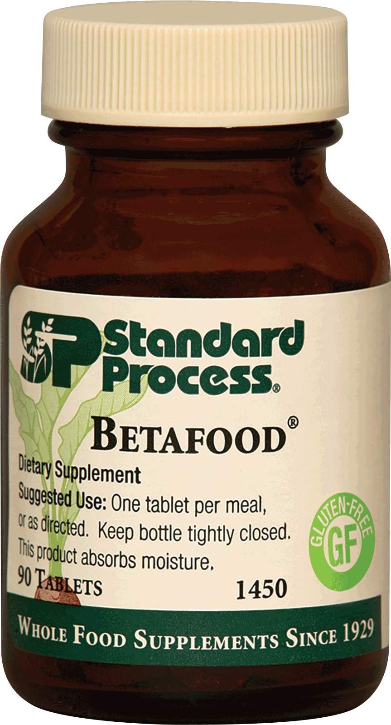
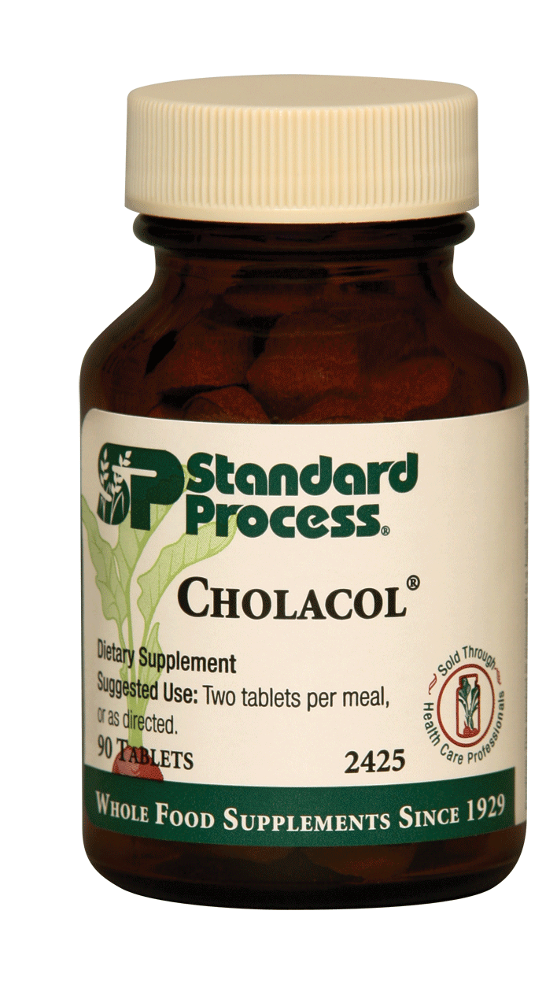
Combine GI AD Asorb with Cholacol® and Betafood®
Fat Digestion

Slide 26
Change the world
It always wants to

