Slide 1
Mentoring the Mentors
Stuart White, DC, DACBN, DABN
Synergy Holistic & Whole Health Assoc.
980/355-0842, 713/522-6336
stuartwhitewha@gmail.com
www.synergycharlotte.com & www.wholehealthassoc.com
www.doctorofthefuture.org

Slide 2
Mentor goals:
To declare what is possible and establish a commitment to that possibility
Address personal and professional barriers limiting the ability to serve
Evolution of vision/mission/ethics that drive success
Create immediate action steps to apply learning and growth
Construct the round table of applied trophologists

Slide 3
Mentoring the mentor:
Who are the mentors? – Practitioners
Who are we mentoring? – Patients and GAP
What’s the purpose? – Optimized life
How does it work? – Whatever you learn you teach someone else (anyone else)
Who’s is included? – Self selection, you pick yourself

Slide 4
Mentoring the mentor:
Each participant attends monthly teleconferences (1 hour in duration, 3rd Wednesday of every 2nd month) creating a round table discussion/exploration of the dynamics and details of a nutrition-based holistic practice
Each participant chooses how to convey the notes and information to their world and community – no information squandering

Slide 5
Hypothesis -
The only reason why anything that ever was working, stops working is because of infection

Slide 6
Mixed Infection Syndrome -
Virus
Fungus / Yeast
Parasite
Bacteria
Stealth
* Cavitated Infection – sequestered colonization typically near bone where less blood exchange occurs
* Latent Intracellular Conjugated Parasites
* DNA encoded hereditary infection

Slide 7
Infectious Personality Disorder -
Infection results in a direct invasion of the CNS across the single layer blood brain barrier (BBB)
Resultant CNS cell death (apoptosis) and neuro-inflammation
Infection directly creates immune activation and inflammatory response, GI microbiome alteration, HPA modulation and dysfunction altering hormonal expression and ability to maintain homeostasis
Each of the above contribute cumulatively to Mood Disorder

Slide 8
Mood Disorder from Infection -
Mood Disorders are the fastest increasing epidemic in the US
The NIH estimates that 20% of American adults deal with a mood disorder and one in six take psychiatric medication
Mood Disorders create personal and social burdens resulting in long and short term disability more than any other medical condition (JAMA. 1990; 264(19): 2524-2528)
Depression makes up 50% of total mood disorder
Compared to a decade ago (2005) the cost of mood disorder has risen by 21%

Slide 9
Infection and limbic depression -
Immune response to infection causes the symptoms that are described as “feeling sick” – malaise, fever, aching, catarrhal, etc
Most people feel depression/sadness during acute illness due to cytokine generated inflammatory response
Indeed often in the subclinical infection syndrome a depressed limbic (unhappy, morbid, non-playful, joyless) state is the first and most telling indication of an immune/infectious burden
We identify limbic depression and stress by interviewing and listening and respecting the stresses of life (financial, relationship, children, loneliness, etc) – and finding every person is either limbically depressed and burdened or they are limbically supported and modulated

Slide 10
Virus and Degeneration -
New research reveals the link between latent viral infection and degenerative events leading to diagnosis
Herpes Simplex Virus (HSV) 1 has been implicated in amyloid beta plaque formation in the brain (Alzheimer’s)
Varicella Zoster Virus (VZV) showed three times more likely to develop dementia if infected by Herpes Zoster Opthalmicus (HZO) within 5 years (846 patients, mean age 62.2 years)
Mednick, S.A., Machon, R. A., Bonnett, D Adult schizophrenia following prenatal exposure to an influenza epidemic. Arch gen Psychiatry, 1988 45:189-192
Parboosing, R., Bao, Y., Shen L., et al. Gastro intestinal influenza and bipolar disorder in adult offspring, JAMA Psychiatry 2013; 70:677-685

Slide 11
Anti Stealth Infection Tools -
Anti Stealth Infection Food: coconut, garlic, fish (sardines, salmon, herring, mackerel), walnuts, flaxseed, canola oil, zinc, olive oil, citrus, onion, sunflower seeds, vitamin E,
Anti Stealth Infection Herbs: Elderberrry, echinacea, calendula, garlic, astragalus, cat’s claw, ginger, licorice, olive leaf, oregano, Chinese wormwood, myrrh, black cumin seed, St. John’s wort, goldenseal, berberine, medicinal mushrooms

Slide 12
Primary Inflammatory Foods
There are 14 primary inflammatory foods:
To reduce these for five days is to dramatically reduce the inflammatory amplitude systemically – remarkable changes seen in 1-2 days – then re-introduction protocol can determine the actual offending food(s)
Milk
Corn
Gluten
Soy
Peanuts
Beef
Tomato
Chocolate
Rice
Nuts
Sesame
Peas
Eggs
Sugar

Slide 13
Immunosenescence
Immune aging – described as a loss of immune reserve and a loss of immune discretion at the same time.
Some immune features decline while others increase (antibody production and inflammatory upregulation).
These changes increase susceptibility to infectious disease, poor immunization response, cancers, autoimmune dysregulation.
Increased inflammation is called ‘inflamaging’.
Factors determining rate of immune decline:
- High cortisol to DHEA ratio
- HGH reduction
- Thyroid decline
- Antioxidant depletion
- Immune burdening
- Stress
- Sleep loss of quality/quantity
- Diet (Elevated HgA1C)
- Exercise reduction

Slide 14
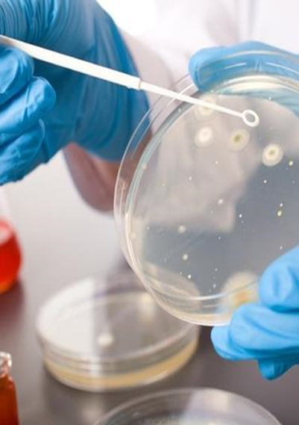
Defining Stealth Pathogens

Slide 15
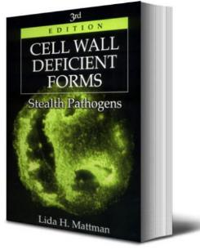
Stealth Pathogens
Possible first reference to the term ‘stealth pathogens’ was by Radolf in 1994¹
“...The syphilis and Lyme-disease spirochetes... persist in their hosts and have strategies for immune evasion...”
However, probably mainly popularized by the late Lida Mattman in her book of that subtitle, first published in 1974²
1. Radolf JD. Trends Microbiol 1994; 2(9): 307-311
2. Mattman LH. Cell Wall Deficient Forms: Stealth Pathogens 3rd edn 2000; CRC Press, Boca Raton
Notes:
But Mattman only used the terms as a subtitle in later editions

Slide 16
What are Stealth Pathogens?
Strict Mattman definition: cell-wall-deficient forms of bacteria (L forms or mollicutes) that can infect intracellularly
Includes Borrelia and other spirochetes, Proteus, Rickettsia, Mycobacteria, Chlamydophila, Helicobacter, Streptococcus and Bartonella
But now other organisms are (rightly) mentioned in this context
Mattman LH. Cell Wall Deficient Forms: Stealth Pathogens 3rd edn 2000; CRC Press, Boca Raton
Astrauskiene D, Bernotiene E. New insights into bacterial persistence in reactive arthritis Clin Exp Rheumatol 2007; 25(3): 470-479
Notes:
Mattman and Radolf were quite specific that stealth pathogens are bacteria and related organisms that can adopt cell-wall deficient forms L-forms, named after the Lister Institute where they were first isolated in 1935, which can infect intracellularly. They especially take up residence in phagocytic cells-ie the immune system itself.
They are also hard to kill since most antibiotics work by attacking the cell wall

Slide 17
Stealth Pathogens and Chronic Diseases
Includes autoimmune diseases, cancer, chronic fatigue syndrome (CFS), fibromyalgia syndrome (FMS), chronic Lyme and sarcoidosis
Can be due to adverse consequences of immune camouflage (molecular mimicry)
Or otherwise via secreted toxins, microbial waste products, host cell necrosis (danger signals) or by driving chronic inflammation
Notes:
So close to self cause an immune cross reaction to self.

Slide 18
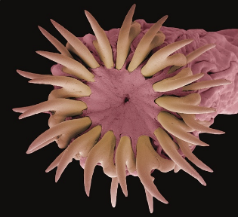
Stealth Pathogens: A Wider Landscape
Most pathogens employ stealth mechanisms
Helminths
Protozoa
Mycoplasma
Normal forms of bacteria
Even viruses
Notes:
… to evade or delay our immune response
Another definition is any pathogen helping to drive a chronic disease that the immune system finds difficult to eradicate because of their evasive defences - Gives a much longer list.
Means they can become hidden or undetected contributors to chronic disease.

Slide 19
The Original Stealth Pathogen
“Treponema pallidum, the syphilis spirochete: making a living as a stealth pathogen”
Has a poorly antigenic and non-inflammatory surface
New evidence that antigenic variation also contributes to its ability to evade host defenses
Silently destroys internal organs in its tertiary phase
Radolf JD, Deka RK, Anand A et al. Nat Rev Microbiol. 2016; 14(12): 744-759. PMID: 27721440
Radolf JD, Desrosiers DC. Mol Microbiol. 2009; 72(5): 1081-1086. PMID: 19432802
Notes:
From a pathogenesis standpoint, this emerging picture of a wily, adaptive adversary makes sense. The complex natural history of syphilis makes plain that the parasitic strategy of the spirochaete is ambitious. It is hard to imagine that the bacterium could implement such an agenda without invoking complex and versatile genetic programs to achieve antigenic variablilty.

Slide 20
Stealth Pathogens’ Strategies

Slide 21
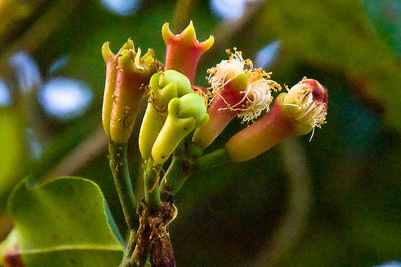
Additional Important Antiparasitic Herbs
Myrrh
Stemona
Wormwood
Cloves
Tannin herbs
Notes:
These will synergise with Aa

Slide 22
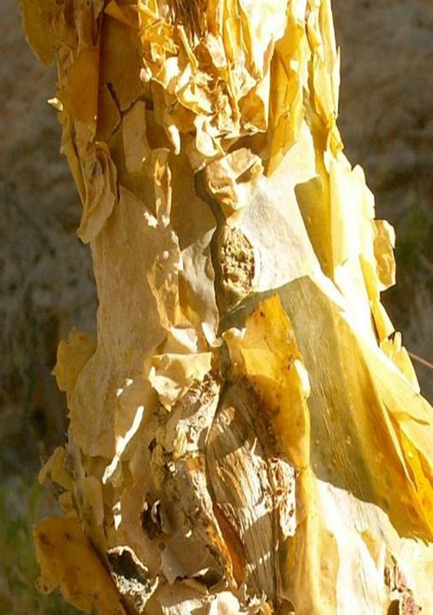
Myrrh Commiphora myrrha

Slide 23
Myrrh: A New Agent Against Stealth Pathogens
An oleo-gum resin from the stem of various species of Commiphora growing in north-east Africa and Arabia. Mentioned in Bible in writings as old as Psalms.
Several clinical studies published suggesting high-dose myrrh represents a significant advance in treatment of parasites.
Myrrh appears to be active against parasites that infest deeper into the body than the gut, such as the liver and bladder.
Bone KM, Mills SY. Principles and Practice of Phytotherapy: Modern Herbal Medicine. 2nd Edition, Elsevier, UK, 2013 pp 753-759
Notes:
Of course it is well known as one of the three gifts that the Magi brought to Jesus Christ.
4 What is particularly interesting is that ....

Slide 24
Myrrh: Active Constituents and Actions
Myrrh contains an essential oil (2 to 10%), largely sesquiterpenes
An alcohol-soluble resin (25 to 40%) containing commiphoric acids
Key actions: antimicrobial, antiparasitic, anti-inflammatory, vulnerary
Bone KM, Mills SY. Principles and Practice of Phytotherapy: Modern Herbal Medicine. 2nd Edition, Elsevier, UK, 2013 pp 753-759

Slide 25
Myrrh: How Does it Work?
Not entirely understood, but has a direct toxic effect.
May work at least in part by stimulating natural resistance and overcoming stealth defences.
Resin is probably the most important component for this.
Resin can stimulate a marked allergic reaction, highlighting its upregulation of immune responses.
Bone KM, Mills SY. Principles and Practice of Phytotherapy: Modern Herbal Medicine. 2nd Edition, Elsevier, UK, 2013 pp 753-759
Notes:
The mode of action of myrrh has not been established. Rather than exerting a direct antiparasitic effect, it could act by stimulating the patient’s natural immunity against parasites.
For example: An oral dose of myrrh extract (20 mg/day for 6 consecutive days) induced eradication of Fasciola gigantica worms in experimentally infected rabbits, with an associated increase in IgG production

Slide 26
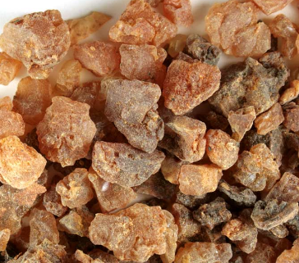
Myrrh: How Does it Work?
Trial of 35 patients with chronic fascioliasis treated with myrrh
IL-4 significantly lower than controls before therapy (p=0.04) and increased significantly after treatment (p<0.001) to reach control levels
Bone KM, Mills SY. Principles and Practice of Phytotherapy: Modern Herbal Medicine. 2nd Edition, Elsevier, UK, 2013 pp 753-759
Notes:
Suggests stealth helminth effects lower IL-4 and myrrh restores this aspect of the immune response. Ie parasite immune suppression

Slide 27
Myrrh: Clinical Trials
All the studies below are open-label studies, all oral doses
At least 6 positive trials for fascioliasis
Mixed results for schistosomiasis, but with several positive trials
Individual trials with positive results for lanceolate fluke, Heterophyes heterophyes flukes, dwarf tape worms and vaginal trichomoniasis
Bone KM, Mills SY. Principles and Practice of Phytotherapy: Modern Herbal Medicine. 2nd Edition, Elsevier, UK, 2013 pp 753-759
Notes:
However, it can be reasonably inferred that a marked placebo effect in parasitic infestation is unlikely and that a true therapeutic effect was observed for myrrh in the positive trials.

Slide 28
Myrrh: Dosage Considerations
Pulsed dosing as per the trials
3 to 9 consecutive days on an empty stomach
Break for 4 to 14 days and then repeat
Daily dose of myrrh used in the trials corresponds about 2 to 3 g of herb
Pulsed dosing reduces risk of allergic response and does not allow the stealth pathogen to adapt to the myrrh
Bone KM, Mills SY. Principles and Practice of Phytotherapy: Modern Herbal Medicine. 2nd Edition, Elsevier, UK, 2013 pp 753-759
Notes:
I believe myrrh is not just against parasites, but will be useful for any stealth pathogen. Can dose even higher with tablet.

Slide 29
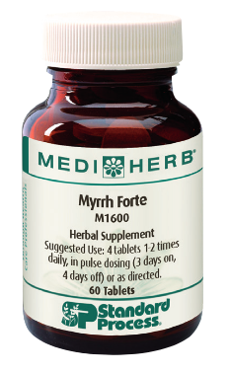
Myrrh
support healthy bowel function
support healthy digestion
support a healthy intestinal environment
support gastrointestinal health
support sinus and respiratory health*

Slide 30
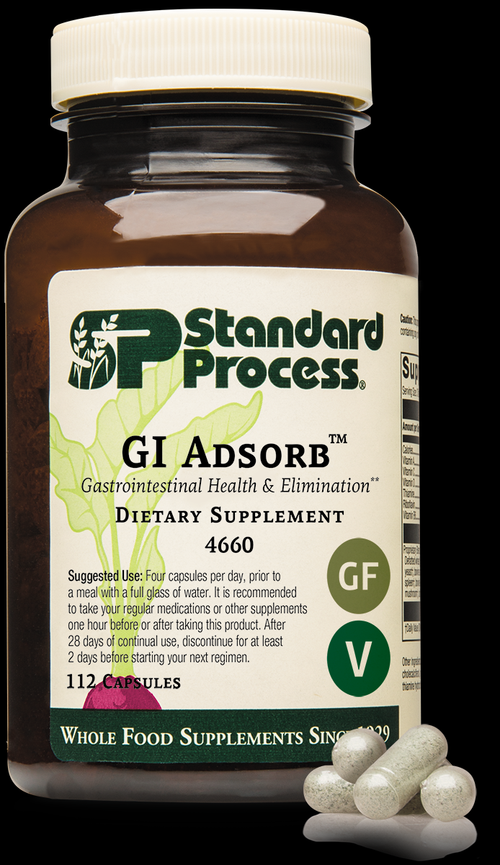
GI Adsorb –binding and eliminating:
New kid in the block
Brand new capabilities clinically
Clarity of mind
Relaxation
Gut repair and renewal
Reduction of chronic toxicity and burdens we have become accustomed to

Slide 31
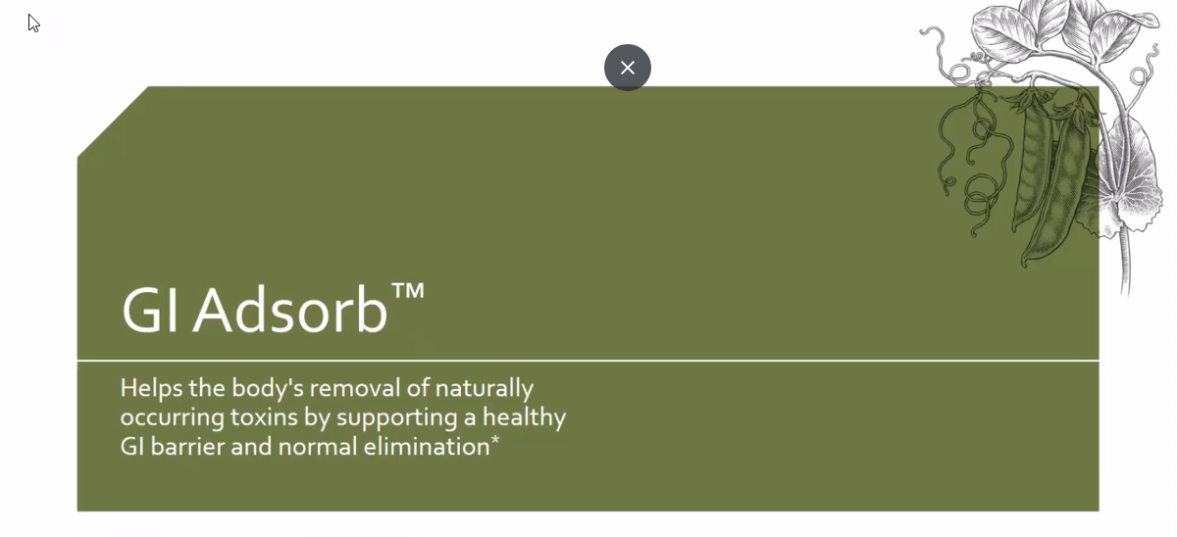
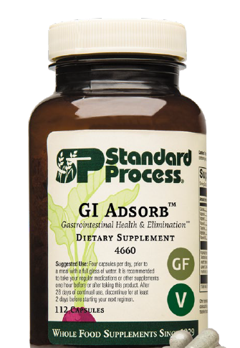
Notes:
Gi Adsorb was released last month and I know many practitioners have started to integrate GI Adsorb into their practices
GI Adsorb is the replacement for Cholacol II, as many of you know because of issues with Bentonite clay we haven’t had Cholacol II for several years.
As good as Choloacol II was, I believe GI Adsorb will be better and more diverse in its uses.
Cholacol II was a short-term product used typically for a week or two, it had limited range of what it was used for and in some cases could cause bloating or stomach cramps
2. The dosage of Cholacol II was very high at 12 per day on an empty stomach, which many patients found it hard to comply with.
Lets’ talk about what makes GI Adsorb such a special product…

Slide 32
Notes:
Zeolites are microscopic, porous minerals that cluster to form larger aggregates with small individual cavities, they are naturally occurring adsorbent substances. The type of natural zeolite, SP uses is in GI Adsorb is clinoptilolite, which is specific to human health, It includes an ion exchange as well as surface adsorption capacity.
Clinoptilolite is an “adsorbent” a substance that is capable of trapping certain substances to its surface or exchange within its pores.
Here’s a simple example between and absorbent and a adsorbent:
The difference between an “absorbent,” which traps substances by allowing them to permeate its structure uniformly a paper towel absorbs liquid it brings the substance into it.
An adsorbent like piece of notebook paper doesn’t actually draw water in like a paper towel

Slide 33
Notes:
Gi Adsorb has a patented G-Pur Clinoptilolite which we source from a company called G-Science. This specific Clinoptilolite in studies has shown its ability to support the gut barrier and shield the GI tract from many different types of toxins entering the GI tract.
In one 12-week double blind placebo trial using 1.85 grams of clinoptilolite showed significant improvement in GI integrity compared to placebo in keeping out and eliminating toxins including C-Diff.
They used the Zonulin test, which measures a family of zonulin proteins in the stool) when elevated, indicates the breakdown of tight junctions between intestinal epithelial cells. Again, Clinoptilolite showed a significant decrease in Zonulin levels.
Figure 1: shows the structure of tight junction proteins between cells was retained
Figure 2: shows the barrier strength of the cell monolayer

Slide 34
Notes:
Another component of GI Adsorb is Cracked wall Chlorella it provides a good source of chlorophyll but probably best known for its detoxifying effects. The World Health Organization did a study showing chlorella pulls dioxin levels down and improves cholesterol levels and blood sugar levels as well as stimulating the immune system
Chlorella in general is powerful sources of nutrition, including macronutrients, micronutrients, and phytonutrients – a triple threat. Chlorella has a variety of health benefits for humans, including its adsorbent activity.
Chlorella has been studied for its ability to support detoxification. A 2015 study showed its ability to detoxify the body of carcinogenic chemicals – like heterocyclic amines (HCAs) which are carcinogenic and formed when beef, pork or fish are cooked at high temperatures especially pan-fried foods
Also polycyclic aromatic hydrocarbons (PAHs) these chemicals are from gasoline engines, tobacco smoke, burning wood-coal, garbage etc. They form small particles in the air that can affect the nervous system, immune system and beyond

Slide 35
Notes:
COLLINSONIA ROOT - it maintains proper tone in the vascular system. Magnesium phosphate is an active factor which gives it this function. Collinsonia primarily has been used to prevent the formation of hemorrhoids and varicose veins, or to assist in their removal if they have already formed.
This product is made from the rock-hard root of the plant, ground up fine and put into capsules. Remember that in conditions of varicose veins and hemorrhoids, the patient often has a congested liver.

Slide 37
The Importance of Co-prescribing Immune Herbs
Stealth immune herbs:
Echinacea root
Astragalus
Eleuthero (viruses mainly)
Andrographis (protozoa and helminths, mainly)
Notes:
Eleuthero and myrrh. Can use Andro for bacteria too.
Because the immune system accesses all parts of the body and the herbs need support to do their job well.

Slide 38
Selecting Key Combinations
Chronic viruses: Licorice, Thuja, St John’s Wort, Echinacea root, Astragalus, Eleuthero
Protozoa: Myrrh, A. annua, Phellodendron, Oregano oil, Andrographis, Garlic
Helminths: Myrrh, Wormwood, Stemona, Cloves, A. annua, Garlic, Andrographis
Bacteria: Myrrh, Phellodendron, Oregano oil, Garlic, Sage, Echinacea root, Astragalus
Fungi: Phellodendron, Oregano oil, Anise oil, Garlic, Echinacea root
Notes:
Synergistic prescribing is essential. Select from these, always choosing an immune herb, but keeping in mind myrrh is such.
Also note: countless studies show better activity of antibiotics and antifungal drugs when combined with such natural agents.

Slide 39
Focusing on Parasites
The Purge Parasite (AAAMG0 455) Protocol
First 4 days: the two Artemisias and Andrographis (all preferably in appropriate combination)
Next 5 days: Myrrh and Garlic
Final 5 days: no treatment
Repeat for 2 to 3 cycles and then assess
Drink high tannin herbal teas throughout, eg strong Peppermint or Green Tea
Notes:
Synergistic prescribing is essential. Select from these, always choosing an immune herb, but keeping in mind myrrh is such.
Also note: countless studies show better activity of antibiotics and antifungal drugs when combined with such natural agents.

Slide 40
Stealth Bioburden Protocol Example
Days 1 to 5
Days 5 to 10
Myrrh Resin bid
Artemisia annua bid
Sarsaparilla bid
Echinacea bid
St John’s Wort bid
Thuja bid
Licorice bid
For best results, 4 to 6 cycles recommended.
Base protocol can be adapted as per the needs of each patient and combined with Bowel Flora Protocol

Slide 41
In Addition for Chronic Lyme
For the depleted energy
Suggested combinations: Rhodiola and Korean Ginseng; or Rhodiola and Schisandra
Most suited to parasympathetic dominance or where the person is sleeping long hours; otherwise Ashwaganda
Rhodiola and Korean Ginseng best for instant energy and/or where there is low mood
Adrenal support is a must: Licorice and/or Rehmannia
Notes:
Also for boosting physical performance. Will improve both physical and cognitive performance to enable a person to get on top of things and provide energy.
R and G Can be stimulating, so Withania is preferred for the patient who is suffering insomnia. Good for healthy people for immediate energy when under stress, start with two tablets in the morning and work up, but watch out for combining with too much caffeine.

Slide 42
In Addition for Chronic Lyme
Treating for immune depletion is paramount: Astragalus, Echinacea and Eleuthero
Support the nervous system, sleep and cognition with Kava, Valerian, St John’s Wort, Saffron and others
Mange pain: Corydalis, California Poppy, Jamaican Dogwood, St John’s Wort, Willow Bark, Boswellia
Address neuroinflammation as a factor: neuropsychiatric Lyme disease

Slide 43
The Importance of Co-prescribing Immune Herbs
Stealth immune herbs:
Echinacea root
Astragalus
Eleuthero (viruses mainly)
Andrographis (protozoa and helminths, mainly)
Notes:
Eleuthero and myrrh. Can use Andro for bacteria too.
Because the immune system accesses all parts of the body and the herbs need support to do their job well.

Slide 44
Selecting Key Combinations
Chronic viruses: Licorice, Thuja, St John’s Wort, Echinacea root, Astragalus, Eleuthero
Protozoa: Myrrh, A. annua, Phellodendron, Oregano oil, Andrographis, Garlic
Helminths: Myrrh, Wormwood, Stemona, Cloves, A. annua, Garlic, Andrographis
Bacteria: Myrrh, Phellodendron, Oregano oil, Garlic, Sage, Echinacea root, Astragalus
Fungi: Phellodendron, Oregano oil, Anise oil, Garlic, Echinacea root
Notes:
Synergistic prescribing is essential. Select from these, always choosing an immune herb, but keeping in mind myrrh is such.
Also note: countless studies show better activity of antibiotics and antifungal drugs when combined with such natural agents.

Slide 45
Focusing on Parasites
The Purge Parasite (AAAMG0 455) Protocol
First 4 days: the two Artemisias and Andrographis (all preferably in appropriate combination)
Next 5 days: Myrrh and Garlic
Final 5 days: no treatment
Repeat for 2 to 3 cycles and then assess
Drink high tannin herbal teas throughout, eg strong Peppermint or Green Tea
Notes:
Synergistic prescribing is essential. Select from these, always choosing an immune herb, but keeping in mind myrrh is such.
Also note: countless studies show better activity of antibiotics and antifungal drugs when combined with such natural agents.

Slide 46
Stealth Bioburden Protocol Example
Days 1 to 5
Days 5 to 10
Myrrh Resin bid
Artemisia annua bid
Sarsaparilla bid
Echinacea bid
St John’s Wort bid
Thuja bid
Licorice bid
For best results, 4 to 6 cycles recommended.
Base protocol can be adapted as per the needs of each patient and combined with Bowel Flora Protocol

Slide 47
In Addition for Chronic Lyme
For the depleted energy
Suggested combinations: Rhodiola and Korean Ginseng; or Rhodiola and Schisandra
Most suited to parasympathetic dominance or where the person is sleeping long hours; otherwise Ashwaganda
Rhodiola and Korean Ginseng best for instant energy and/or where there is low mood
Adrenal support is a must: Licorice and/or Rehmannia
Notes:
Also for boosting physical performance. Will improve both physical and cognitive performance to enable a person to get on top of things and provide energy.
R and G Can be stimulating, so Withania is preferred for the patient who is suffering insomnia. Good for healthy people for immediate energy when under stress, start with two tablets in the morning and work up, but watch out for combining with too much caffeine.

Slide 48
In Addition for Chronic Lyme
Treating for immune depletion is paramount: Astragalus, Echinacea and Eleuthero
Support the nervous system, sleep and cognition with Kava, Valerian, St John’s Wort, Saffron and others
Mange pain: Corydalis, California Poppy, Jamaican Dogwood, St John’s Wort, Willow Bark, Boswellia
Address neuroinflammation as a factor: neuropsychiatric Lyme disease

Slide 49
Change the world
It always wants to

