Slide 1

Mentoring the Mentors
Stuart White, DC, DACBN, DABN
Synergy Holistic & Whole Health Assoc.
980/355-0842, 713/522-6336
stuartwhitewha@gmail.com
www.synergycharlotte.com & www.wholehealthassoc.com
www.doctorofthefuture.org

Slide 2
Mentor goals:
To declare what is possible and establish a commitment to that possibility
Address personal and professional barriers limiting the ability to serve
Evolution of vision/mission/ethics that drive success
Create immediate action steps to apply learning and growth
Construct the round table of applied trophologists

Slide 3
Mentoring the mentor:
Who are the mentors? – Practitioners
Who are we mentoring? – Patients and GAP
What’s the purpose? – Optimized life
How does it work? – Whatever you learn you teach someone else (anyone else)
Who’s is included? – Self selection, you pick yourself

Slide 4
Mentoring the mentor:
Each participant attends monthly teleconferences (1 hour in duration, 3rd Wednesday of every 2nd month) creating a round table discussion/exploration of the dynamics and details of a nutrition-based holistic practice
Each participant chooses how to convey the notes and information to their world and community – no information squandering

Slide 5

Hypothesis -
The only reason why anything that ever was working, stops working is because of infection

Slide 6
Mixed Infection Syndrome -
Virus
Fungus / Yeast
Parasite
Bacteria
Stealth
* Cavitated Infection – sequestered colonization typically near bone where less blood exchange occurs
* Latent Intracellular Conjugated Parasites
* DNA encoded hereditary infection

Slide 7
The greatest use of your time
Think New Thoughts

Slide 8
Truth & Understanding
Suffering is the origin of consciousness
Fyodor Dostoevsky

Slide 9
Choosing your own way
I didn’t choose to suffer
I chose to grow
The suffering was because of growth
It was worth it

Slide 10
Triage Theory by Bruce Ames
The Triage Theory describes that DNA damage and late onset disease are consequences of ‘triage’ allocation mechanisms developed in evolution to cope with periods of micro-nutrient shortages
In this observation he sees that rate limiting shortages cause certain events to be postponed to later activity in favor of immediate short term survival needs
Micronutrients, when scarce, are used for short-term survival at the expense of long-term survival
“The theory explains why diseases associated with aging like cancer, heart disease and dementia (and the pace of aging itself) may be unintended consequences developed during evolution to protect against episodic vitamin/mineral shortages”
The following white paper describes this in more detail

Slide 11
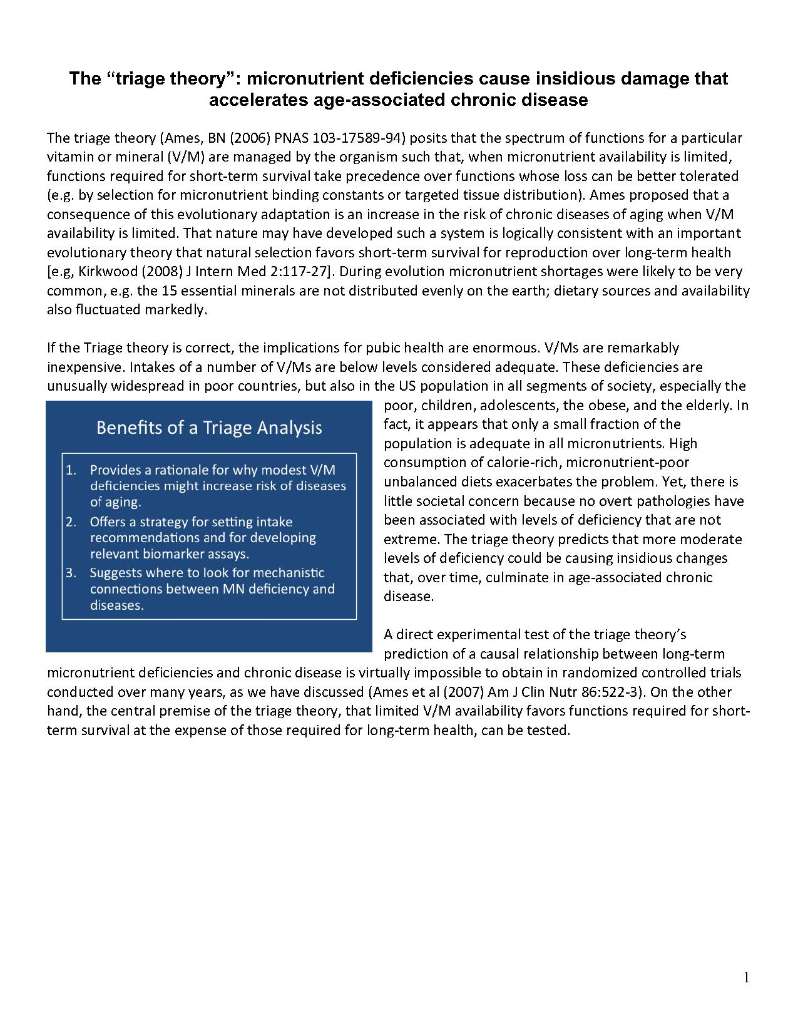
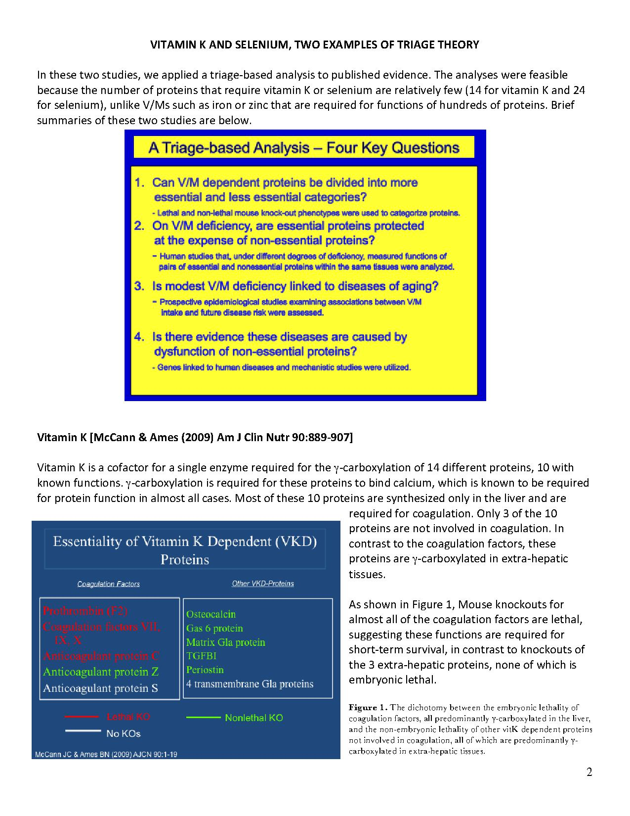
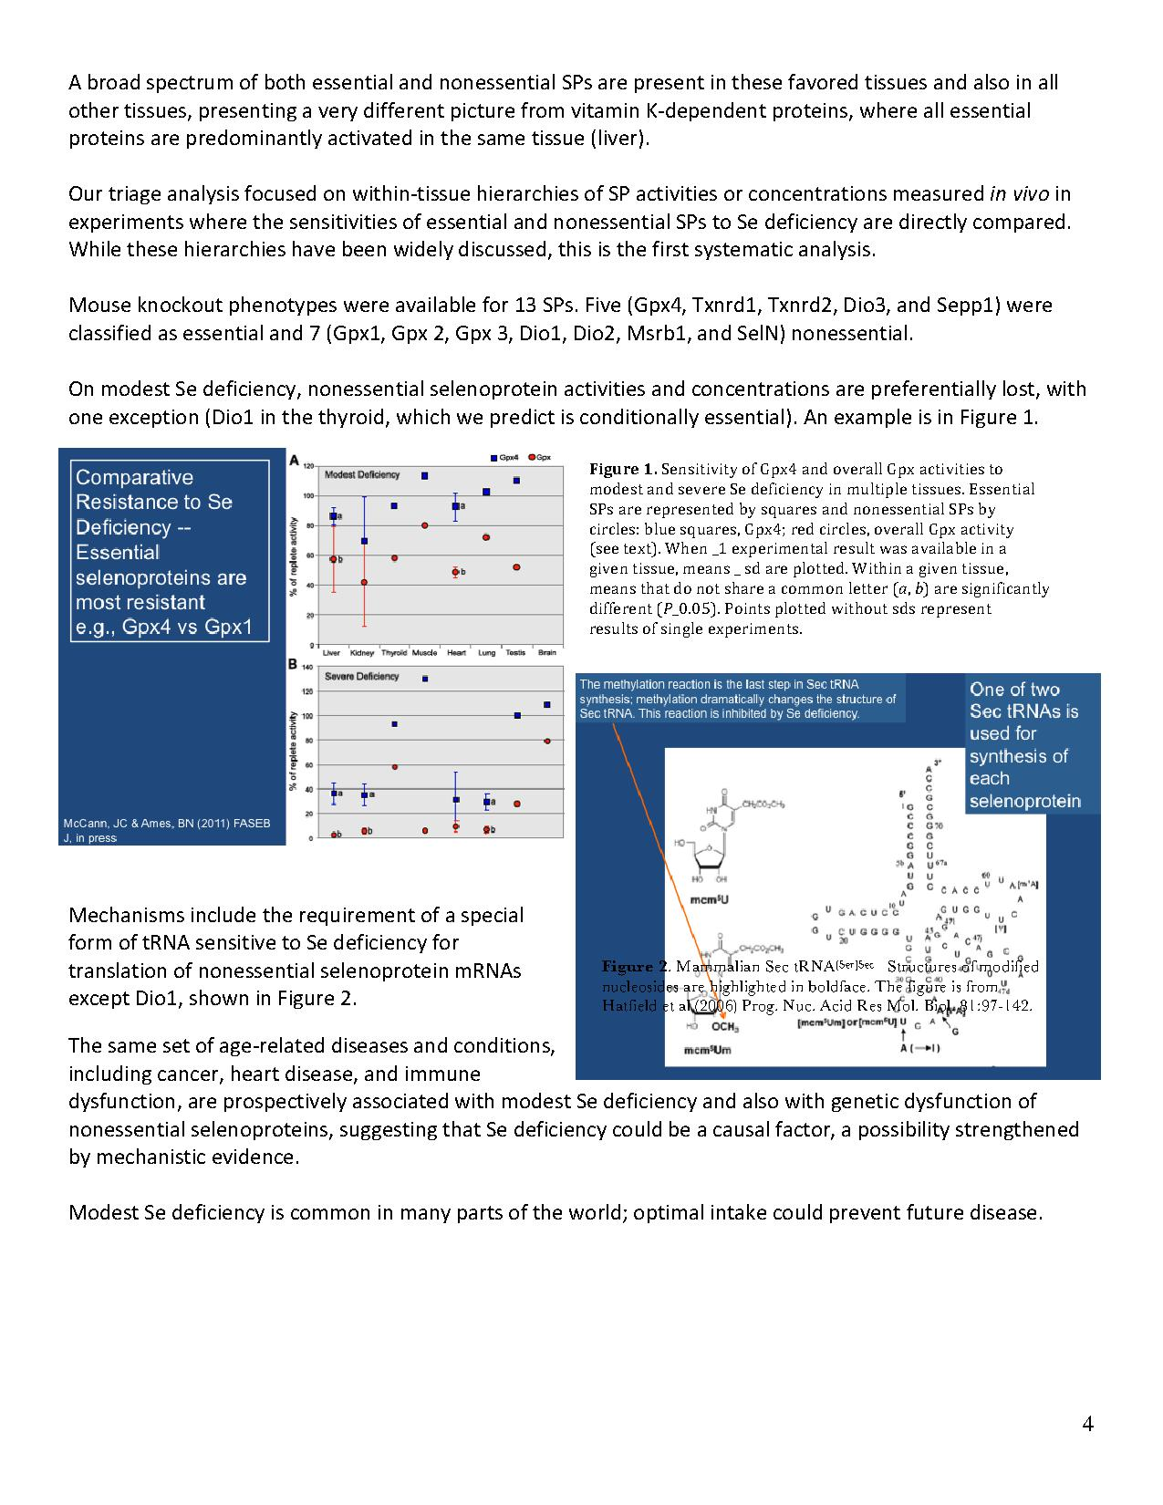
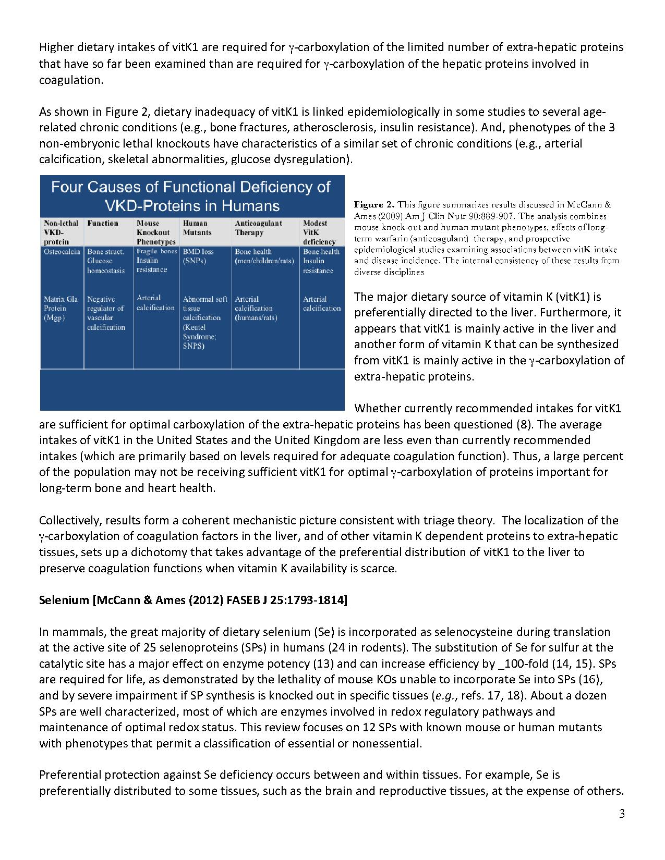
Triage Theory by Bruce Ames

Slide 12
Autoimmune
Of the almost 3,000 named autoimmune diseases many of them will present on a weekly basis and you will miss the opportunity to assist them if the practitioner is not ready with a nutritional strategy
There is nothing more sequential than autoimmune support as you gradually coax the body out of its inflammatory response and into remission

Slide 13
Eternal Truth
If you build it
they will come

Slide 14
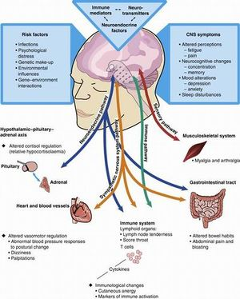
Autoimmunity
What is the paradigm?
And how does it direct intervention?

Slide 15
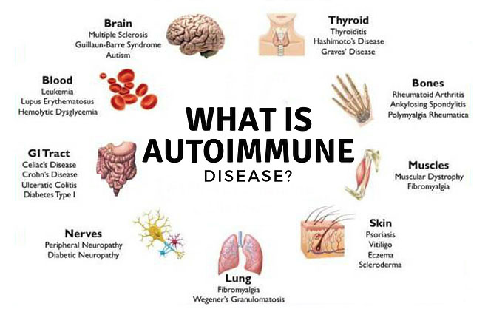

Slide 16
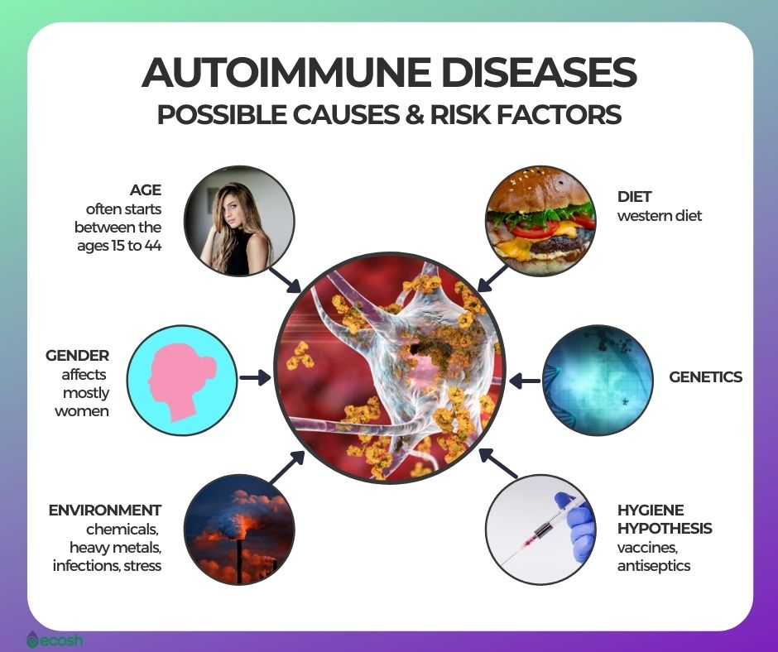

Slide 17
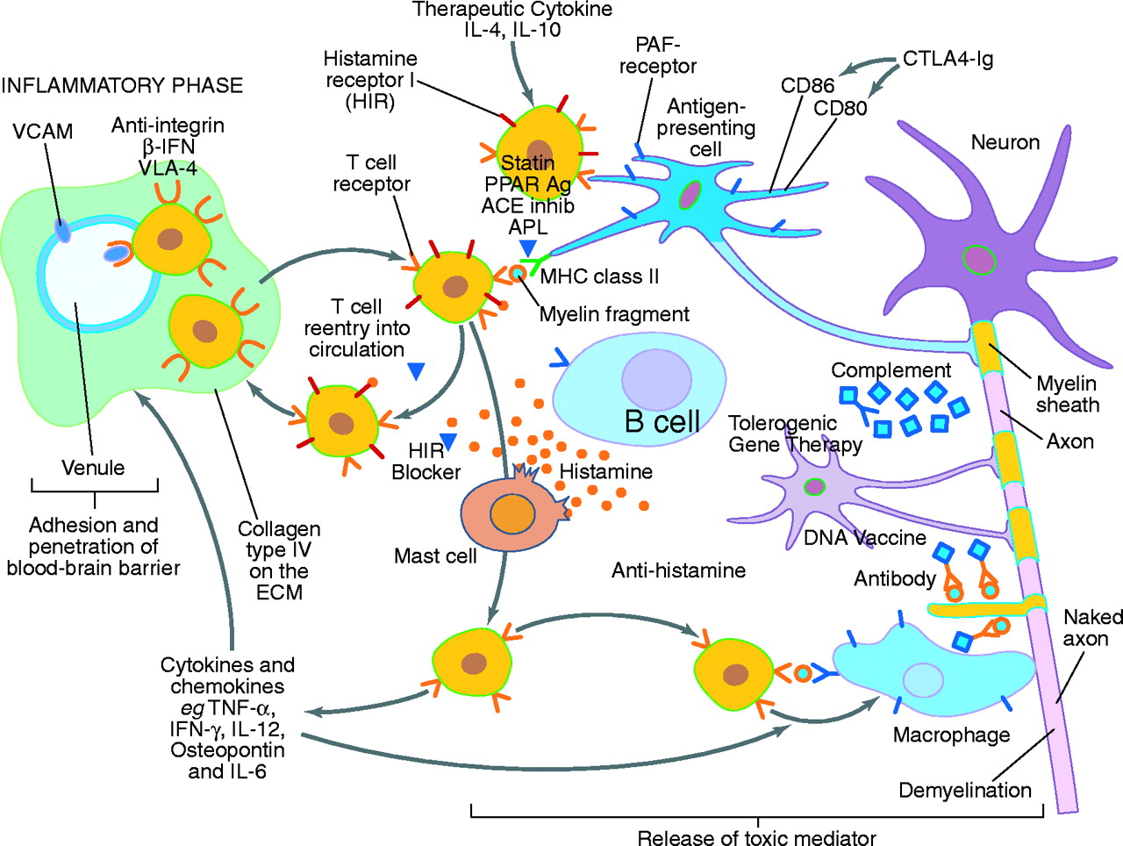

Slide 18
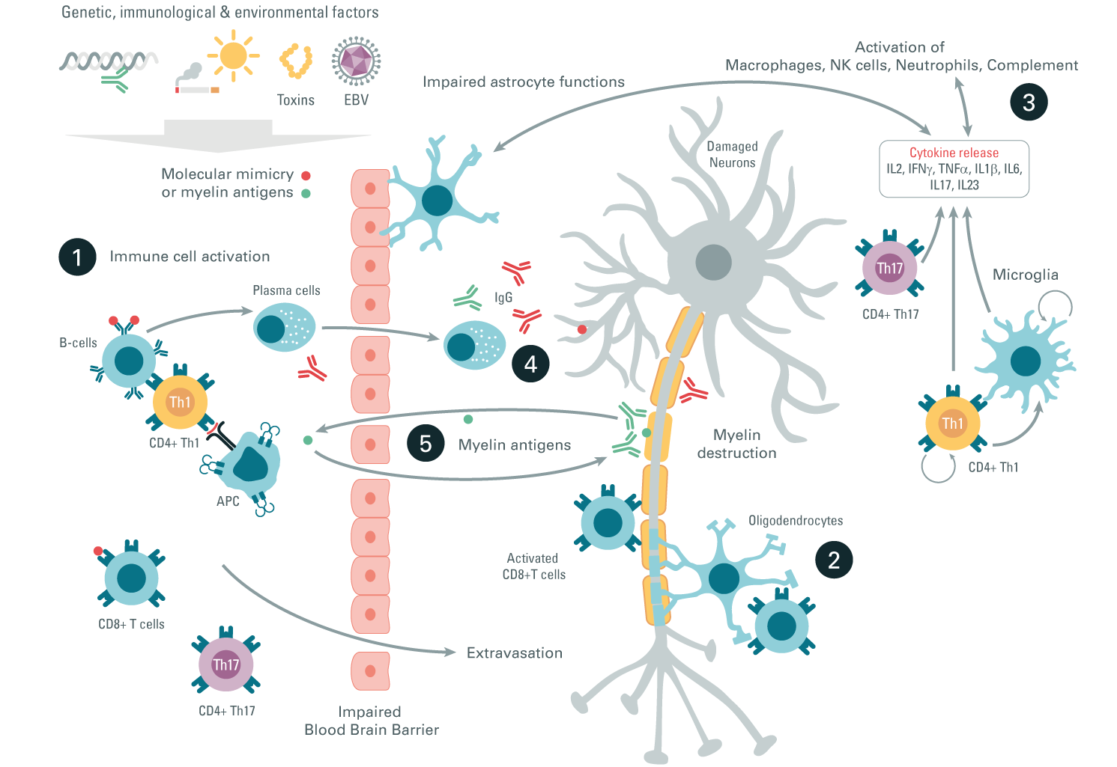

Slide 19
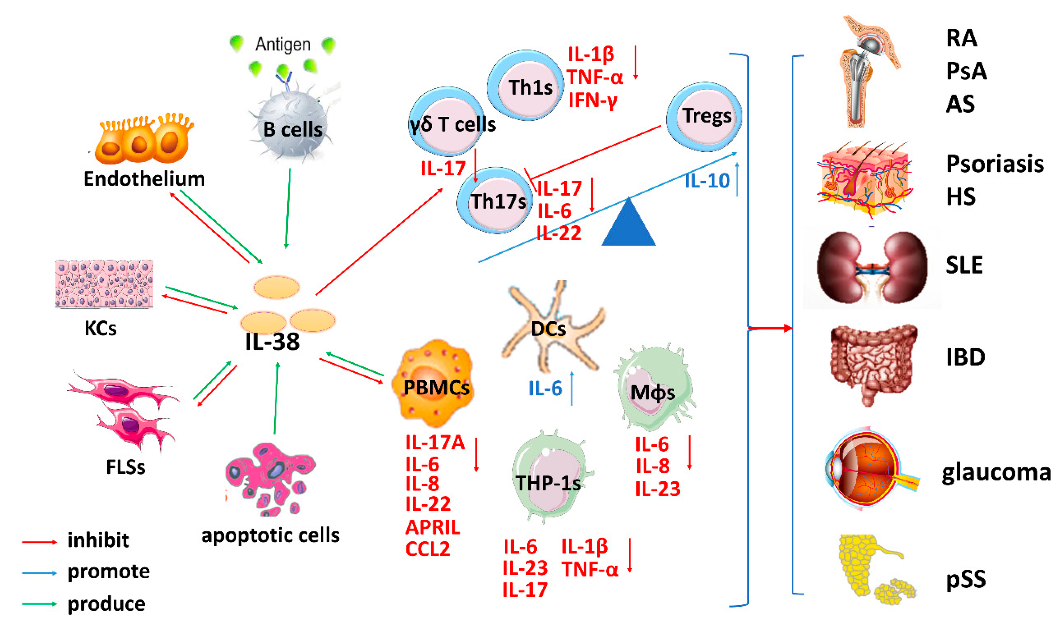

Slide 20
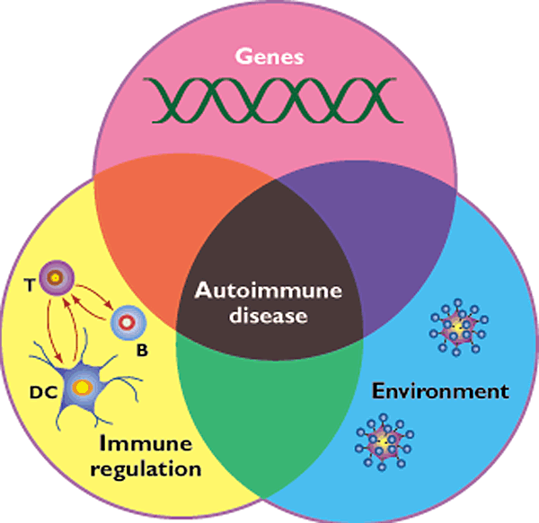
Summation Event

Slide 21
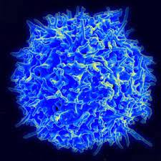
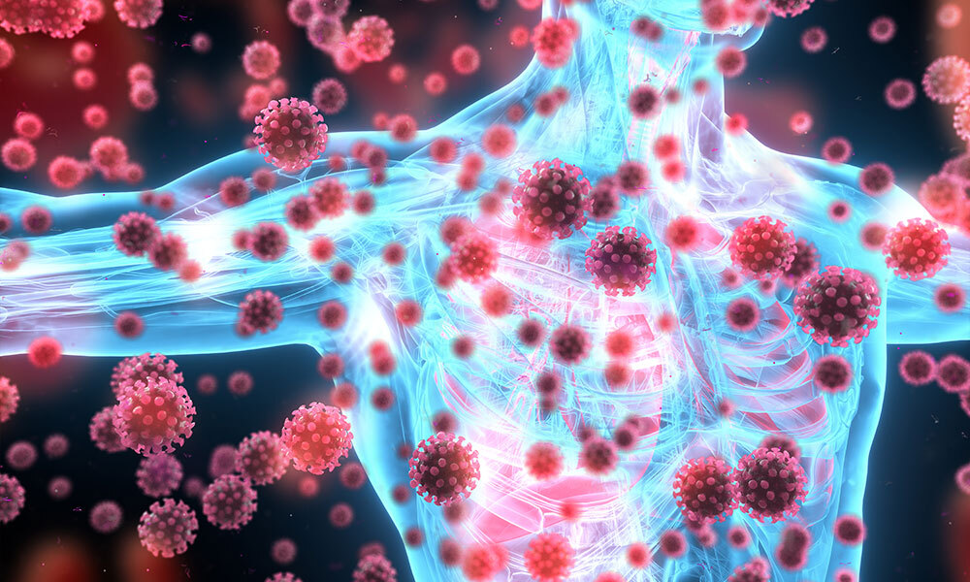

Slide 22
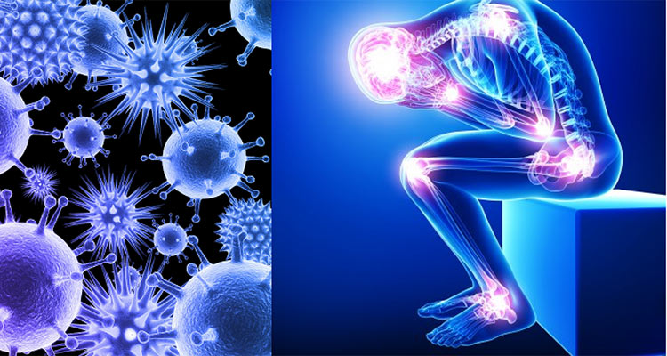

Slide 23
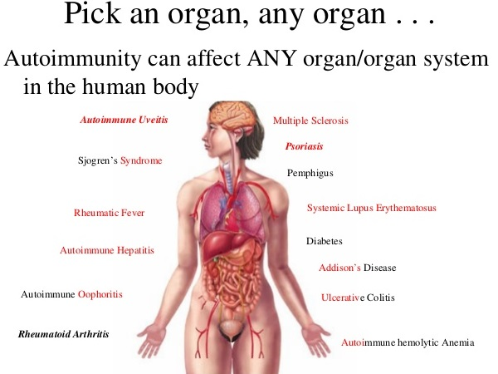

Slide 24
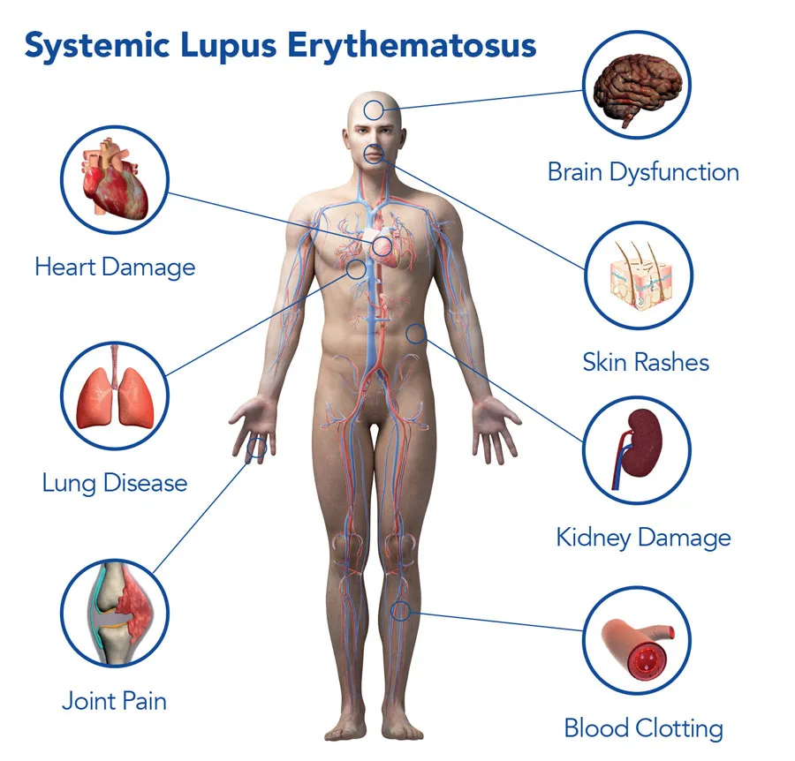

Slide 25
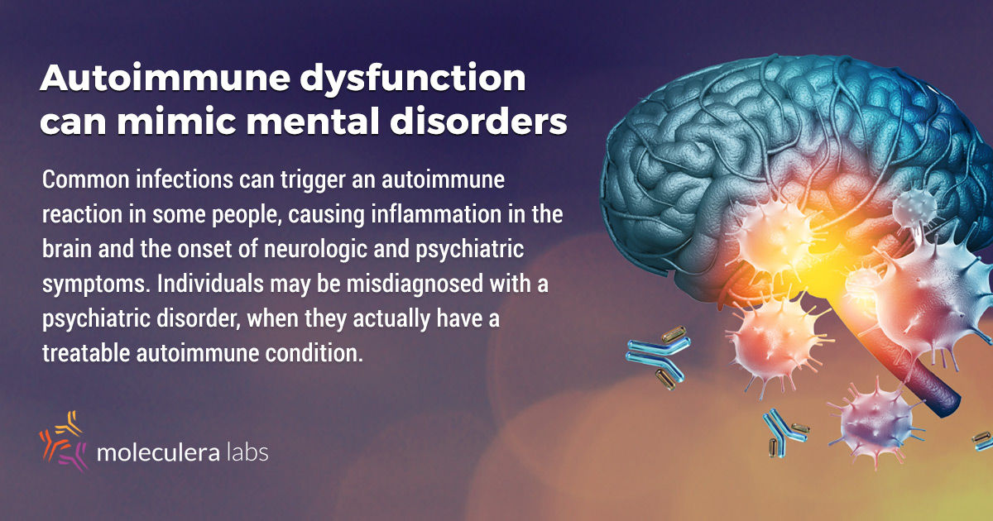
Upstream Etiology creates downstream confusion: Starting Place vs. End Stage symptoms

Slide 26
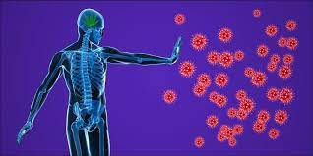
Treatment and Correction

Slide 27
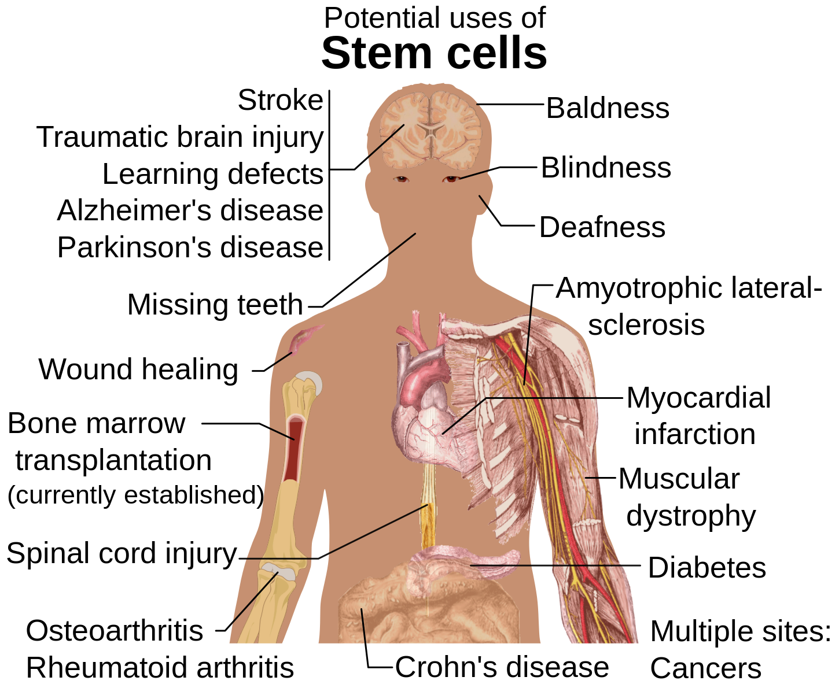

Slide 28
Infection first, then autoimmunity
Evolution could be to blame for our autoimmune diseases, such as lupus, multiple sclerosis and rheumatoid arthritis. For the first time, we have evidence that people who are more susceptible to disorders of this kind are that way because their immune system is better equipped to combat dangerous infections, enabling them to live longer.
“There are so many autoimmune diseases affecting all sorts of tissues,” said Andrea Graham, an evolutionary biologist at Princeton University, at the annual meeting of the International Society for Evolution, Medicine and Public Health in Durham, North Carolina, last month. So what could explain the existence of these conditions? “One potential answer is that vulnerability to immune-mediated disease is simply the price we must pay for potent and rapid defence against infection.”
Read more: https://www.newscientist.com/article/2099313-autoimmune-diseases-may-be-side-effect-of-a-strong-immune-system/#ixzz7TQgpPdyg

Slide 29
Autoimmune burden shortens lifespan
Graham and her colleagues have found evidence for this idea using a long-running study of elderly people in Taiwan. It has tracked more than 1000 people born between 1892 and 1953 for the past 27 years.
The team analyzed blood samples collected from 639 of these people in 2000 and 2006, measuring the levels of “self-reactive” antibodies – those capable of attacking the body’s own tissues. They found that individuals with higher levels of these antibodies were likely to live longer.
For any particular age, the participants with high levels of self-reactive antibodies had on average a 33 per cent lower risk of dying that year. These people also seemed less likely to have a type of chronic viral infection.
The downside is that these antibodies are precisely those implicated in autoimmune diseases. The kidney is one of the first organs to be affected by the autoimmune disorder lupus, so the team also looked at urine samples, which can indicate kidney health. They found that people who had higher levels of self-reactive antibodies may also be more likely to develop lupus.

Slide 30
New thinking about purpose
What makes this study remarkable is that it explains in evolutionary terms why human evolution has failed to weed out autoimmune diseases, says Gabriele Sorci, an evolutionary biologist at the University of Bourgogne in France.
The work was inspired by Graham’s findings from a similar study in the UK that involves not humans but sheep. For the last 30 years, researchers have been painstakingly recording the health and life details of more than 7000 Soay sheep on the Scottish island of St Kilda.
By analyzing the antibodies in sheep blood samples, Graham’s team had found that there was a correlation between levels of self-reactive antibodies and those of antibodies against parasites, and that a high level of self-reactive antibodies runs in sheep families. Together, the findings suggest that genetics influences levels of self-reactive antibodies, and that this is linked to mounting a stronger defense against parasites. This seems to provide an evolutionary advantage – sheep with higher levels of self-reactive antibodies live longer.
“Autoimmunity has previously been considered to be a bad thing, and a consequence of the immune system misfiring instead of attacking what it’s supposed to,” says Aaron Blackwell, an evolutionary anthropologist at the University of California, Santa Barbara. “These studies show that there may be a function for autoimmunity,” says Blackwell.

Slide 31

So many clues about how to think – how to treat
Statistical analysis of the sheep data revealed that the correlation between survival and high levels of self-reactive antibodies isn’t completely explained by being better at beating parasites. This may mean that self-reactive antibodies are not just a side effect of a strong immune system – perhaps they are doing something useful too. Other studies suggest that self-reactive antibodies can help clear dying cells and other debris from the body, and it is possible that they may play a role in watching for cancer cells.
The emerging picture is that physiological responses are a product of long evolutionary processes, and often serve a function that makes an animal more likely to survive under the right circumstances, says Blackwell. “I would expect these results to be applicable across many species and across different human populations,” he says.

Slide 32
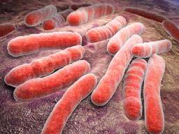
Infection or autoimmunity or both???
TB is an infectious disease caused by the bacteria Mycobacterium tuberculosis. While the bacteria primarily attack the lungs, they can also affect the brain, spine, kidney, and other parts of the body.
M. tuberculosis is an airborne bacterium; when a person with TB in the lungs or throat coughs, sneezes, or even speaks, TB bacteria enter the air, where they can be inhaled by another person, though not all individuals infected with the bacteria become ill.
Still, last year, TB infected around 10.4 million people across the globe, causing around 1.8 million deaths – 95 percent of which occurred in low and middle income countries.
While there are vaccines that can prevent TB and drugs that can treat it, TB bacteria are becoming increasingly resistant to current medications.
Last year, around 480,000 TB cases worldwide were multidrug-resistant, and only 52 percent of these cases were successfully treated.

Slide 33
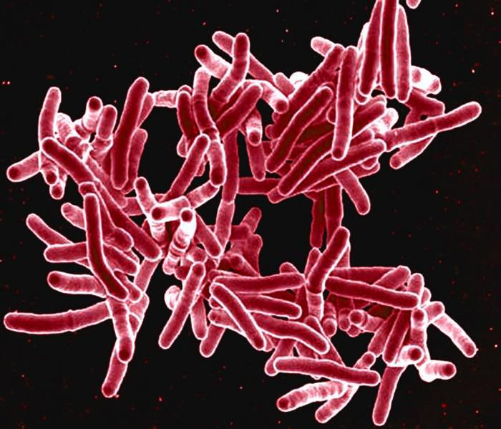
Infection/Autoimmunity
Now, a new study may pave the way for new vaccines and drugs for TB, after finding evidence that suggests TB “tricks” the immune system into attacking the lungs, enabling the bacteria to become more infectious.
The research team – led by Prof. Paul Elkington of the University of Southampton in the United Kingdom – reviewed a number of published studies that looked at the TB infection process.
The review published in the journal Trends in Immunology, uncovered evidence that TB bacteria trigger autoimmunity, prompting the immune system to launch an attack on healthy lung tissue.
“It seems that TB tricks the immune system into damaging our own lung tissue, which therefore makes the person highly infectious through coughing and the TB then spreads by aerosol droplets to other individuals.”
The researchers believe this theory is feasible, given that some patients with TB also experience eye and joint inflammation and skin rashes – symptoms that are not normally associated with TB, but which arise in certain autoimmune diseases.
“These symptoms are usually associated with diseases like rheumatoid arthritis and Crohn’s disease, which led us to believe autoimmunity plays a key role in the TB disease process,” notes Prof. Elkington.

Slide 34
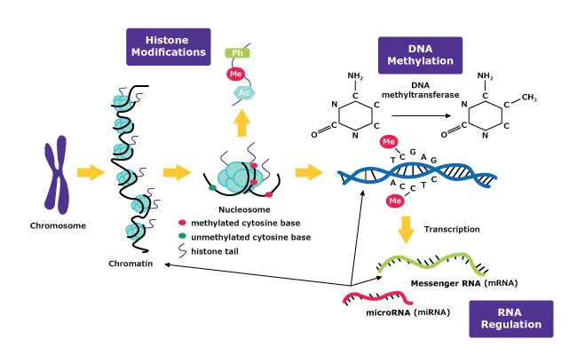
Methylation of DNA

Slide 35
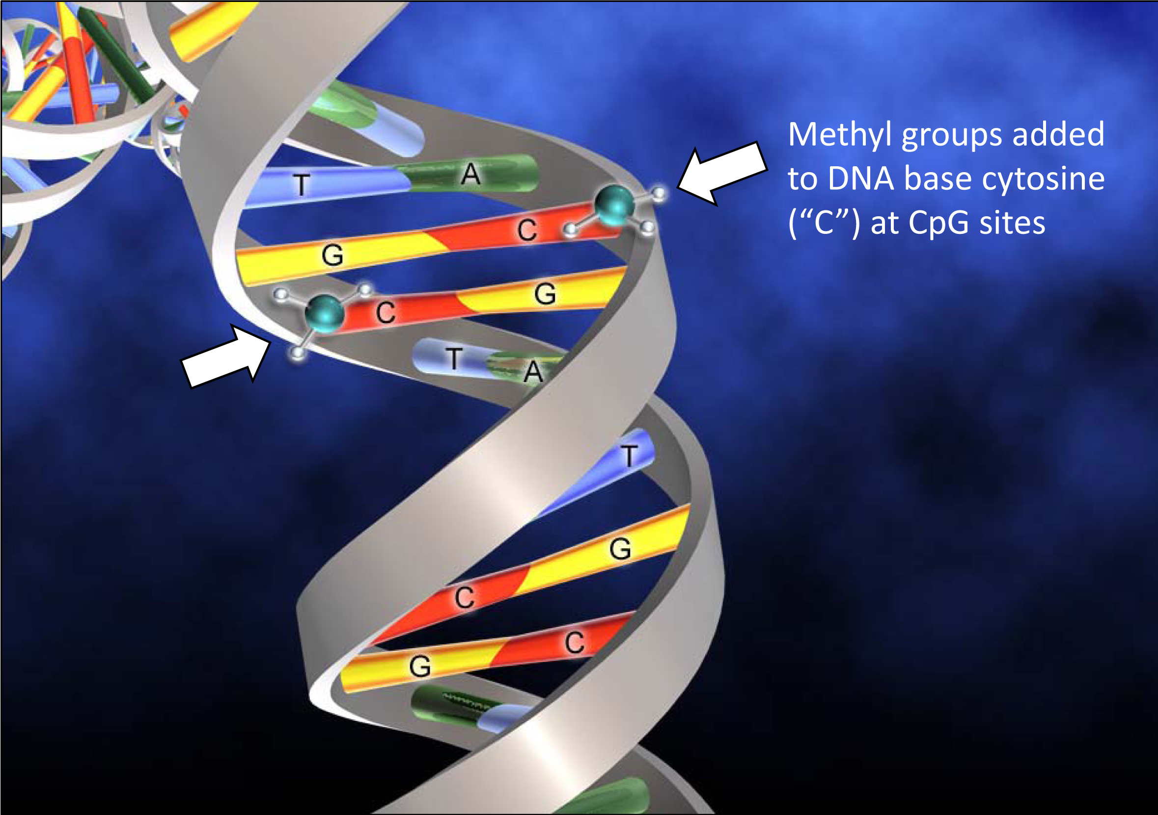

Slide 36
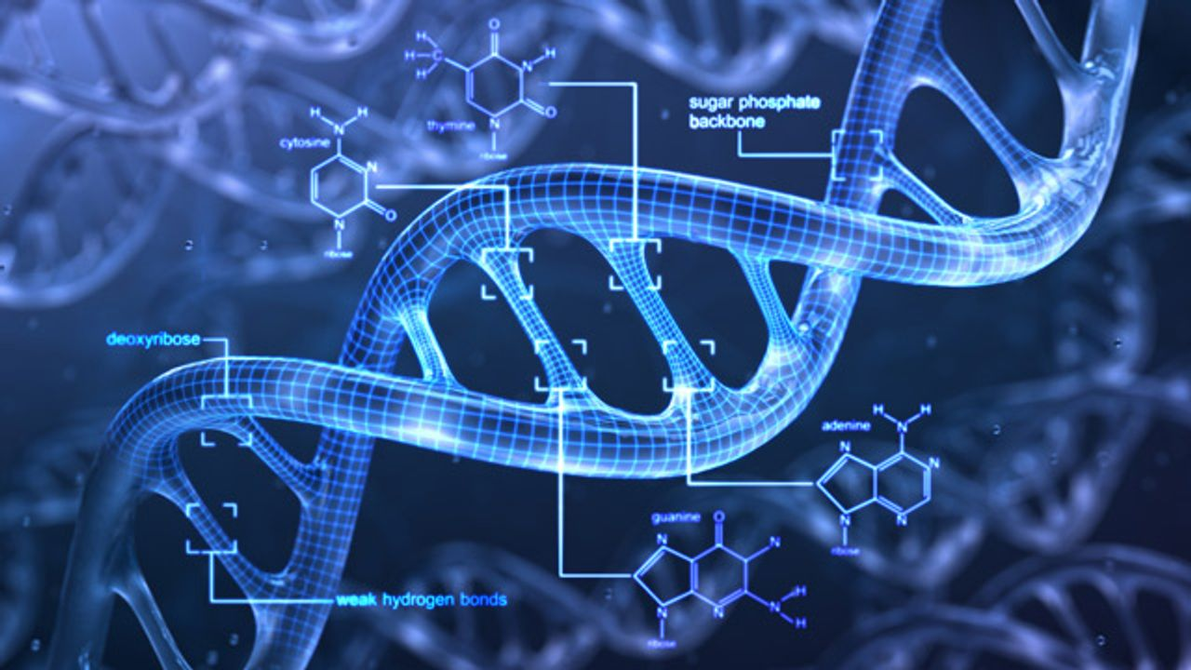
Methylated DNA
DNA methylation is one of the earliest epigenetic modifications to be discovered in human beings. It involves the transfer of methyl (CH3) groups to the C5 position of cytosine bases that comprise deoxyribonucleic acid (DNA) – the reaction is catalyzed by a family of enzymes called DNA methyltransferases (DNMTs).
DNMTs have several distinct roles, for instance, they may function as de novo DNMTs, which involves establishing the initial pattern of methyl groups on a DNA molecule. While other DNMTs adopt maintenance roles, copying the methylation pattern from an existing DNA strand to its new partner after replication has occurred.
Several studies in the 1980s revealed that DNA methylation played a major part in both gene regulation and cell differentiation. Since then, further research has confirmed the role of abnormal methylation in the development and progression of various diseases. According to Manel Esteller, director at the University of Barcelona, “DNA methylation is one of the main controllers for specific-tissue expression allowing the correct expression of a gene in the right organ or cell type.” He further added, “DNA methylation acts as a buffer to stabilize our genome and silence repetitive chromosomic regions. Many diseases show an alteration of DNA methylation that disrupts cellular activity.”

Slide 37
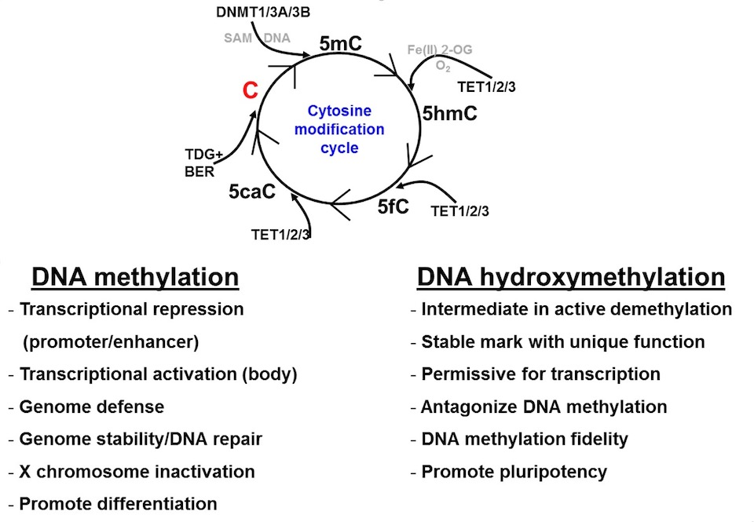
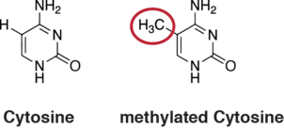
Repletion vs. Depletion

Slide 38
Autoimmune Issues -
There are over 2,000 named autoimmune diseases, with approximately 200-300 new ones being identified yearly
Each disease is treated by medicine as a syndrome and collection of symptoms without any respect for the etiology and mechanisms of disease
Is the fundamental mechanisms are examined rational intervention is mandated
As long as we focus on symptoms and ignore the cascade of events the process is progressing

Slide 39
Autoimmunity – Is it increasing?
Chronic inflammatory disease is clearly increasing worldwide (atopic syndrome, asthma, metabolic syndrome, atherosclerosis)
Corresponding epidemiological data on autoimmune disease is limited because: AD not reportable – estimates of incidence and increase are much lower than actual, many estimates on incidence is decades old and based on small sample size, apparent increase in incidence could be due to improved diagnostics
Despite poor reporting it appears AD increases, especially: 3,000 new cases annually of Type 1 Diabetes, Crohn’s Disease has more than tripled in last 30 years, MS has doubled in Europe, US data shows significant increase in women

Slide 40
Autoimmunity – Estimated US prevalence
Psoriasis – 7 million cases
Graves Disease – 3.5 million cases
Vitiligo – 3.5 million cases
Rheumatoid Arthritis – 2.1 million cases (30-50 K children)
Celiac Disease – 2 million cases (1 in every 133 people)
Hashimoto’s Thyroiditis – 1.5 million cases
Inflammatory Bowel Disease – 800,000 cases (2/3 colitis, 1/3 Crohn’s)
Type 1 Diabetes – 300-500,000 cases
Multiple Sclerosis – 250-350,000 cases
Systemic Lupus Erythematosus – 240,000 cases

Slide 41
Autoimmunity as early immune signaling
Autoimmune conditions are nothing more than undifferentiated immune failure, ultimately leading to defined cancers, infections, and degeneration
Natural tissue antibodies are the first seen up-regulation wherein the immune system is attempting to confront the burden of unmethylated DNA (nuclear proteins) in the blood
Lack of methylation, inability to accomplish Phase I and Phase II detoxification results in failure of the methylation processes and subsequent accumulation of nuclear proteins in the blood compelling an immune response
The primary factors that contribute to autoimmunity are genetic predisposition to methylation difficulty, toxic burdens, psychological stress, and immune dysregulation due to immune burdens chief of which is leaky gut syndrome

Slide 42
Autoimmune antecedents schematic
Liver/systemic circulation
Natural Tissue Antibodies (NTA) produced in liver for self targeting
Blood/lymph fluids
Viral/radical oxygen species degradation of lipid membranes
Cytoplasmic membrane
Loss of membrane integrity resulting in cellular contents leaking into blood
Cell Nucleus
DNA nucleoproteins
Unmethylated DNA in blood – Autoimmune activation

Slide 43

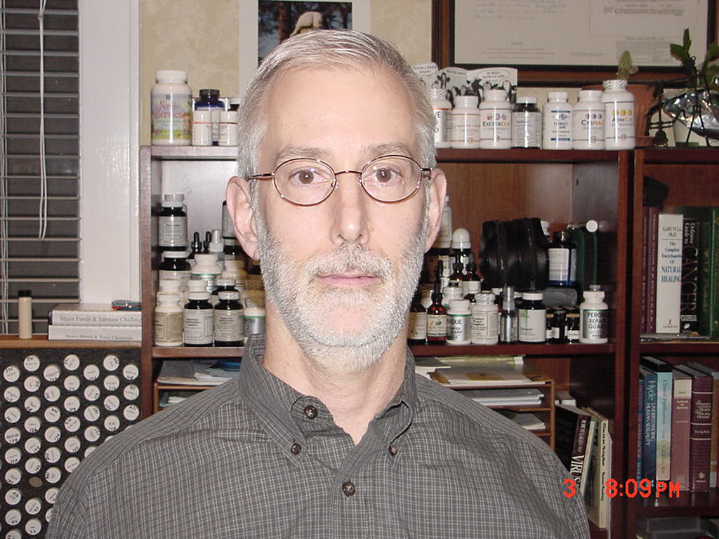
Robert in trouble - Pericarditis
Presented 08/08 with autoimmune pericarditis
Symptom free in two months
Ran marathon in 5 months
Treatment will still be total 12 months to minimally correct autoimmune vectors and attempt to insure a ‘never again’ experience

Slide 44
Autoimmune Issues -
Every person has a normal amount of autoimmune activity – this is normal and vital for immune management
Normal sampling of genetic material in the blood stream feedback to autoimmune mechanisms in the liver where natural tissue antibodies are formed to prevent the macroscopic exposure to infection brought about by weakened vulnerable tissue
Remember the inherent genetic code acquired over millennia is to prevent the primary cause of death which is infection
The body interprets genetic material in the blood as upstream tissue damage and degeneration vulnerable to infection and disease

Slide 45
Autoimmune Issues -
Methodical Intervention involves:
  Lipid membrane reinforcement to support cytoplasmic and nuclear membrane containment of genetic material
  Supporting methylation processes to keep circulating DNA methylated (attached to methyl groups) and thus avoid autoimmune activation
  Reducing body immune/inflammatory burdens thus helping the immune system to a state of tolerance
  Support target tissue repair and fortification
  Support liver health and detoxification since it is the site on autoimmune regulation
  Support adrenal cytokine proliferation as a means of reducing autoimmune amplitude – turn down the volume
  Provide background endocrine disruption support, especially the more chronic the condition
  Promote gut-lining health – pre and probiotic efforts as a source of immune genius
  Detoxify toxic metals and exo/endogenous toxins
  Balance dysglycemia and insulin resistance (the major dietary cause of inflammation)
  Address lack of blood flow – sedentary lifestyle
  Address malnutrition with improved diet
  Promote widespread physiological potency
  Address psychological stresses

Slide 46
Rational Intervention involves:
  Lipid membrane reinforcement – Linum/B6 (4), Tuna Omega (4), Super EFF (2)
  Supporting methylation - Cruciferous (4), Greenfood (4), Spanish Black Radish (6)
  Reducing body immune/inflammatory burdens – Food allergen elimination, Sequential immune up-regulation, Gut Flora Complex (4)
  Support target tissue – PMG glandular therapy specific for target tissue (6)
  Support liver - Livaplex (6), Livco (4), Livton (4), Silymarin (4), Antronex (8)
  Support adrenal cytokine proliferation – Rehmannia Complex (4), Drenamin (6), Tuna Omega (4), Ginger & Pomegranate & anti-inflammatory nutraceutical devices
  Provide endocrine support – Symplex F/M (6), Hypothalmex (2), Hypothalmus PMG (2), Folic Acid/B12 (4), e-Poise (4)
  Promote gut-lining health – pre and probiotic efforts – Gastrofiber (4), Chlorophyll (4), LactEnz (4), IgG production with colostrum (Whey Pro Complete), Gut Flora Complex( (4), Prebiotic Inulin (I tsp), 2 Tbsp Flax seed for roughage
  Detoxify toxic metals and exo/endogenous toxins – Chelaco (2), Parotid PMG (2), methyl formers
  Balance dysglycemia and insulin resistance– Phase I/II diet
  Lack of blood flow – Promote movement and incremental conditioning
  Address malnutrition with improved diet – raw food sources, minerals, whole foods
  Promote widespread physiological potency - Address all 7 pillars of health
  Address psychological stresses – NET, Tissue memory techniques

Slide 47
Immune Tolerance
”Don’t be so Reactive”
Understanding of oral tolerance mechanisms is evolving rapidly – one of the most active areas of research areas in immunology
The role of normal flora and the nature of antigenic presentations are the key areas of interest
Lack of tolerance is now seen as root cause for many intractable diseases and autoimmune conditions
Re-induction of tolerance is the only treatment/prevention modality that addresses the cause of disease
Probiotics, prebiotics, antigen introduction offers safe and efficacious means of treating disease

Slide 48
Epidemic Intolerance
In last 50 years there has been a 40 fold rise in allergic asthma in the developed world – the same period marks no rise in the developing world
1 in 7 children born in the developed world will develop allergic asthma
Juvenile Diabetes has risen 5 fold in developed world – no increase in developing world
Environmental pollution has been eliminated as the suspected cause
Children with juvenile diabetes had fewer childhood infections
Children with no infections during the first year of life are 5 times more likely to develop diabetes or asthma
Every infection in the first year of life correlates with a 20% reduction in the risk of developing diabetes
Measles sufferers have 3 fold lower incidence of allergic disease
Antibiotic use in first 2 years of life increase teenage allergies
Sterile artificial environments weaken the developing/learning immune system

Slide 49
The Hygiene Theory
Children raised in ‘less hygienic’ environments has significantly less allergies than western counterparts from a ‘more hygienic’ environment
Linkage with disease simply indicates exposure to a wider variety of antigens
Allergic infants have significantly different gut flora compared to non-allergic infants
Manipulation/supplementation of gut flora safely optimizes antigenic exposure and reduces allergies

Slide 50
Autoimmunity – Juvenile Diabetes Models Hope
In the hopeless Juvenile Diabetic condition there is now evidence of hope through understanding that comes from watching
“Honeymoon period” follows initial insulin dependency showing an initial beta cell proliferation and corresponding decrease in insulin dependency – then a return to complete insulin insufficiency
Ongoing islet cells immune attacks from lymphocytes (NTA’s) finally destroy the regeneration beta cells such that regeneration is only transient
It appears that islet regeneration attempts are prominent for the first 18 months following onset of JD
If autoimmune cascades can be modulated and suppressed regeneration may continue free of lymphocyte attack and degeneration
Tolerance induction is a growing concern in autoimmune disease to promote endogenous regeneration
Research of Charles Sia and Francoise Homo-Delarche, jointly from New York and Paris, copyright 2004, Dept. Immunology, United Biomedical Inc, Hauppage, NY. Doi: 10.1900/RDS.2004.1.198.

Slide 51

A Clinical Study: Autoimmune
Yvonne first attended 08/04 – Lupus onset ’95, presenting stomach disorder, multiple joint pains, night sweats, bruising, fatigue, IBS, Raynaud’s, foot numbness
Cataplex AC (8), Symplex F (6), Hypothalmex (2), BCSO (2), SSO (6), Inositol (3), L-Glutamine (3), Calcifood (2), AF Betafood (12), Choline (6)
Within three months no joint pains, off all medications (3), training for marathon
01/05 Ran 2 marathons within three weeks – came down with severe viral flu – exacerbated the autoimmune condition – frightened her like original onset in ’95 – returned finally to drugs – required another three months to quiet things down
Use autoimmune handout attachment to create chronic strategy

Slide 52
A Clinical Study – Auto-Immune
Charlie (56 years old) retired police officer presented 10/26/02 with diagnosis of Myasthenia Gravis with chronic severe respiratory infection and reflux both secondary to long-term prednisone use, low energy, slow start, loss of taste, hair loss, blepharptosis, cramps and aches in lower extremities
Recorded extensive case history, Calcium cuff test 110 mm, Ragland’s reclining 156/96 (66) standing 128/75 (82), Muscle testing exam, determined to begin Endocrine Pillar – Symplex M (3-3), BCSO (1-1), Essential Fatty Acid blend; Bio-terrain Pillar – Calcifood (1Tbsp), L-Glutamine (1.5 g); Circulatory Pillar – Cardioplus (3-3); Immune Pillar – Cataplex AC (6-6), Sesame Oil (3-3), Allerplex (7-7), Broncafect (2-2)
Returned in one month reporting no dry eyes, recovery of taste, loss of eye puffiness, less neck stiffness, refllux gone (med. stopped), cramps & aches gone, hair loss gone, depression and worry gone, energy level up
Full of hope and renewed in his work

Slide 53
Charlie continued
Throughout the course of next four years achieved multiple successes including reversal of CAD by 30% in 3 months obviating the need for a angiogram, complete consistent control of respiratory infections with no use of antibiotics since commencement
Finally one month ago reported from neurologist complete remission of MG due to chronic repair of autoimmune factors especially cell membrane repair

Slide 54

Twins with Juvenile Arthritis -
Presented 08/07 both with same diagnosis leaving 2 days later for a year to middle east
Controlled inflammation by detesting allergy to wheat and milk, pillar 5 reduced immune burden by cleansing liver and up-regulating immune system with Thymex, SSO, Cataplex AC, ionic calcium powder
See you next year
01/08 was referred a case of J. Arthritis by the success with the twins

Slide 55
Innate Heirarchy
The body is designed to keep the blood normal – this is how it maintains homeostasis globally
The blood is the last system to display abnormality and this is why it is always pathagnomonic
The second effort of the body is to maintain normal organ function
This is how it controls the blood
Autonomic determines somatic
AKA Viscero-somatic

Slide 56
Primary Inflammatory Foods
There are 14 primary inflammatory foods:
To reduce these for five days is to dramatically reduce the inflammatory amplitude systemically – remarkable changes seen in 1-2 days – then re-introduction protocol can determine the actual offending food(s)
  Milk
  Corn
  Gluten
  Soy
  Peanuts
  Beef
  Tomato
  Chocolate
  Rice
  Nuts
  Sesame
  Peas
  Eggs
  Sugar

Slide 57
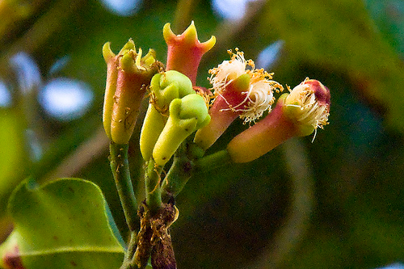
Additional Important Anti-Infection Herbs
Myrrh
Stemona
Wormwood
  Artemesia
  Berberine
Cloves
Cats Claw
Black Cumin Seed
Tannin herbs
Notes:
These will synergise with Aa

Slide 58

Change the world
It always wants to

