Slide 1
Mentoring the Mentors
Tongkat Ali
Awakening Immune Vitality
Stuart White, DC,DACBN
Synergy Holistic, LLC
2300 Randolph Road, Suite B
Charlotte, NC 28207
980/355-0842
stuartwhitewha@gmail.com
www.synergycharlotte.com
www.wholehealthassoc.com
www.doctorofthefuture.org

Slide 2
Mentor goals:
To declare what is possible and establish a commitment to that possibility
Address personal and professional barriers limiting the ability to serve
Evolution of vision/mission/ethics that drive success
Create immediate action steps to apply learning and growth
Construct the round table of applied trophologists

Slide 3
Mentoring the mentor:
Who are the mentors? – Practitioners
Who are we mentoring? – Patients and GAP
What’s the purpose? – Optimized life
How does it work? – Whatever you learn you teach someone else (anyone else)
Who’s is included? – Self selection, you pick yourself

Slide 4
Mentoring the mentor:
Each participant attends monthly teleconferences (1 hour in duration, 3rd Wednesday of every 2nd month) creating a round table discussion/exploration of the dynamics and details of a nutrition-based holistic practice
Each participant chooses how to convey the notes and information to their world and community – no information squandering

Slide 5
DISCLAIMER
Standard Process sponsors this seminar to provide healthcare information to practitioners and to provide them the opportunity to hear about the views & recommendations of practitioners like Dr. Stuart White. Health-related information provided here is not a substitute of medical advice.
Neither Standard Process nor Stuart White have evaluated the legal status of any products, services or recommendations with respect to State or Federal laws, including scope of practice. Standard Process NW and Stuart White do not and cannot accept responsibility for errors or omissions or for any consequences from applications of the information provided and makes no warranty, expressed or implied, with respect to the information provided.
The following webinar is completely compiled and presented by Stuart White with no suggestions or advice from Standard Process, and contains only his individual opinions and estimation of relevant material as derived from his education and experience of 42 years in practice consulting with over 44,000 cases.

Slide 6
Ideas are the foundation…
Nothing is more powerful
than an idea whose time has come
BJ Palmer, DC

Slide 7
Humbly and Genuinely -
These are my ideas

Slide 8
Eternal Truth
When you get close to the best of the best at anything, you always discover that they insanely persist at learning about their craft.
Matthew Kelly

Slide 9
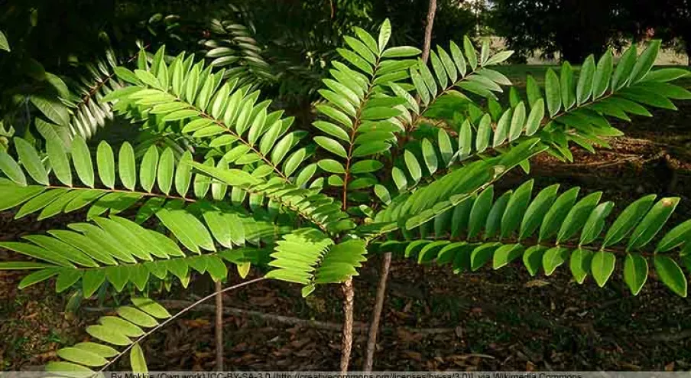
Tongkat Ali New guy on the block

Slide 10
Eternal Truth
If you build it
they will come

Slide 11
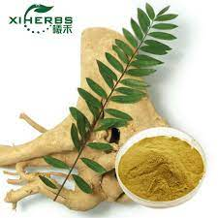
Tongkat Ali

Slide 12
Tongkat Ali
A valuable herb for both eastern and western herbalists, in particular it is considered to have a remarkable potential in supporting male vitality.
As a general tonic and mild stress relief, Tongkat Ali is also a valuable herb for overall health
MediHerb’s ® Tongkat Ali is an exciting new addition, with promising research, that will expand your Doctors herbal dispensary options, and will become an essential botanical for supporting male health and wellbeing
181. Thu HE, Mohamed IN, Hussain Z, Jayusman PA, Shuid AN. Eurycoma Longifolia as a potential adoptogen of male sexual health: a systematic review on clinical studies. Chin J Nat Med. 2017 Jan; 15(1): 71-80. Tongkat Ali

Slide 13
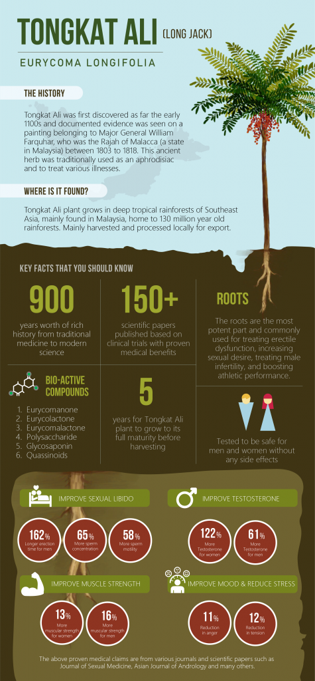
The Story

Slide 14
Tongkat Ali – New kid on the block
Tongkat Ali is one of the most well-known traditional plants in Southeast Asia where it has been used for centuries for an array of health challenges
The roots in particular are popular amongst Malay and south-east Asia to support endogenous testosterone production and maintain a healthy sexual appetite1,2
Tongkat Ali root products are generally available as a health supplement in leading pharmacies in Malaysia where they are marketed as a traditional tonic to promote vitality and overall wellbeing, especially in middle-aged
men with reduced levels of energy and sexual interest 4
1. Compendium of Medicinal Plants used in Malaysia. Vol.1..Kuala Lumpur: Herbal Medicine Research Centre. Institute for Medical Research; 2002, pp.337-338.
2. Bhat R, Karim AA. Tongkat Ali (Eurycoma longifolia Jack): a review on its ethnobotany and pharmacological importance. Fitoterapia 2010 Oct; 81(7): 669-79
3. Tambi MI, Imran MK, Henkel RR. Standardised water-soluble extract of Eurycoma longifolia, Tongkat ali, as testosterone booster for managing men with late-onset
hypogonadism? Andrologia 2012 May; 44 Suppl 1:226-30
4. Talbott et al 2013. Effect of Tongkat Ali on stress hormones and psychological mood state in moderately stressed subjects.
Journal of the International Society of Sports Nutrition 2013, 10:28

Slide 15
Vitality

Slide 16
The Right Plant Profile
▪ Tongkat Ali contains various classes of bioactive plant constituents, such as the quassinoids (a group of nortriterpenoids), canthin-6-one alkaloids,ß-carboline alkaloids, triterpene tirucallane type, squalene derivatives and biphenyl neolignan,eurycolactone, laurycolactone, eurycomalactone, and bioactive steroids
▪ The bitter tasting quassinoids, especially eurycomanone1 , have been shown to support normal healthy testosterone production in a dose dependent manner
1. Rehman SU, Choe K, Yoo HH. Review on a Traditional Herbal Medicine, Eurycoma longifolia Jack (Tongkat Ali): Its Traditional Uses, Chemistry, Evidence-Based Pharmacology and Toxicology. Molecules 2016 Mar 10; 21(3): 331 2. George A, Henkel R. Phytoandrogenic properties of Eurycoma longifolia as a natural alternative to testosterone replacement therapy. Andrologia 2014; 46: 708–2

Slide 17
Research + Experience
You Will

Slide 18
Testosterone and Age
▪ The amount of testosterone in man’s body naturally decreases with age ▪ Levels tend to peak between the age of 25 and 30, but then decline gradually over time ▪ At age 60, testosterone levels may have fallen by more than 50% with; everyday stress, diet, exercise and sleep also affecting normal levels ▪ Testosterone levels strongly determine levels of sexual interest, mental and physical energy, and general well-being
Talbott et al. Effect of Tongkat Ali on stress hormones and psychological mood state in moderately stressed subjects. Journal of the International Society of Sports Nutrition 2013; 10: 28

Slide 19
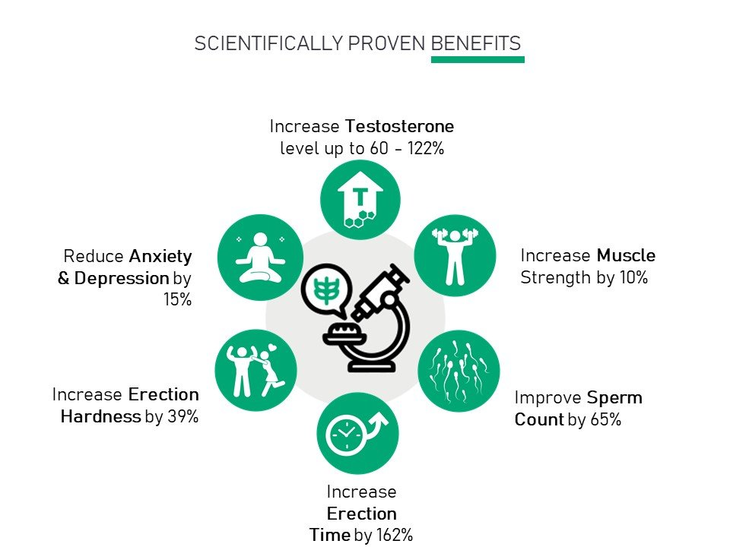

Slide 20
Supports Testosterone Production and Normal Healthy Testosterone Levels, including Free Testosterone
▪ Most of the testosterone in the blood is attached or bound to proteins, while only a small percentage remains unattached or “free” ▪ Free testosterone is important as it’s immediately available to the body ▪ Tongkat Ali has been shown to support normal levels of both attached testosterone and free testosterone levels gradually over time using the body’s own natural processes ▪ By supporting the endogenous synthesis of male hormones via a complex biological process in the body, as well as by supporting the release rate of free testosterone from its binding state, Tongkat Ali acts as a “maintainer” of normal testosterone levels

Slide 21
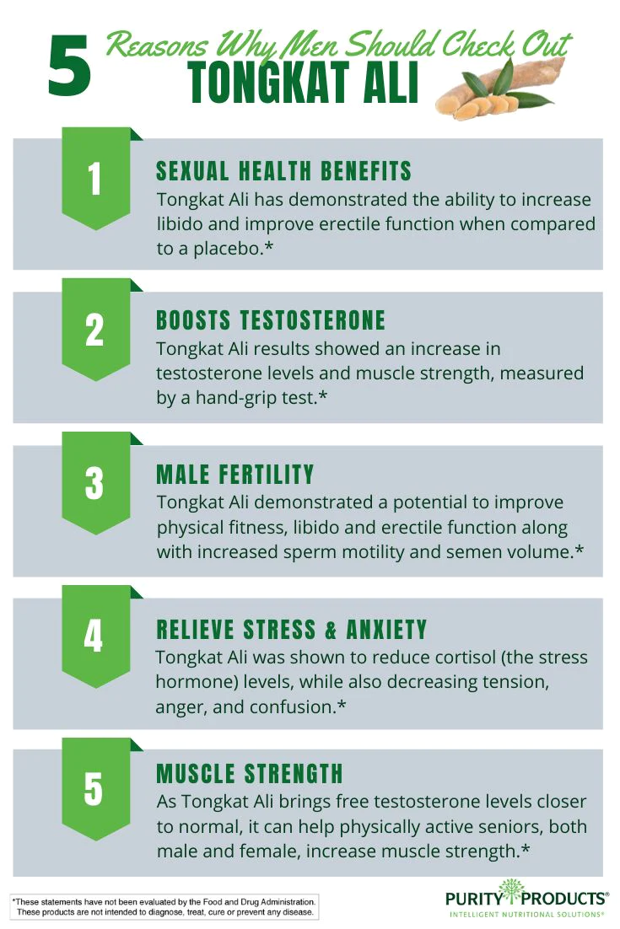

Slide 22
MediHerb® Tongkat Ali
May benefit male patients aged 40 years and over: ▪ Male patients who want to maintain normal levels of sexual interest ▪ Men who experience a normal age-related decline in testosterone levels ▪ Aging men needing to support normal healthy blood levels of free testosterone ▪ Older men wanting to maintain their normal vitality levels ▪ Older men wanting to support a general sense of well-being

Slide 23
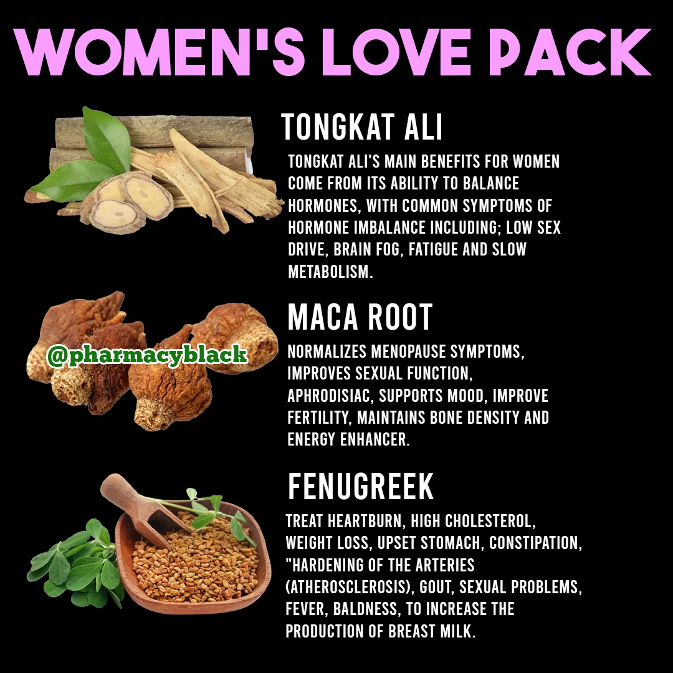
Support of the female

Slide 24
Supports Healthy Sexual Interest, Well-being & Vitality
▪ Tongkat Ali contains bioactive substances which are thought to play a role in sexual interest ▪ Sexual interest is also dependent on normal healthy testosterone levels, including free testosterone ▪ Tongkat Ali supports both sexual interest and healthy testosterone levels when taken at a daily dose of 200 mg for four to twelve weeks ▪ Tongkat Ali supports male vitality and a sense of overall well-being in mature men, either when taken alone or when combined with a multivitamin

Slide 25
A regular beverage

Slide 26
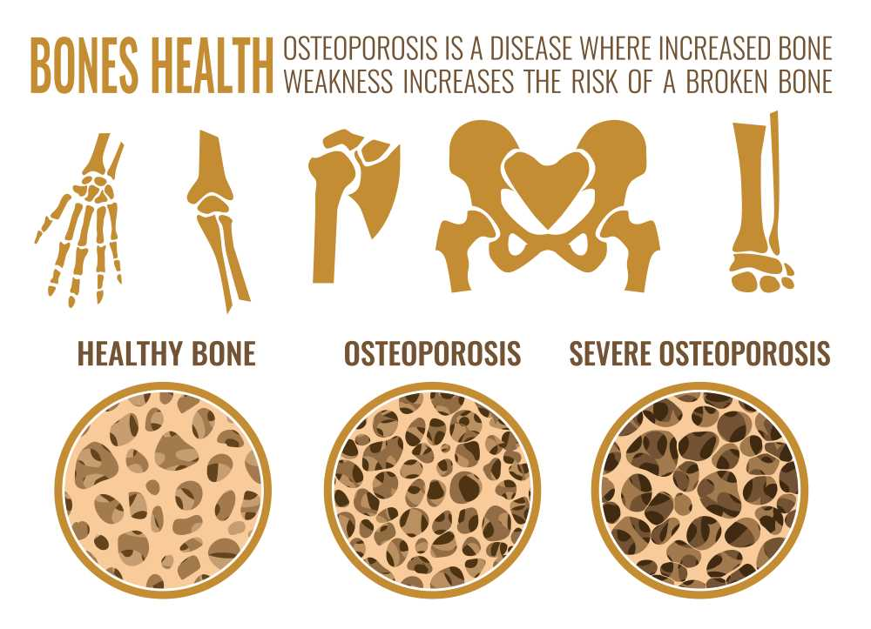
Bone Promotion

Slide 27
Hypothesis -
The only reason why anything that ever was working, stops working is because of infection

Slide 28
Immune Modulation

Slide 29
Testosterone increases cytokine activity …
Deficiency creates pro-inflammatory cytokines –seen in CAD, prostate cancer,diabetes
Abundance reduces pro-inflammatory signaling
Promotion of IL-10 and reduction of Il-1beta, Il-6, TNF-alpha
Increase of eosinophilic activity

Slide 30
Testosterone influences are explainable

Slide 31
Moving the immune signaling

Slide 32
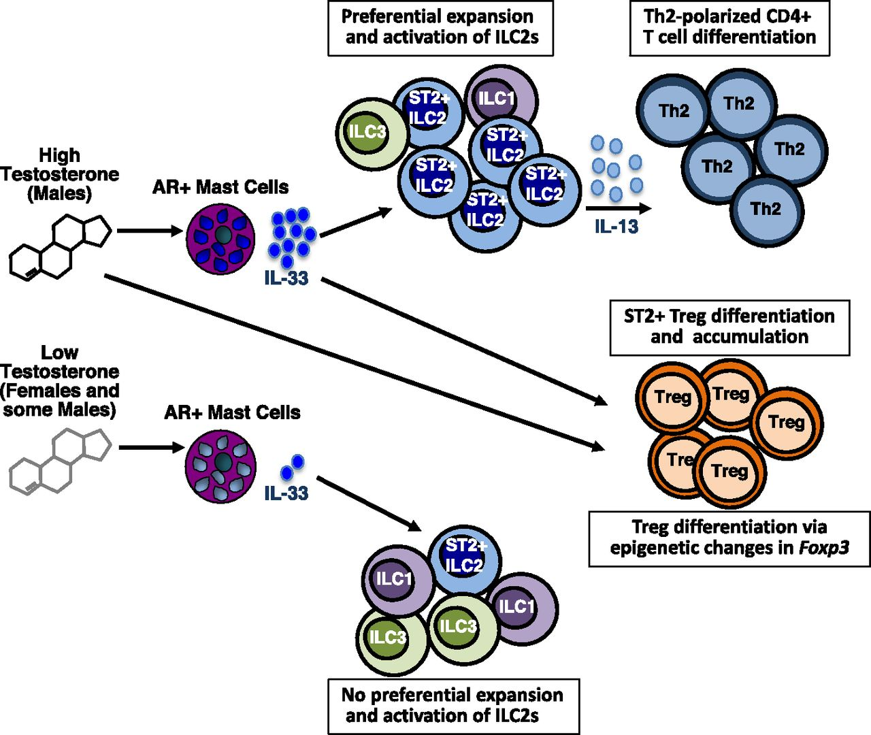
ILC2 increases by influence of testosterone – NK cells are Innate Lymphoid Cells formed in the bone marrow

Slide 33
The Starting Line -
It is what it is.
It becomes what you make of it.

Slide 34
Indications to consider:
Fatigue Lack of vitality, loss on motivation and stamina, low initiative, no joy in accomplishmenets
Cognitive Decline Forgetfulness, confusion, persevoration, emotional congestion, spiritual blocks, core belief distortion
Immune Burden Loss of immune virulence, reduced ROM, inflammation, inflammaging, fibromyalgia, immunosenescence
Limbic Wellbeing Negativity, lack of passion, overly sympathetic, despondent, emotional numbness, remoteness
Chronic Degeneration Stubborn unresponsive conditions, use in all heroic interventions, slow healing (two steps forward and one backwards)

Slide 35
Powerful Combinations
Endocrine combine with endocrine triad
Immune combine with Sequential Immune Up-Regulation
Libido combine with Tribbulus, Wild Yam, Wheat Germ Oil
Vitality combine with adrenal protocols
Bone Health combine with Biost, Gotu Kola Cx and Bone Cx

Slide 36
Change the world
It always wants to

