Slide 1
The Top Ten
Healing Concepts
Stuart White, DC, DACBN
Synergy Holistic
2300 Randolph Road, Suite B
Charlotte, NC 28207
980/355-0842
stuartwhite@wholehealthassoc.com
www.wholehealthassoc.com
www.doctorofthefuture.org

Slide 2
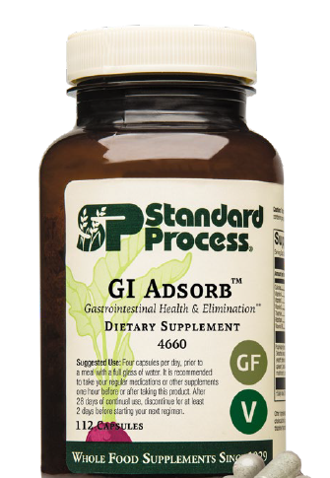
Notes:
Gi Adsorb was released last month and I know many practitioners have started to integrate GI Adsorb into their practices
GI Adsorb is the replacement for Cholacol II, as many of you know because of issues with Bentonite clay we haven’t had Cholacol II for several years.
As good as Choloacol II was, I believe GI Adsorb will be better and more diverse in its uses.
Cholacol II was a short-term product used typically for a week or two, it had limited range of what it was used for and in some cases could cause bloating or stomach cramps
2. The dosage of Cholacol II was very high at 12 per day on an empty stomach, which many patients found it hard to comply with.
Lets’ talk about what makes GI Adsorb such a special product…

Slide 3
Notes:
Standard Process has been on the search and testing many types of products for several years and finally secured an sourced a specific ingredient that met the standards and quality we demand and with research to back it.
You can see at the bottom of this slide some of the other ingredients we considered and tested. These included Activated Charcoal, Diatomaceous Earth, Humic/Fulvic acid, and other sources of Bentonite Clay, all of which had limited scope of efficacy and other issues associated with them.
Clinoptilolite is also stable at different pH’s and is exceptionally pure, making it superior to other similar products in the market containing bentonite clay or charcoal.
Clinoptilolite a specific form of Zeolite rose to the top with all the areas it supports
Zeolites/ Clinoptilolite were first used for water purification and has stood the test of time for its adsorbent qualities and beyond.
Let’s break it down a bit further on the next slide

Slide 4
Notes:
Zeolites are microscopic, porous minerals that cluster to form larger aggregates with small individual cavities, they are naturally occurring adsorbent substances. The type of natural zeolite, SP uses is in GI Adsorb is clinoptilolite, which is specific to human health, It includes an ion exchange as well as surface adsorption capacity.
Clinoptilolite is an “adsorbent” a substance that is capable of trapping certain substances to its surface or exchange within its pores.
Here’s a simple example between and absorbent and a adsorbent:
The difference between an “absorbent,” which traps substances by allowing them to permeate its structure uniformly a paper towel absorbs liquid it brings the substance into it.
An adsorbent like piece of notebook paper doesn’t actually draw water in like a paper towel

Slide 5
Notes:
Gi Adsorb has a patented G-Pur Clinoptilolite which we source from a company called G-Science. This specific Clinoptilolite in studies has shown its ability to support the gut barrier and shield the GI tract from many different types of toxins entering the GI tract.
In one 12-week double blind placebo trial using 1.85 grams of clinoptilolite showed significant improvement in GI integrity compared to placebo in keeping out and eliminating toxins including C-Diff.
They used the Zonulin test, which measures a family of zonulin proteins in the stool) when elevated, indicates the breakdown of tight junctions between intestinal epithelial cells. Again, Clinoptilolite showed a significant decrease in Zonulin levels.
Figure 1: shows the structure of tight junction proteins between cells was retained
Figure 2: shows the barrier strength of the cell monolayer

Slide 6
Notes:
Another component of GI Adsorb is Cracked wall Chlorella it provides a good source of chlorophyll but probably best known for its detoxifying effects. The World Health Organization did a study showing chlorella pulls dioxin levels down and improves cholesterol levels and blood sugar levels as well as stimulating the immune system
Chlorella in general is powerful sources of nutrition, including macronutrients, micronutrients, and phytonutrients – a triple threat. Chlorella has a variety of health benefits for humans, including its adsorbent activity.
Chlorella has been studied for its ability to support detoxification. A 2015 study showed its ability to detoxify the body of carcinogenic chemicals – like heterocyclic amines (HCAs) which are carcinogenic and formed when beef, pork or fish are cooked at high temperatures especially pan-fried foods
Also polycyclic aromatic hydrocarbons (PAHs) these chemicals are from gasoline engines, tobacco smoke, burning wood-coal, garbage etc. They form small particles in the air that can affect the nervous system, immune system and beyond

Slide 7
Notes:
COLLINSONIA ROOT - it maintains proper tone in the vascular system. Magnesium phosphate is an active factor which gives it this function. Collinsonia primarily has been used to prevent the formation of hemorrhoids and varicose veins, or to assist in their removal if they have already formed.
This product is made from the rock-hard root of the plant, ground up fine and put into capsules. Remember that in conditions of varicose veins and hemorrhoids, the patient often has a congested liver.

Slide 9
Notes:
Clinoptilolite is a specific patented form of zeolite. It is an ancient volcanic ash mineral with honeycomb shaped pores. The unique purified form of zeolite used in GI AdsorbTM has positively charged calcium ions in each honeycomb shaped pore. This allows the product to detoxify metals and microbes and restore overall gut health,
Three main mechanisms of action:
1. Adsorbing – Molecules that have an affinity for the charged calcium become bound and trapped in the honeycomb structures - this includes heavy metals such as lead, mercury, cadmium, and nickel.
2. Binding – Microbes that are small enough to fit in the pores are trapped and held inside to safely pass through the body (these include mycotoxins and bacterial exotoxins).
3. Agglomoration – The clinoptilolite minerals will surround substance and bind together to form an agglomerate shell, safely removing it from the body.
PB-Lead
Cd-Cadmium
Cu-Copper
Co-Cobalt
Hg- Mercury
Ni-Nickel

Slide 10
Notes:
Clinoptilolite’s adsorbent properties make it critical for the elimination of mycotoxins, includes aflatoxins which are caused by molds found on many foods – nuts can be high in aflatoxins
Exotoxins are secreted by bacteria can be eliminated with clinoptilolite as well as
ammonia, cholesterol, and harmful heavy metals, such as lead, cadmium, silver, and mercury. Mycotoxins are secondary metabolites produced by microscopic fungi, and they are associated with negative health outcomes in humans
Clinoptilolite promotes regular bowel movements by support the GI lining under stress conditions, it counteracts GI barrier damage, and enhances mucosal barrier protection and repair.
GI Adsorb is effective for toxin removal, helping the body’s natural detoxification process remove toxins and keep the body in homeostasis

Slide 11
Dosage: 4 Capsules per day all at once with a full glass of water
Four capsules per day, prior to a meal with a full glass of water. It is recommended to take your regular medications or other supplements one hour before or after taking this product. After 28 days of continual use, discontinue for at least 2 days before starting your next regimen.
Considerations for Standard Process GI AdsorbTM
Heavy metal removal • Mycotoxin removal
Bacterial exotoxin removal • Leaky gut
Alleviates intestinal breakdown • Microbial dysbiosis
Travel • Metabolic detoxification
Contaminated food or water • Normal elimination
IBS symptoms / diarrhea

Slide 12
Notes:
Zonulin is a test to look at a specific proteins when increased represents increased GI toxicity because of its ability to open tight junctions of the intestinal lining
Lac-tu-lose mannitol test – A urine test to check leaky gut syndrome by seeing how much sugar leaks through the gut lining
A1-antitrypsin – Is a protein produced by the liver it circulates in the blood, high levels in the stool can signify gut barrier disruption

Slide 13
Dosing Instructions for GI Adsorb

Slide 14
Powerful Combinations
GI Tract Health combine with GI StabilityTM or Okra Pepsin E3
Travel combine with Zypan® and/or Zymex®
Detoxification combine with the 21-Day Purification Program/10-Day
Programs/SP Detox Balance™ or ChelaCo
Liver Support combine with Spanish Black Radish or LivCo®
Fat Digestion combine with Cholacol® and/or Betafood®

Slide 15
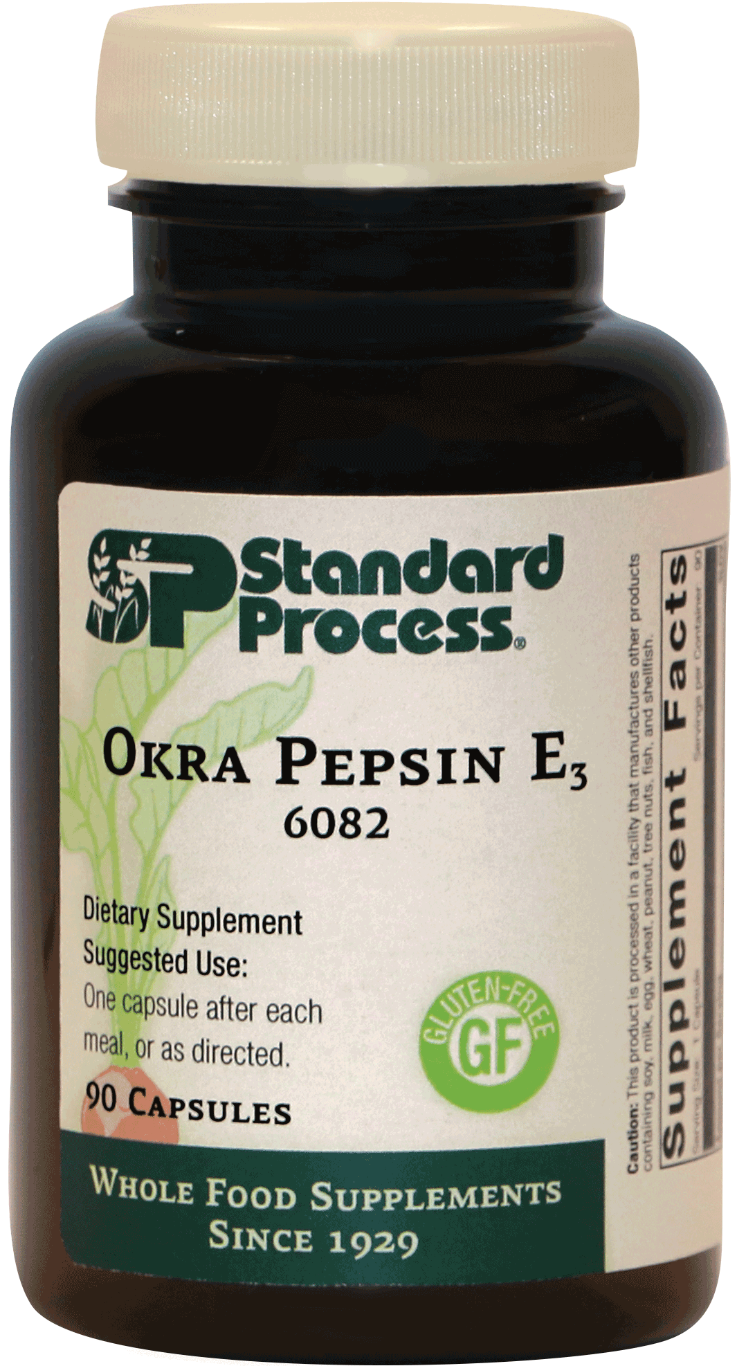
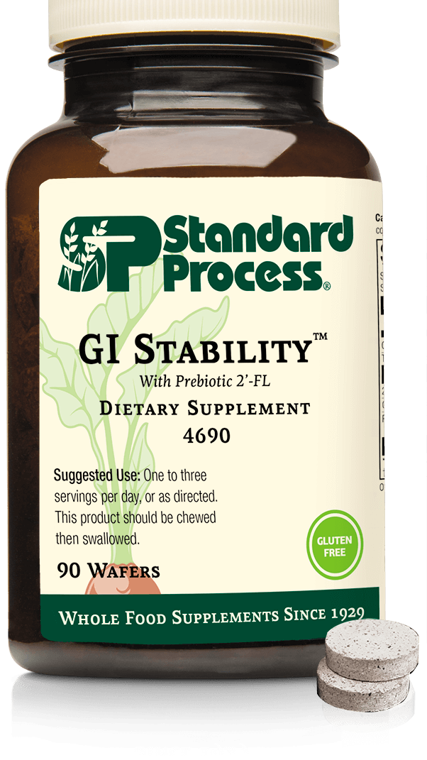
Combine GI Adsorb with GI Stability and Okra Pepsin
GI Tract Health
Notes:
One of the main issues of course with leaky gut is hyperpermeability of the GI tract due to compounds or toxins that cross the GI barrier because of a weakened and damaged mucosal lining
GI Stability with the 2-FL’ the prebiotic carbohydrate that is chemically identical to human milk oligosaccharides has shown to benefit the lower GI, where only a few Bifidobacterium strains can metabolize it to enhance microbiome function. 2’-FL has shown to positively support the proper functioning of the GI barriers, also, by decreasing immune activation and inflammation.
2’-FL as a Decoy
2’-FL also acting as a decoy in the gut. Microbial invaders make their way to the lower GI where they adhere to surface sugars that line our GI tract, here they colonize and create biological toxins, which in turn leads to dysbiosis, inflammation, and gut symptoms. 2’-FL has a similar structure to the surface sugars that line the GI tract, causing the microbial invaders to attach to the 2’-FL as opposed to our own GI tract, diverting the microbes away from healthy tissue and avoiding an inflammatory response.
Okra Pepsin E3 with its fiber and mucilage properties is soothing to the digestive tract, it has anti-adhesive properties that block H. Pylori colonization in the stomach and binds to bile acids allowing for excretion of cholesterol and toxic metabolites through the stool.
Okra is also high in key nutrients that help with inflammation, methylation, oxidative stress and blood sugar balance. Don’t forget the Pepsin in this product helps digest invaders that adhere GI tract and the E3 that helps to heal the GI tract.

Slide 16
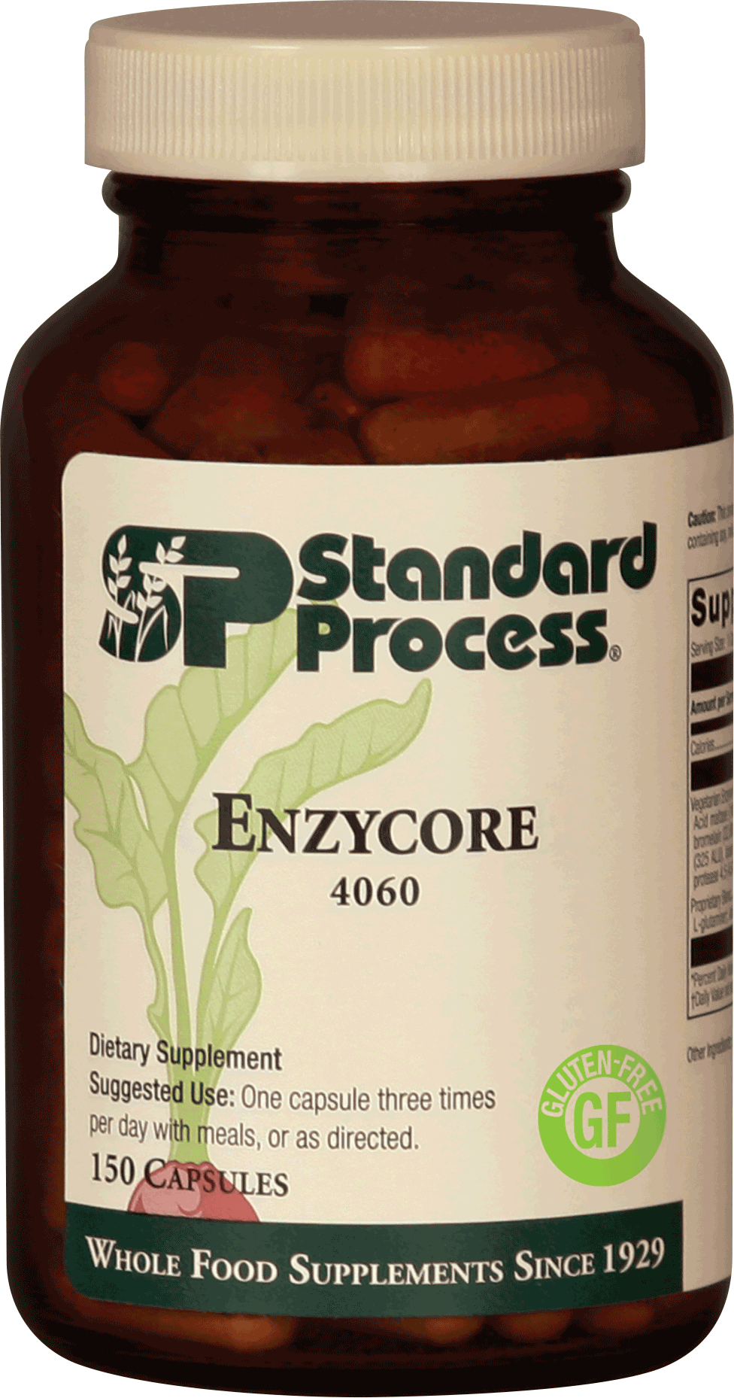
Combine GI Adsorb with Zypan and Enzycore
Travel

Slide 17
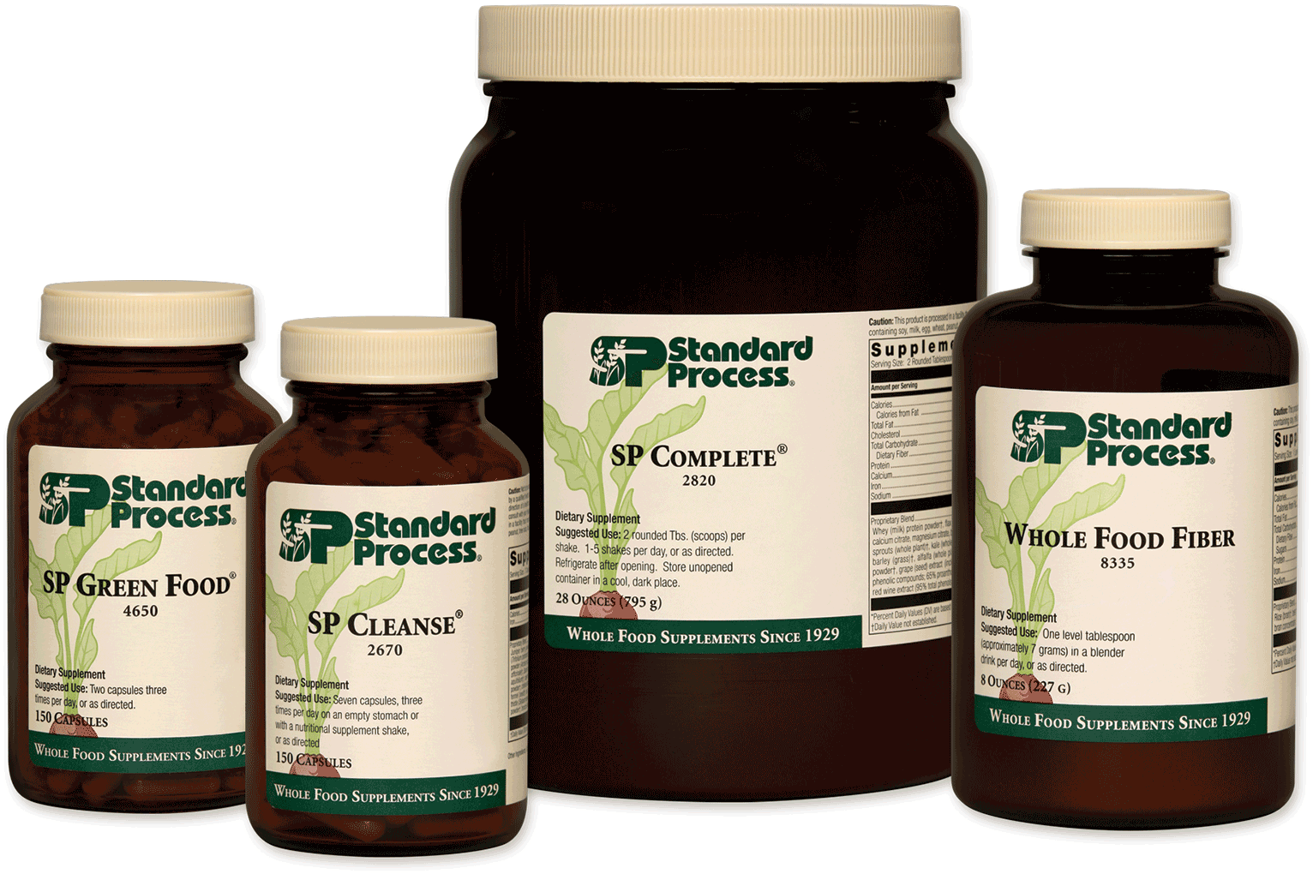
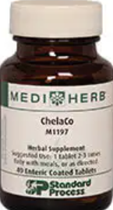
Combine GI Adsorb with the 21-Day Purification Program or the10-Day Programs Consider ChelaCo
Detoxification
&
Purification
Notes:
In 1989 the EPA estimated in 1 year almost
6 billion lbs of chemicals were either dumped into public sewage or released into
the ground, surface waters or air.

Slide 18
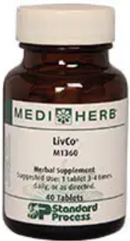
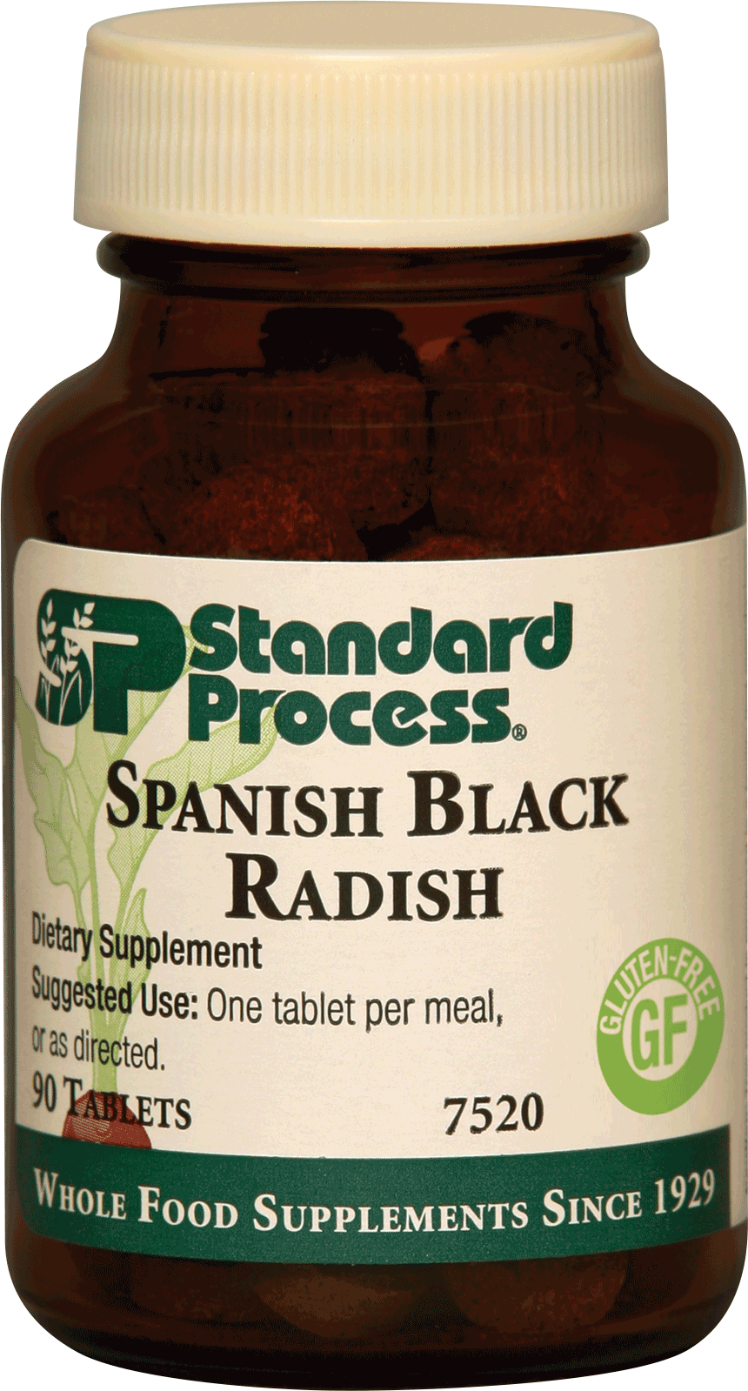
Combine GI Adsorb with Spanish Black Radish / LivCo®
Liver Support

Slide 19
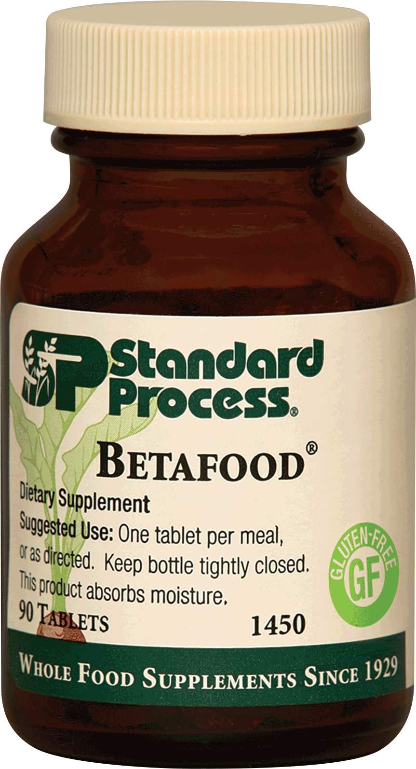
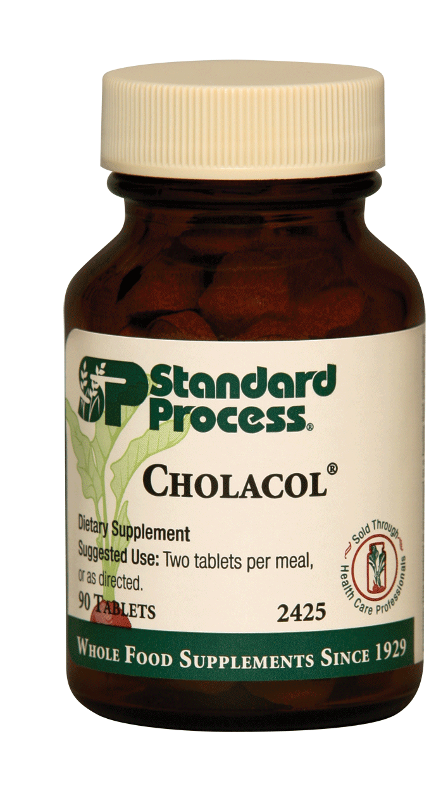
Combine GI AD Asorb with Cholacol® and Betafood®
Fat Digestion

Slide 20
Covid 19 Characteristics Understanding dictates action

Slide 21
Herd Immunity is happening
COVID-19 mortality — which had declined for the last 10 weeks straight — is currently at the epidemic threshold, meaning if it slides down just a little more, COVID-19 will no longer meet the CDC's criteria for "epidemic" status.
In other words, the fact that young and middle-aged adults are testing positive in droves is not a warning sign of an impending onslaught of deaths, as the risk of death in these age groups is minuscule. If anything, it seems to show herd immunity is building which, ultimately, will help protect the most vulnerable among us.

Slide 22
Viral Replication
Even though the COVID-19 curve has been flattened, mainstream media outlets continue to push doomsday predictions of an impending explosion of deaths
· According to Stanford University's disease prevention chairman Dr. John Ioannidis, the COVID-19 fatality rate for those under the age of 45 is “almost zero,” and between the ages of 45 and 70, it’s somewhere between 0.05% and 0.3%
· So, the fact that young and middle-aged adults are testing positive in droves is not a warning sign of an impending onslaught of deaths, as the risk of death in these age groups is minuscule
· According to the Centers for Disease Control and Prevention, the COVID-19 mortality — which had declined for the last 10 weeks straight — “is currently at the epidemic threshold,” meaning if it declines just a little more, COVID-19 will no longer be considered an epidemic
This Photo by Unknown Author is licensed under CC BY-SA

Slide 23
Testing to flatten the curve -
Why Did They Want to Flatten the Curve?
The primary justification for the tyrannical governmental interventions of COVID-19 was to slow the spread of the infection so that hospital resources would not be overwhelmed, causing people to die due to lack of medical care. These interventions were not about stopping the spread or reducing the number of people that would eventually get infected.
It was only intended to slow it down so, eventually, naturally-acquired herd immunity — the best kind — would prevent its spread. Well guess what? They have changed the narrative. That is why you now do not hear anything about flattening the curve. Instead they transitioned the fear-mongering to alarm the public that the number of “cases” are increasing.
Bear in mind that you do NOT need any test to be classified as a COVID case. All you need is a simple upper respiratory infection and you can legally be classified as a COVID-19 case to artificially inflate the totals.
This Photo by Unknown Author is licensed under CC BY-SA

Slide 24
Immunity – 81% Resistant
Majority of People Appear Resistant to COVID-19
Another study28,29 published in the journal Cell found 70% of samples from patients who had recovered from mild cases of COVID-19 had resistance to SARS-CoV-2 on the T-cell level. Curiously, 40% to 60% of people who had not been exposed to SARS-CoV-2 also had resistance to the virus on the T-cell level.
According to the authors, this suggests there's "cross-reactive T cell recognition between circulating 'common cold' coronaviruses and SARS-CoV-2." In other words, if you've recovered from a common cold caused by a particular coronavirus, your humoral immune system may activate when you encounter SARS-CoV-2, thus rendering you resistant to COVID-19.
May 14, 2020, Science magazine reported30 these Cell findings, drawing parallels to another earlier paper31 by German investigators that had come to a similar conclusion. That German paper,32 the preprint of which was posted April 22, 2020, on Medrxiv, found helper T cells that targeted the SARS-CoV-2 spike protein in 15 of 18 patients hospitalized with COVID-19.
Yet another study,33,34,35 this one by researchers in Singapore, found common colds caused by the betacoronaviruses OC43 and HKU1 might make you more resistant to SARS-CoV-2 infection, and that the resulting immunity might last as long as 17 years.
The authors suggest that if you've beat a common cold caused by a OC43 or HKU1 betacoronavirus in the past, you may have a 50/50 chance of having defensive T-cells that can recognize and help defend against SARS-CoV-2.
81% of Unexposed Individuals May Be Resistant to SARS-CoV-2
Two additional studies suggesting herd immunity is near were reported36 by Reason, July 1, 2020. These include a Swedish study,37,38 which found "SARS-CoV-2 elicits robust memory T cell responses akin to those observed in the context of successful vaccines, suggesting that natural exposure or infection may prevent recurrent episodes of severe COVID-19 also in seronegative individual." Similarly, a German study39 concluded:
"SARS-CoV-2-specific T-cell epitopes enabled detection of post-infectious T-cell immunity, even in seronegative convalescents. Cross-reactive SARS-CoV-2 T-cell epitopes revealed preexisting T-cell responses in 81% of unexposed individuals, and validation of similarity to common cold human coronaviruses provided a functional basis for postulated heterologous immunity in SARS-CoV-2 infection."
This Photo by Unknown Author is licensed under CC BY-SA

Slide 25
Complexity and Potency
Complexity –
Covid 19 – is it manmade (functional augmentation of a bat virus)
5G network conversion
Mandatory vaccine and data chipping issues
Potency –
Innate immune and complement system
Acquired immune learning/activation with antibody and prepared immune response

Slide 26
Covid 19 Characteristics
What we know (we learn more daily)
Covid 19 – is it man altered bat virus (it would take approximately 800 years for natural selection to allow a bat virus to develop that could jump between species)
- Augmentation of function is a scientific term to describe the steps taken in a laboratory to increase the virulence of a virus in order to amplify its characteristics and better see ways to prepare therapies in advance
- the genome sequence of the virus is unique to the horseshoe bat (Living in caves 600 miles south of Wuhan in China)
- the virus is optimized for human transmission – an uncommon event in nature
- the S proteins on he surface of the viral particles are what make it dangerous and contagious and so able to infect humans
- In 2008 the covid 19 virus was augmented in function with HIV homology, bio-engineered for augmentation to predict and develop therapeutics
- Gain of function for the bat ACE II receptor to the human ACE II receptor
- Subsequently the gain of function continued (weaponized) at Fort Dietrich and UNC allowedaccess to receptors CD147, CD209, CD299 and GRP 78

Slide 27
Getting to know Covid 19 -
Unique characteristics of Covid 19:
Lives for 2 hours on stainless steel
Lives for 3 hours on plastic
Lives for 24 hours on cardboard
Stays suspended floating the air for three hours
In proper conditions (heat and hydration) virus can live ou tside the body for up to 7 weeks
The unique protein spike of this corona virus acts like the key to fit the receptor lock on numerous cells – namely lung cells, nerve tissue and RBC/T cells effecting the functionality of these cells and, when invaded, commandeering and killing these cells

Slide 28
Clinical Findings of Covid 19 -
Symptoms typically include: fever, neck stiffness, severe headache, loss of smell/taste, heavy sensation in the chest (fibrosis), fatigue, malaise and loss of limbic wellbeing
further observation reveals that the virus also can attack the heart and reduce output (ejection fraction reduced)
Can also penetrate the central nervous system and create aphasia and memory impairment and activate latent neuroviral activity which produces neuritis and extension neuralgias and paresthesias

Slide 29
Rumors of Covid 19 -
Manmade virus which has been augmented to study its characteristics
May have genetic strands from HIV, Ebola, SARS grafted into it
May have been accidentally or deliberately released on the public
May have been funded in China by the NIH ($3.7 million) after research of this sort was banned in the USA
Poor public health data management has inflated the morbidity of the virus
Some say there are 700,000 more people infected in American than has been estimated, which would then reduce the morbidity quotient against the number of deaths

Slide 30
Concept of Co-Infection
* The latest explanation of the Covid 19 dynamic is that infection of this carries a diverse complexity of many retroviruses and co-virus components.
* It also acts in the host to upset the latent viral balance which is being maintained in a state of suppression by immune tolerant mechanisms
* Which means the balanced seesaw can be upset
This Photo by Unknown Author is licensed under CC BY

Slide 31
Flattening the curve …
The total all-cause mortality is not significantly different than in previous years as discussed by my interview with Denis Rancourt. Many other deaths have been shifted to COVID-19, bringing a high spike in deaths, but when you look at the area under the curve for total deaths, it really doesn't differ from previous years.
This was also echoed by the American Institute for Economic Research.44 Back in April 2020 they referred to the COVID-19 pandemic as "An egregious statistical horror story" that resulted in "a vandalistic lockdown on the economy," which:
"… would have been an outrage even if the assumptions were not wildly astronomically wrong. Flattening the curve was always a fool's errand that widened the damage …
The latest figures on overall death rates from all causes show no increase at all. Deaths are lower than in 2019, 2018, 2017 and 2015, slightly higher than in 2016. Any upward bias is imparted by population growth.
Now writing a book on the crisis with bestselling author Jay Richards, [statistician William] Briggs concludes: 'Since pneumonia deaths are up, yet all deaths are down, it must mean people are being recorded as dying from other things at smaller rates than usual.' Deaths from other causes are simply being ascribed to the coronavirus.
As usual every year, deaths began trending downward in January. It's an annual pattern. Look it up. Since the lockdown began in mid-March, the politicians cannot claim that their policies had anything to do with the declining death rate.
A global study45 published in Israel by Professor Isaac Ben-Israel, chairman of the Israeli Space Agency and Council on Research and Development, shows that 'the spread of the coronavirus declines to almost zero after 70 days — no matter where it strikes, and no matter what measures governments impose to try to thwart it.'
In fact, by impeding herd immunity, particularly among students and other non-susceptible young people, the lockdown in the U.S. has prolonged and exacerbated the medical problem. As Briggs concludes, 'People need to get out into virus-killing sunshine and germicidal air.'"

Slide 32
Synthetic Virus attacks immune compromised systems
Absence of Interferon 1 in the fermenter that grows virus means there is no suppression of viral activity
So there is an exponential increase of viral replication and adaptation including ‘accelerated evolution’ wherein the virus being grown picks up and combines with all the unnamed viral strains that are co-present
Virus is not allowed to replicate and mutate like that in the human body and nature because of the present of Interferon 1, which suppresses viral activity
This Photo by Unknown Author is licensed under CC BY-SA-NC

Slide 33
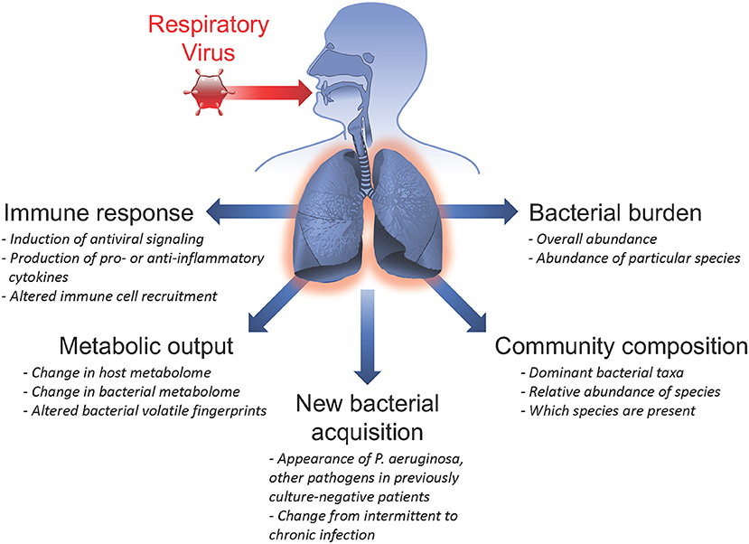
No Single Virus
Viruses don’t travel alone
HIV doesn’t cause AIDS because there is a multiplicity of interacting viruses all activating and spreading throughout the host
The answer always lies in host immune competence to interrupt viral spread and suppress viral activity
Be strong – Be prepared – this is the answer
The anti viral antidote is the potentiated human
This Photo by Unknown Author is licensed under CC BY

Slide 34
Preparation to meet Covid 19, 20, 21 …
There is no prevention! There is only preparation for exposure to the virus for the entire population eventually
A vaccine is highly unlikely for a number of reasons (corona virus/ common cold cannot be vaccinated against according to world leading virologist who invented the vaccine for HPV and is thus nominated for the Nobel Prize, the quickest development of a vaccine in history took 4 years for the Measles vaccine, it will not create immunity against mutations of the virus, etc)
The immune system can meet Covid 19 and easily control exposure and spread and shorten symptomatology and contagiosity – Immune up-regulation is the answer to the pandemic

Slide 35
Opinions on Covid 19 -
This pandemic exposes the at risk population that is nutritionally deficient (Zn, D3, Quercitin etc) and biochemically imbalanced (immune compromised) according to Kerry Bone
The only people who complicate with viral exposure are those who receive only palliative care to suppress the symptoms and allow the virus to further penetrate and infect the body (suppressing fever/inflammatory complement system is contra-indicated) according to Stuart White

Slide 36
Ivermectin outcomes are obvious -
The massive drop in cases and deaths in India to almost nothing after the addition of Ivermectin proved the drug's effectiveness. This is a truth that the NIH, CDC, and FDA cannot allow because it would endanger the vaccine policy. Never mind that Ivermectin would save more lives with much less risk, much less cost, and it would end the pandemic quickly.
Uttar Pradesh is a state in India that contains 241 million people. The United States’ population is 331 million people. Therefore, Uttar Pradesh can be compared to the United States, with 2/3 of our population size.
This data shows how Ivermectin knocked their COVID-19 cases and deaths - which we know were Delta Variant - down to almost zero within weeks. A population comparable to the US went from about 35,000 cases and 350 deaths per day to nearly ZERO within weeks of adding Ivermectin to their protocol.
By comparison, on August 5, here in the good ol’ USA, blessed with the glorious vaccines, we have 127,108 new cases per day and 574 new deaths.
Let us look at the August 5 numbers from Uttar Pradesh with 2/3 of our population. Uttar Pradesh, using Ivermectin, had a total of 26 new cases and exactly THREE deaths. The US without Ivermectin has precisely 4889 times as many daily cases and 191 times as many deaths as Uttar Pradesh with Ivermectin.
It is not even close. Countries do orders of magnitude better WITH Ivermectin. It might be comparable to the difference in travel between using an automobile versus a horse and buggy.

Slide 37
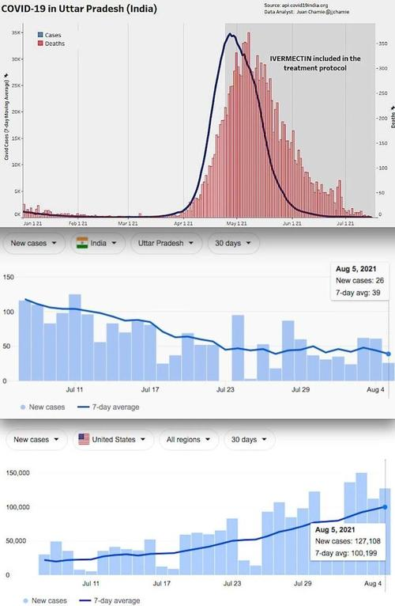
Ivermectin outcomes are obvious -
Uttar Pradesh on Ivermectin: Population 240 Million [4.9% fully vaccinated]
COVID Daily Cases: 26
COVID Daily Deaths: 3
The United States off Ivermectin: Population 331 Million [50.5% fully vaccinated]
COVID Daily Cases: 127,108
COVID Daily Deaths: 574
Let us look at other Ivermectin using areas of India with numbers from August 5, 2021, compiled by the JHU CSSE:
Delhi on Ivermectin: Population 31 Million [15% fully vaccinated]
COVID Daily Cases: 61
COVID Daily Deaths: 2
Uttarakhand on Ivermectin: Population 11.4 Million [15% fully vaccinated]
COVID Daily Cases: 24
COVID Daily Deaths: 0

Slide 38
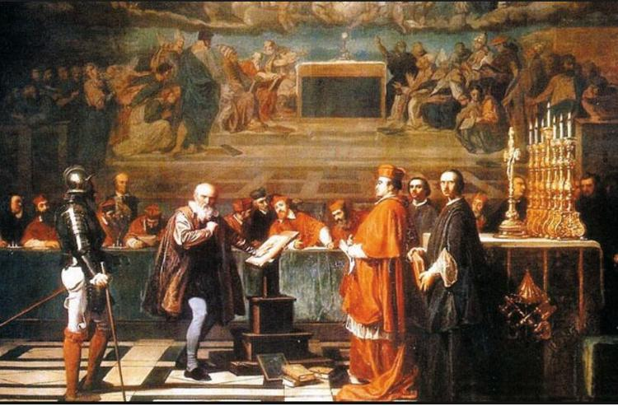
Ivermectin outcomes are obvious -
Now let us look at an area of India that rejected Ivermectin.
Tamil Nadu announced they would reject Ivermectin and instead follow the dubious USA-style guidance of using Remdesivir. Knowing this, you might expect their numbers to be closer to the US, with more cases and more deaths. You would be correct. Tamil Nadu went on to lead India in COVID-19 cases.
Tamil Nadu continues to suffer for its choice to reject Ivermectin. As a result, the Delta variant continues to ravage their citizens while it was virtually wiped out in the Ivermectin-using states. Likewise, in the United States, without Ivermectin, both the vaccinated and unvaccinated continue to spread the Delta variant like wildfire.
Tamil Nadu off Ivermectin: Population 78.8 Million [6.9% fully vaccinated]
COVID Daily Cases: 1,997
COVID Daily Deaths: 33
Heresy is disagreeing with the government, or their health authority, even if they are all wrong and even if their policies harm people. Today we no longer call it heresy; it is labeled as misinformation.
Galileo was found guilty of heresy and sentenced on June 22, 1633, to formal imprisonment, although this was commuted to house arrest, under which he remained for the rest of his life.

